Slide 1
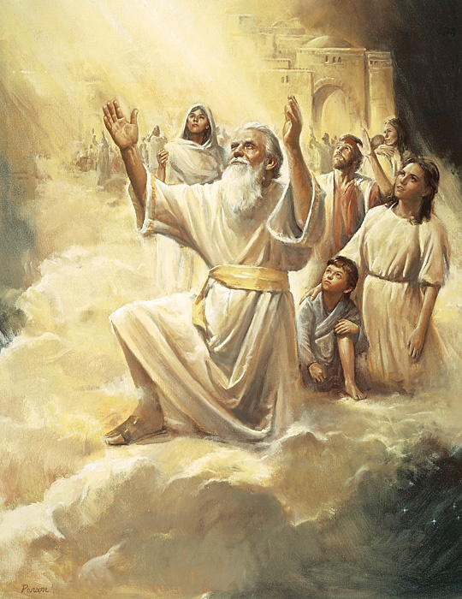
Lesson 7: Enoch and a zion people
Lesson 7: Primary 6. Old Testament, (1996),27

Slide 2
Purpose
To help you want to become pure in heart as was Enoch.

Slide 3
OUR OPENING PRAYER WILL BE GIVEN BY
(Enter name here)

Slide 4
Inside this container…
I have a small, clear container of clean water inside a larger container of dirty water.
Is it possible for the water in the small container to remain pure even when it is surrounded by filthy water?

Slide 5
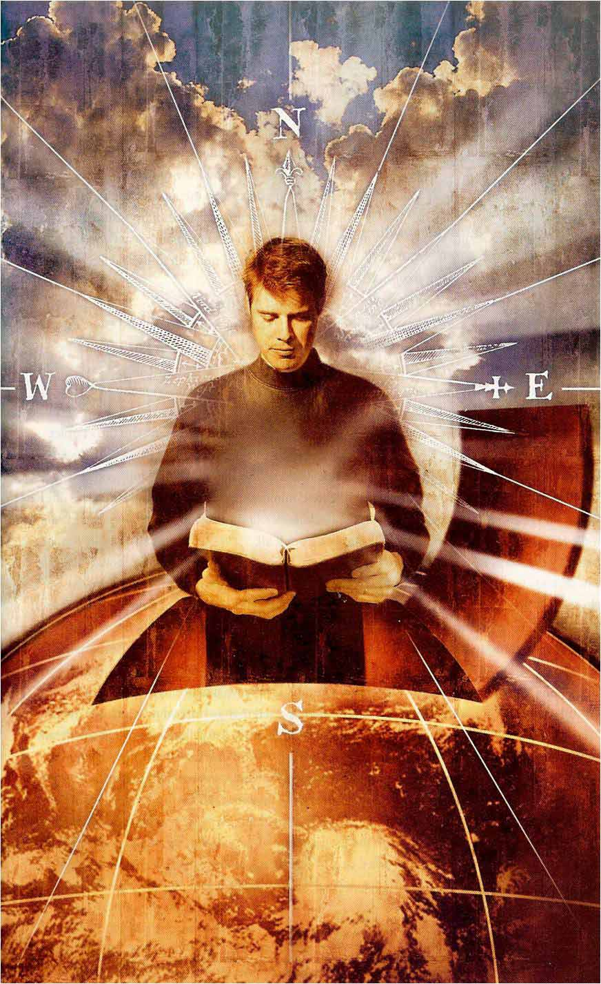
The clean water is like people who are trying to live clean lives in world that evil exists in. It is possible for us to remain pure and righteous if we do not allow any impurity or unrighteousness into our lives.
In this lesson we will learn about Enoch, an Old Testament prophet, who was pure in heart.

Slide 6
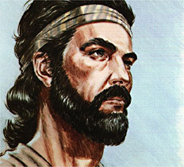
Let’s read Moses 6:31
31 And when Enoch had heard these words, he bowed himself to the earth, before the Lord, and spake before the Lord, saying:
Why is it that I have found favor in thy sight, and am but a lad, and all the people hate me; for I am slow of speech; wherefore am I thy servant?

Slide 7
When Enoch was first called to be a prophet, he felt inadequate.
He was young and “slow of speech” but he exercised faith and obeyed the Lord’s will.

Slide 8
Go to the Video
Go to the Narrated Slides
Continue

Slide 9
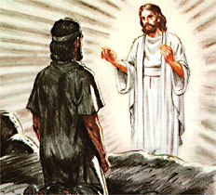
Enoch talked with the Lord face to face and saw many visions.
He prophesied of the Restoration of the gospel and the coming forth of the Book of Mormon (“truth will I send forth out of the earth”), the preaching of the gospel to all the world, the building of the New Jerusalem, and the ushering in of the Millennium.

Slide 10
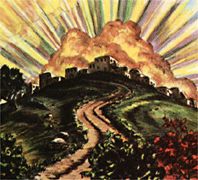
Enoch taught, helped convert, and baptized many people, who became so righteous that they lived in a “City of Holiness, even Zion.” (Moses 7:19)

Slide 11
This holy city was “taken up into heaven” and will return at the time of the Millennium.
When it returns it will join with the earthly Zion, which is the New Jerusalem.

Slide 12
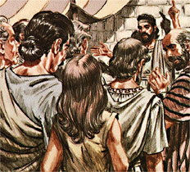
How did Enoch receive his calling? (Moses 6:26–27, 42)
What was Enoch called to do?
How were most of the people living at the time Enoch received his call? (Moses 6:27–29)

Slide 13
Why did Enoch feel his calling was too difficult for him? (Moses 6:31)
What specifically did the Lord tell Enoch to do before he would be blessed? (Moses 6:32)

Slide 14
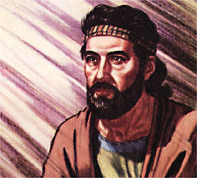
What did the Lord tell Enoch to say? (Moses 6:33)
How were the Lord’s promises in Moses 6:34 fulfilled? (Moses 7:13)

Slide 15
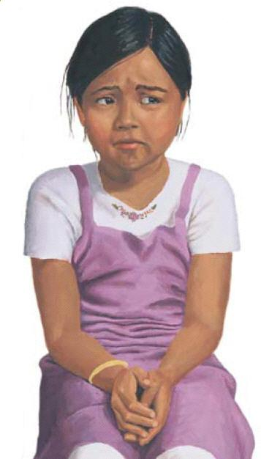
Think of a time when you struggled or had a problem that was difficult.
What can you learn from Enoch’s example in dealing with challenges?

Slide 16
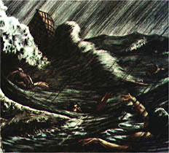
What can we learn about the Lord from Enoch’s visions? (Moses 7:4)
What did Enoch learn about the people of the world? (Moses 7:41)

Slide 17
How were the people who heard and obeyed Enoch’s words blessed? (Moses 7:16–17)
Why was their city called Zion? (Moses 7:18–19)

Slide 18
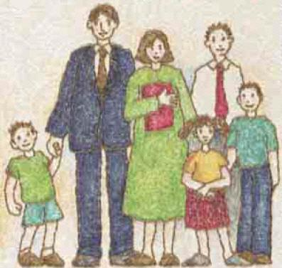
What do you think it means to be “of one heart and one mind”?
How can you help your family be more like the people who lived in Zion?

Slide 19
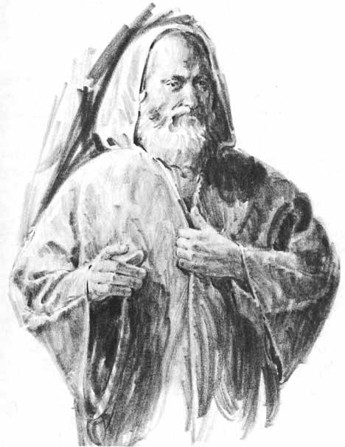
What happened to Enoch and all the people in the city of Enoch? (Moses 7:21, 69; D&C 107:49)
What does it mean to be “taken up into heaven,” or translated?

Slide 20
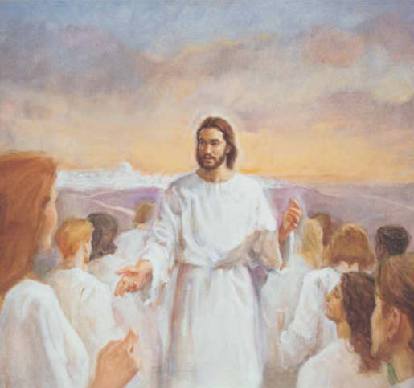
When people are translated, their bodies are changed so they will not experience pain and will “never taste of death.” (3 Nephi 28:7)
At the time of the Second Coming they will “be changed in the twinkling of an eye from mortality to immortality” (3 Nephi 28:8)

Slide 21
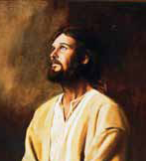
Why did the Lord weep? (Moses 7:28, 32–33)
How do you want your parents and the Lord to feel when they see your actions?
How do we know that each individual is important to the Lord?

Slide 22
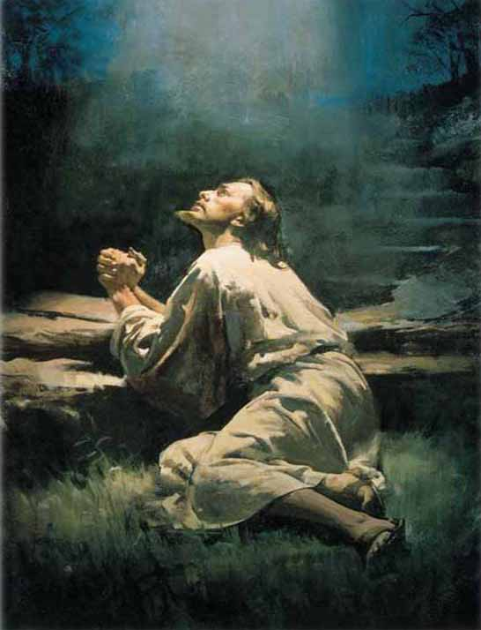
When Enoch wept, how did the Lord comfort him? (Moses 7:44–45, 47)
How can thinking about Jesus Christ and his love and sacrifice for us comfort us even though there is great wickedness in the world?

Slide 23

When will Zion, or a city of the pure in heart, again be established? (Moses 7:62)
What is the “truth” that must “sweep the earth” to prepare for the establishment of Zion? (President Ezra Taft Benson defined this truth as the Book of Mormon [in Conference Report, Oct. 1986, p. 102; or Ensign, Nov. 1986, p. 79.)
How can we help fulfill this prophecy about the Book of Mormon?

Slide 24
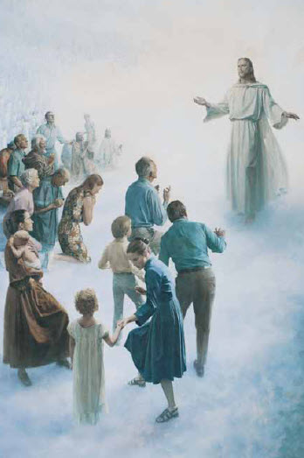
Where will Zion, the New Jerusalem be located?
How long will Jesus Christ dwell on the earth with the righteous in Zion? (Moses 7:64–65)

Slide 25
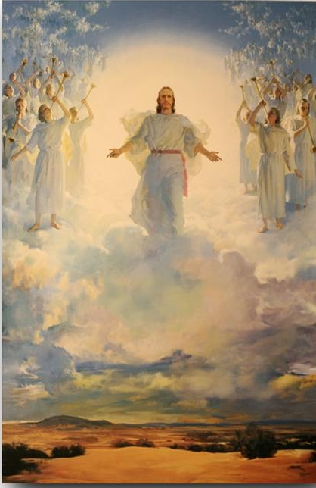
This period of one thousand years is called the Millennium.
How can you take part in preparing for this joyous time when Zion will be established?

Slide 26
Enrichment
Activities
T

Slide 27
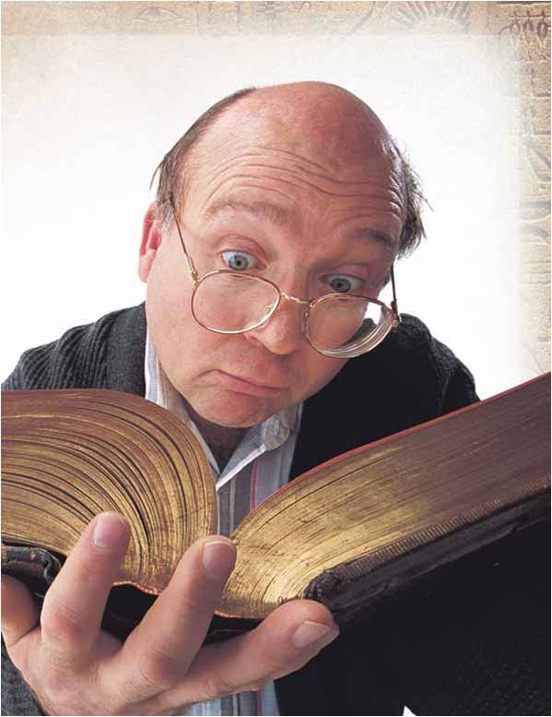
Let’s compare the story of Enoch’s call with the account in Ether 12:27 of God’s promises to those who feel inadequate to accept callings.
T
Enrichment Activity 1

Slide 28
If you have your own copies of the Pearl of Great Price mark any of the following verses that could strengthen and help you when you feel inadequate:
  Moses 6:31—Enoch felt weak so he prayed in humility.
  Moses 7:13—Enoch had faith and his weaknesses became his strengths.
  Moses 6:35—Enoch was obedient.
  Moses 6:37—Enoch worked hard.
  Moses 7:41, 44—Enoch had compassion.
T
Enrichment Activity 1

Slide 29
The tenth Article of Faith
We believe in the literal gathering of Israel and in the restoration of the Ten Tribes; that Zion (the New Jerusalem) will be built upon the American continent; that Christ will reign personally upon the earth; and, that the earth will be renewed and receive its paradisiacal glory.
T
Enrichment Activity 3

Slide 30

The time when the earth will be renewed and Jesus Christ will come to reign personally on the earth will be the Millennium.
T
Enrichment Activity 3

Slide 31
I need a volunteer to try to break these sticks while they are tied together.
It is too difficult for one person.
Now, I’m going to untie the string and give each of you a stick to break.
T
Enrichment Activity 4

Slide 32
It is important for each of us to do our part in establishing a Zion-like society in our homes and circles of friends.
You could try this activity at home and then discuss with your family different ways you can each do your part to make your home more like the city of Enoch.
T
Enrichment Activity 4

Slide 33
Name things you can do each day that will help you become more pure in heart.
Name things that will take away that purity.
I’m going to write your ideas on slips of paper and put them in this container.
T
Enrichment Activity 5

Slide 34
The front of the classroom is “Zion.”
Stand side by side in a row facing “Zion.”
I’ll pull a slip of paper out of the container and read what is written on it.
Move forward one step if the idea will help you become pure or move back one step if the idea would influence you to become unrighteous.
Congratulations! You’ve reached “Zion!”
T
Enrichment Activity 5

Slide 35
When he comes again
1. I wonder, when he comes again, will herald angels sing?
Will earth be white with drifted snow, or will the world know spring?
I wonder if one star will shine far brighter than the rest;
Will daylight stay the whole night through? Will songbirds leave their nests?
I’m sure he’ll call his little ones together ’round his knee,
Because he said in days gone by, “Suffer them to come to me.”
2. I wonder, when he comes again, Will I be ready there
To look upon his loving face and join with him in prayer?
Each day I’ll try to do his will and let my light so shine
That others seeing me may seek for greater light divine.
Then, when that blessed day is here, he’ll love me and he’ll say,
“You’ve served me well, my little child; come unto my arms to stay.”
Words and music: Mirla Greenwood Thayne, 1907–1997 © 1952 by Mirla Greenwood Thayne, Provo, Utah. Renewed 1980. Used by permission. This song may be copied for incidental, noncommercial church or home use.
T
Enrichment Activity 6

Slide 36
TESTIMONY
Being pure in heart as Enoch and his people were brings happiness.
Decide on one or two specific things you can do during the coming week to become more pure and thus help others around you become better also.

Slide 37

OUR CLOSING PRAYER WILL BE GIVEN BY
(Enter Name Here)

Slide 38
THE END

Slide 39
Images and clipart are from lds.org, Microsoft office, and other websites indicating the images were in the public domain or permitted for church and home use.
The hymns, Lesson and Scripture story are from lds.org.
Please do not use this presentation for commercial use. Feel free to alter the presentation for use in church or home to suit personal preference.
This presentation is intended to supplement, not replace, the lesson manual and scriptures.
Teachers should refer to the manual, scriptures and other resources when preparing and conducting the lesson.

Slide 40
TESTIMONY
I am grateful that we can receive all the blessings necessary for us to return to Heavenly Father because of the restoration of the priesthood.
I want to challenge the boys to prepare to receive the great power of the priesthood and to always live worthy to exercise that power.
I want to challenge the girls to honor the priesthood and prepare themselves to be worthy to receive the blessings of the priesthood.

Slide 41
OUR CLOSING PRAYER WILL BE GIVEN BY
(Enter Name Here)

Slide 42
THE END

Slide 43
Images and clipart are from lds.org, Microsoft office, and other websites indicating the images were in the public domain or permitted for church and home use.
The hymns, Lesson and Scripture story are from lds.org.
Please do not use this presentation for commercial use. Feel free to alter the presentation for use in church or home to suit personal preference.
This presentation is intended to supplement, not replace, the lesson manual and scriptures.
Teachers should refer to the manual, scriptures and other resources when preparing and conducting the lesson.

Slide 44
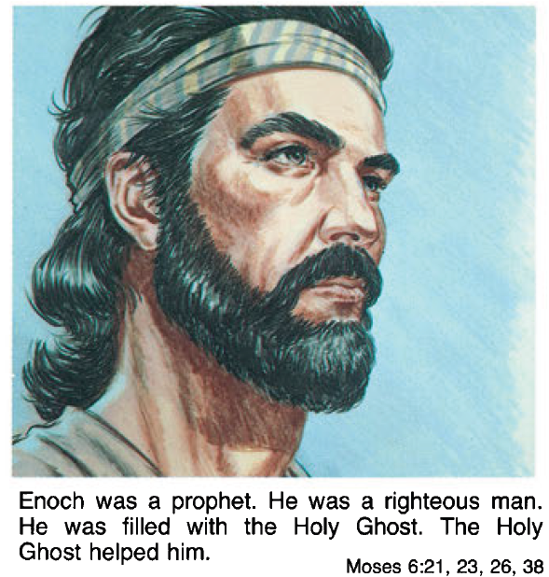

Slide 45
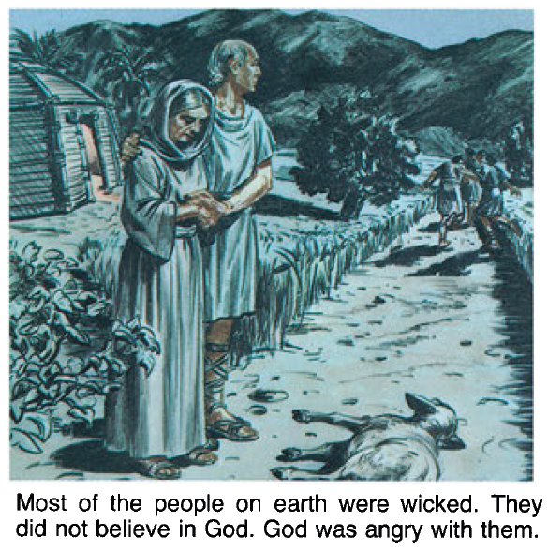

Slide 46
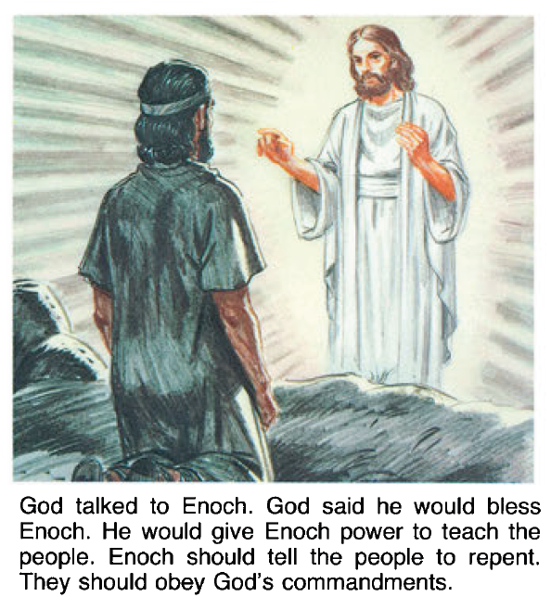

Slide 47
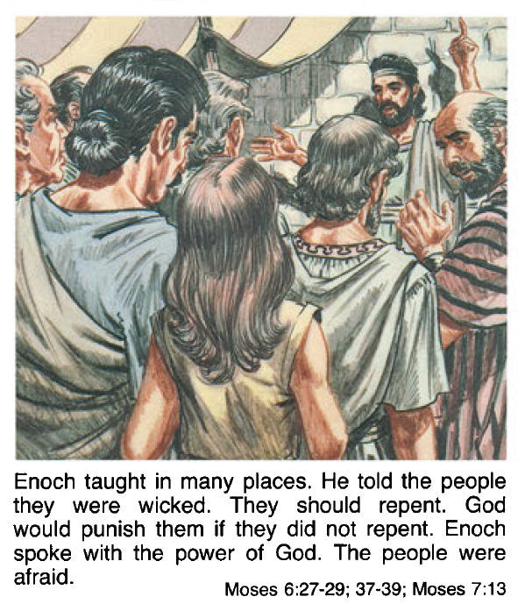

Slide 48
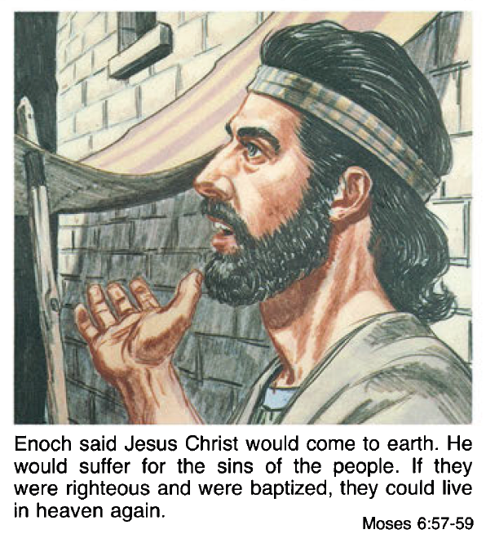

Slide 49
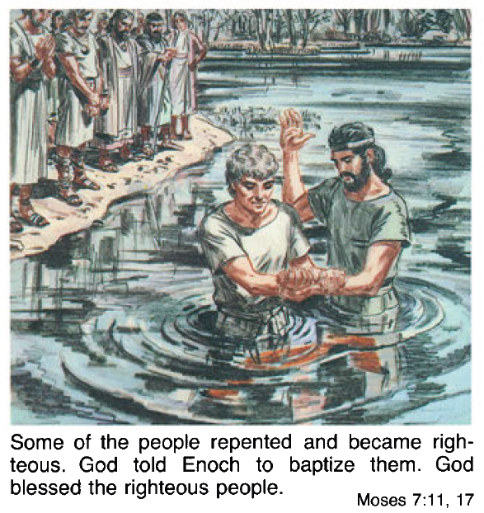

Slide 50
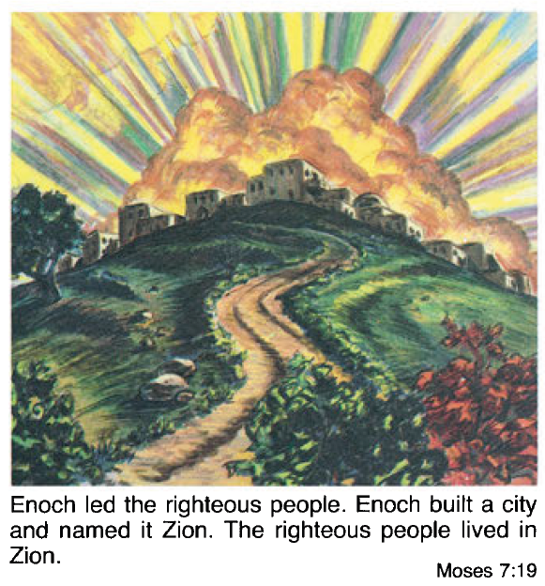

Slide 51
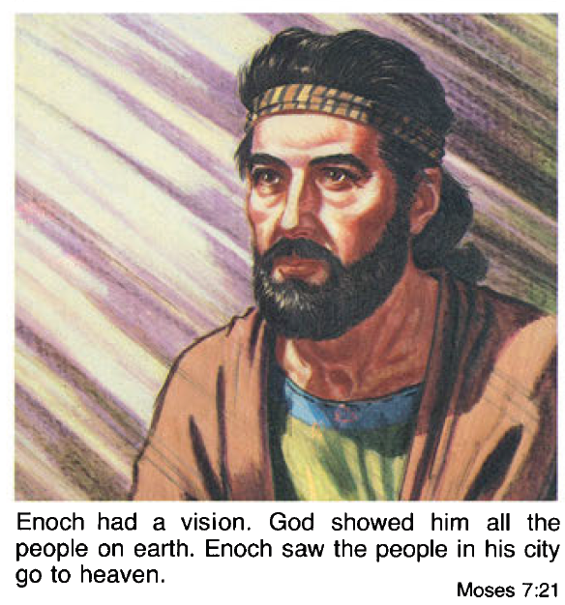

Slide 52
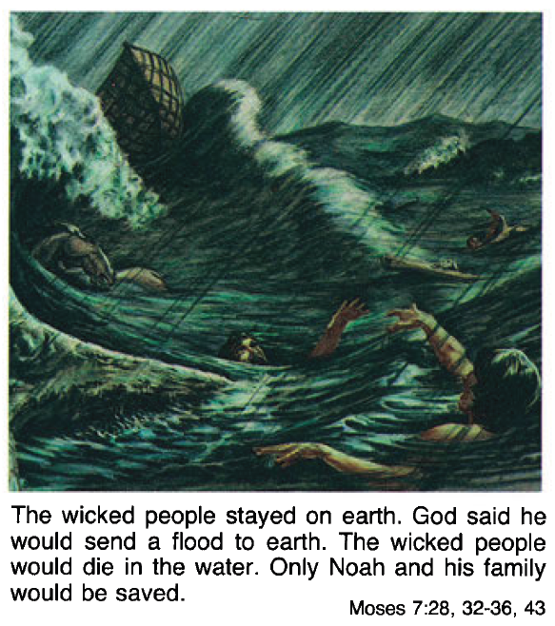

Slide 53
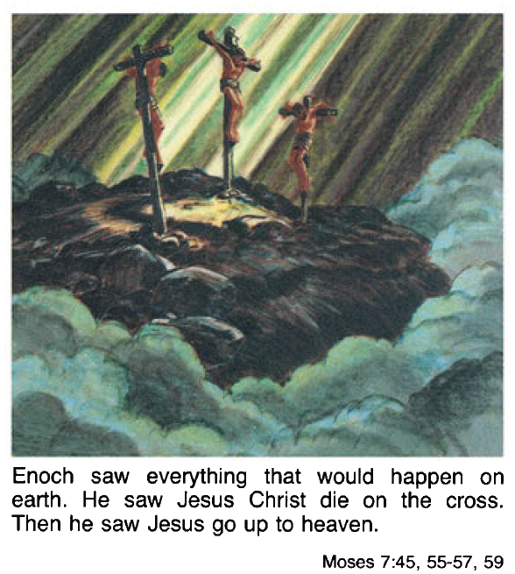

Slide 54
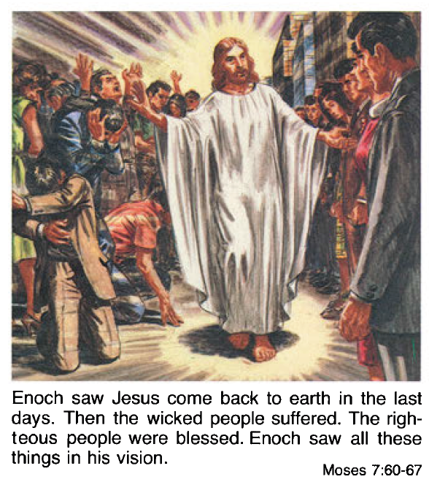

Slide 55
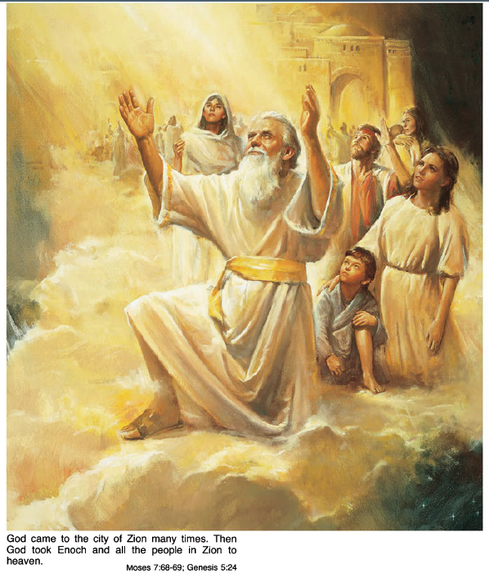
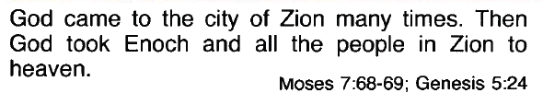

Slide 56

Click on the Black area above to start the video
Click Here if the video above doesn’t start

