Slide 1
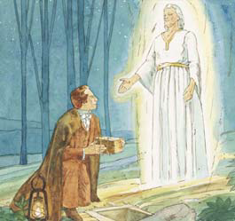
LESSON 5: Joseph Smith Receives the Gold Plates

Slide 2
PURPOSE
To help the children understand that when we are obedient and do our part, Heavenly Father will help us.

Slide 3
OUR OPENING PRAYER WILL BE GIVEN BY
David Lerohl

Slide 4
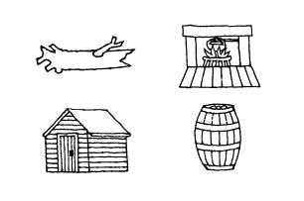
What do these objects have in common?

Slide 5
Each of these was used by Joseph Smith to hide the gold plates to keep them safe.
In today’s lesson, listen to find out how Joseph used each of these locations.

Slide 6
LESSON 5: Joseph Smith Receives the Gold Plates

Slide 7
Several months after Joseph and Emma were married, Joseph went again to the Hill Cumorah.
Four years had passed since Joseph had first seen the gold plates, and this time Moroni let him take them.
Moroni told Joseph to take good care of the plates.

Slide 8
When the time had come for Joseph Smith to receive the gold plates, he borrowed a horse and wagon and
went with his wife, Emma, to the Hill Cumorah, where the plates were buried. Joseph left Emma with the wagon at the bottom of the hill and climbed the hill alone to meet the angel Moroni.

Slide 9
Moroni gave Joseph the gold plates.
He also gave Joseph the Urim and Thummim and a breastplate, tools to help with the translation of the gold plates.

Slide 10
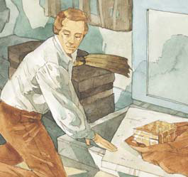
Moroni warned Joseph that evil men would be watching for a chance to steal the plates and told Joseph that he must do everything in his power to keep them safe (see JS—H 1:59).

Slide 11
Joseph found that as soon as people knew that he had the plates, they tried to take them away (see JS—H 1:60).
He had to hide the plates in many places to keep them safe.

Slide 12
Many people heard about Joseph receiving the gold plates.
They tried to steal the plates from him, but he hid them where they could not be found.
God helped Joseph keep the gold plates safe.

Slide 13
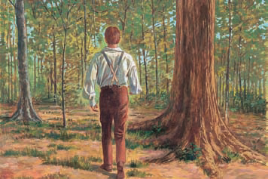
After Joseph and Emma left the hill where the plates had been buried, Joseph stopped and took the plates into the woods.
There he found a large fallen tree that was soft and decayed inside.

Slide 14
He cut back the bark of the tree, dug out a hole, and hid the plates inside, covering them up again with the tree bark.

Slide 15
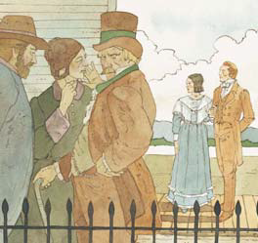
A few days later, while Joseph was working several miles away from Palmyra, his family learned that some men were coming to search for the gold plates.

Slide 16
Emma immediately got a horse and rode to warn Joseph about the men.
Joseph had also been warned through the Urim and Thummim that the plates were in danger.

Slide 17
Joseph returned to Palmyra and took the plates from the tree, wrapped them in a linen cloth, and started for home with them.

Slide 18
He thought it would be safer to travel through the woods rather than on the road, but in the woods someone hit him from behind with a gun.

Slide 19
Joseph knocked down the man who attacked him and ran away as fast as he could.
He was attacked twice more, but was able to escape each time and bring the plates safely to his home.

Slide 20
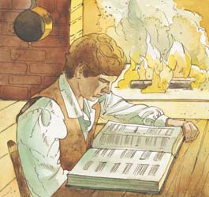
On another occasion, Joseph learned that a mob was coming to look for the plates.
He pulled up some stones in front of the fireplace and hid the plates underneath

Slide 21
As soon as the stones were put back into place, a group of men came up to the house.
Joseph and his father and brothers ran out the front door yelling.

Slide 22
The mob thought that there were many men helping Joseph and ran away frightened.

Slide 23
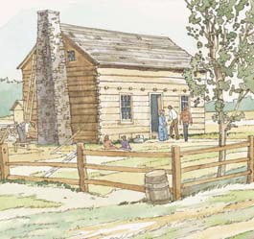
A few days later Joseph was inspired to take the plates, along with the wooden box in which he kept them, from under the fireplace stones.
He carried the bundle across the street to a workshop on the Smith farm.

Slide 24
He took the gold plates out of the box, wrapped them in cloth, and hid them in the loft of the shop.
Then he pulled up some floorboards, hid the empty wooden box under the boards, and nailed the boards back down.

Slide 25
When night came, a mob came and hunted for the plates.
The mob pulled up the floorboards and found the empty wooden box, but the gold plates remained safe where Joseph had hidden them in the loft.

Slide 26
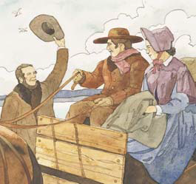
Because of all the persecution and the people trying to steal the gold plates, Joseph knew that he would not be able to work on their translation in Palmyra.

Slide 27
Joseph and Emma decided to move to Harmony, Pennsylvania, where Emma’s parents lived.

Slide 28
Joseph was worried about how to get the gold plates safely to Harmony.
He put the plates in a box and put the box at the bottom of a barrel.

Slide 29
Joseph then filled the barrel with beans and nailed down the lid.
With the barrel and their other belongings in a wagon, Joseph and Emma set off for Harmony.

Slide 30
Although they were stopped along the way and their wagon was searched by people looking for the plates, the plates were not found.

Slide 31
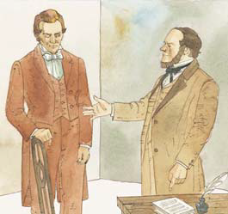
Because Joseph did his best to protect the plates as he had been commanded, Heavenly Father helped him keep the plates safe and also sent help in other ways.

Slide 32
Part of this help came from a successful farmer named Martin Harris, an old friend of the Smith family

Slide 33
When Joseph and Emma were preparing to move to Harmony, Martin Harris came to Joseph and said, “Here, Mr. Smith, is fifty dollars; I give this to you to do the Lord’s work with; no, I give it to the Lord for his own work”

Slide 34
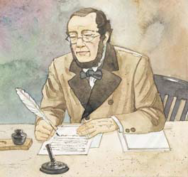
Martin Harris continued to help Joseph Smith in a number of ways. After Joseph and Emma moved to Harmony, Martin visited Joseph there.

Slide 35
Joseph had copied many of the characters from the gold plates and translated some of them.

Slide 36
Martin took the characters and their translation to Charles Anthon, a professor of languages in New York City, and later to a Dr. Mitchell.

Slide 37
DISCUSSION TIME

Slide 38
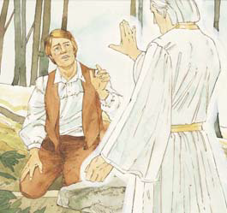
How many years passed between the angel Moroni’s first visit and when Joseph Smith
received the gold plates? (JS—H 1:53.)
Why did Joseph have to wait so long to receive the plates?

Slide 39
What responsibility did the angel Moroni give Joseph Smith concerning the gold plates? (JS—H 1:59)
What warning and promise did Moroni give Joseph?

Slide 40
What happened as soon as it was known that Joseph Smith had the gold plates? (JS—H 1:60.)
Why do you think people wanted to try to get the gold plates away from Joseph?

Slide 41
The gold plates were worth a lot of money, Satan did not want the plates to be translated.
Although these people did not believe Joseph was a prophet, they did believe he had the gold plates.

Slide 42
Why do you think people believed Joseph had the gold plates even though they did not believe he was a prophet?

Slide 43
What did Joseph Smith do to keep the plates safe?
How did Joseph know when and where to move the gold plates to keep them safe?

Slide 44
Heavenly Father helped Joseph know when the plates were in danger.

Slide 45
Joseph did his part and was obedient to Moroni’s warning.

Slide 46
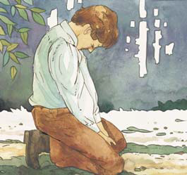
When we have problems or difficulties, how can we receive Heavenly Father’s help in solving them?
Can anyone share a time when Heavenly Father has helped you with problems.

Slide 47
ENRICHMENT ACTIVITIES
T

Slide 48
Pray about the problem or difficulty
Heavenly Father will help us with our problems and difficulties when we do our part.
How might the following be solved using these three steps?
Live worthily and follow the promptings of the spirit
Do all you can to solve the problem

Slide 49
Pray about the problem or difficulty
You are going to have a test at school.
You have been asked to give a talk in Primary.
You are going to play in a sports event
Live worthily and follow the promptings of the spirit
Do all you can to solve the problem

Slide 50
Pray about the problem or difficulty
You have just moved to a new area and you want to make new friends.
You have had a quarrel with a friend.
Live worthily and follow the promptings of the spirit
Do all you can to solve the problem

Slide 51
Pray about the problem or difficulty
You sometimes fight with a brother or sister.
You are going to perform in a program or recital.
Live worthily and follow the promptings of the spirit
Do all you can to solve the problem

Slide 52
Pray about the problem or difficulty
You want to play with a friend but your parents need you to help at home.
Live worthily and follow the promptings of the spirit
Do all you can to solve the problem

Slide 53
Can you name anyone that helps you each day?
Heavenly Father can give you help in the form of friends.
The Lord inspired Martin Harris to help Joseph Smith when Joseph needed help.

Slide 54
It is important to be a friend and help others in need when ever possible.
Can anyone share an experience when you needed help and help came in the form of a friend, or an experience when you were able to help a friend.

Slide 55
The Urim and Thummim is a sacred tool given by God to help prophets receive revelations from the Lord and translate languages.
Joseph Smith described the Urim and Thummim as “two stones in silver bows … fastened to a breastplate” (JS—H 1:35).

Slide 56
The Prophet stated that when he was humble and prayerful, he could look into these stones and read the strange language on the gold plates.
He could also look into these stones and get Heavenly Father’s word about certain things he ought to know and do.

Slide 57
Let’s find the following scriptures that refer to the Urim and Thummim:
Exodus 28:30
Mosiah 28:11, 13
Ether 3:23–24, Ether 4:4–5
Doctrine and Covenants 17:1

Slide 58
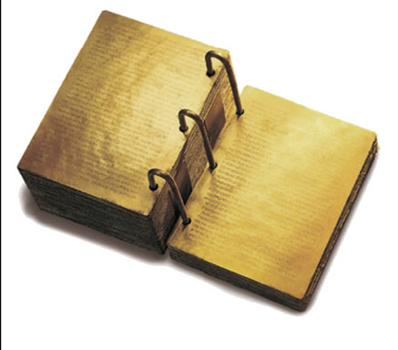
You have heard about these gold plates.
Here’s some facts about the plates.
Each gold plate was six inches wide and eight inches long.
Joseph Smith described each plate as “not quite so thick as common tin”

Slide 59
Three rings bound the book of plates together.
The whole book was about six inches thick.
The plates had small characters engraved on them.

Slide 60
A portion of the book was sealed and could not be translated.
Joseph Smith was told that the sealed part would be translated at a future time.

Slide 61
Testimony
I want to bear my testimony that Heavenly Father loves each of us and will help us as we are obedient and do our part.
I appreciate the example and diligence of Joseph Smith as he faced many problems and challenges in protecting the gold plates.
Return

Slide 62
OUR CLOSING PRAYER WILL BE GIVEN BY
Jaden Thomas

Slide 63
THE END

Slide 64
Images and clipart are from lds.org, microsoft office, and other websites indicating the images were in the public domain or permitted for church and home use.
The Lesson and Scripture story are from lds.org.
Please do not use this presentation for commercial use. Feel free to alter the presentation for use in church or home to suit personal preference.
This presentation is intended to supplement, not replace, the lesson manual and scriptures.
Teachers should refer to the manual, scriptures and other resources when preparing and conducting the lesson.

Slide 65
JS—H 1:59
59 At length the time arrived for obtaining the plates, the Urim and Thummim, and the breastplate. On the twenty-second day of September, one thousand eight hundred and twenty-seven, having gone as usual at the end of another year to the place where they were deposited, the same heavenly messenger delivered them up to ªme with this charge: that I should be ^{b}responsible for them; that if I should let them go carelessly, or through any ^{c}neglect of mine, I should be cut off; but that if I would use all my endeavors to ^{d}preserve them, until he, the messenger, should call for them, they should be protected.
Return

Slide 66
JS—H 1:60
60 I soon found out the reason why I had received such strict charges to keep them safe, and why it was that the messenger had said that when I had done what was required at my hand, he would call for them. For no sooner was it known that I had them, than the most strenuous exertions were used to ªget them from me. Every stratagem that could be invented was resorted to for that purpose. The persecution became more bitter and severe than before, and multitudes were on the alert continually to get them from me if possible. But by the wisdom of God, they remained safe in my hands, until I had accomplished by them what was required at my hand. When, according to arrangements, the messenger called for them, I delivered them up to him; and he has them in his charge until this ^{b}day, being the second day of May, one thousand eight hundred and thirty-eight.
Return

Slide 67
JS—H 1:53
53 I made an attempt to take them out, but was forbidden by the messenger, and was again informed that the time for bringing them forth had not yet arrived, neither would it, until four years from that time; but he told me that I should come to that place precisely in one year from that time, and that he would there meet with me, and that I should continue to do so until the time should come for obtaining the plates.
Return

Slide 68
JS—H 1:59
59 At length the time arrived for obtaining the plates, the Urim and Thummim, and the breastplate. On the twenty-second day of September, one thousand eight hundred and twenty-seven, having gone as usual at the end of another year to the place where they were deposited, the same heavenly messenger delivered them up to ªme with this charge: that I should be ^{b}responsible for them; that if I should let them go carelessly, or through any ^{c}neglect of mine, I should be cut off; but that if I would use all my endeavors to ^{d}preserve them, until he, the messenger, should call for them, they should be protected.
Return

Slide 69
JS—H 1:60
60 I soon found out the reason why I had received such strict charges to keep them safe, and why it was that the messenger had said that when I had done what was required at my hand, he would call for them. For no sooner was it known that I had them, than the most strenuous exertions were used to ªget them from me. Every stratagem that could be invented was resorted to for that purpose. The persecution became more bitter and severe than before, and multitudes were on the alert continually to get them from me if possible. But by the wisdom of God, they remained safe in my hands, until I had accomplished by them what was required at my hand. When, according to arrangements, the messenger called for them, I delivered them up to him; and he has them in his charge until this ^{b}day, being the second day of May, one thousand eight hundred and thirty-eight.
Return

Slide 70
JS—H 1:35
35 Also, that there were two stones in silver bows—and these stones, fastened to a ªbreastplate, constituted what is called the ^{b}Urim and Thummim—deposited with the plates; and the possession and use of these stones were what constituted ^{c}“seers” in ancient or former times; and that God had prepared them for the purpose of translating the book.
Return

Slide 71
Exodus 28:30
30 ¶And thou shalt put in the breastplate of judgment the ªUrim and the Thummim; and they shall be upon Aaron’s heart, when he goeth in before the Lord: and Aaron shall bear the judgment of the children of Israel upon his heart before the Lord continually.
Return

Slide 72
Mosiah 28:11, 13
11 Therefore he took the records which were engraven on the plates of ªbrass, and also the plates of ^{b}Nephi, and all the things which he had kept and preserved according to the commandments of God, after having translated and caused to be written the records which were on the ^{c}plates of gold which had been found by the people of Limhi, which were delivered to him by the hand of Limhi;
13 And now he translated them by the means of those two ªstones which were fastened into the two rims of a bow.
Return

Slide 73
Ether 3:23–24
23 And behold, these ªtwo stones will I give unto thee, and ye shall seal them up also with the things which ye shall write.
24 For behold, the ªlanguage which ye shall write I have confounded; wherefore I will cause in my own due time that these stones shall magnify to the eyes of men these things which ye shall write.
Return

Slide 74
Ether 4:4–5
4 Behold, I have written upon these plates the ªvery things which the brother of Jared saw; and there never were ^{b}greater things made manifest than those which were made manifest unto the brother of Jared.
5 Wherefore the Lord hath commanded me to write them; and I have written them. And he commanded me that I should ªseal them up; and he also hath commanded that I should seal up the interpretation thereof; wherefore I have sealed up the ^{b}interpreters, according to the commandment of the Lord.
Return

Slide 75
Doctrine and Covenants 17:1
1 Behold, I say unto you, that you must rely upon my word, which if you do with full purpose of heart, you shall have a ªview of the ^{b}plates, and also of the ^{c}breastplate, the ^{d}sword of Laban, the ^{e}Urim and Thummim, which were given to the ^{f}brother of Jared upon the mount, when he talked with the Lord ^{g}face to face, and the ^{h}miraculous directors which were given to Lehi while in the wilderness, on the borders of the ^{i}Red Sea.
Return

