Slide 1
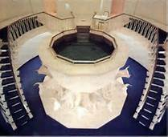
Lesson 34: Joseph Smith Teaches about Baptism for the Dead
“Lesson 34: Joseph Smith Teaches about Baptism for the Dead,” Primary 5: Doctrine and Covenants: Church History, (1997),193

Slide 2
Purpose
To help the children understand the importance of priesthood authority and have a desire to be worthy of priesthood ordinances and blessings.

Slide 3
OUR OPENING PRAYER WILL BE GIVEN BY
(Enter name here)

Slide 4

Who here thinks they can comb their hair?
If I asked you to comb your hair, without bending your arm at the elbow, do you think you could still comb your hair?

Slide 5
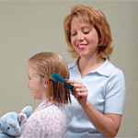
Why can’t you comb your hair?
If we were not able to bend our elbows, how would our hair get combed?
Someone else would have to comb it for us.

Slide 6

When has someone helped you by doing something that you could not do for yourself, how did you feel about having someone help you in that way

Slide 7
Let’s Read John 3:5
5 Jesus answered, Verily, verily, I say unto thee, Except a man be born of water and of the Spirit, he cannot enter into the kingdom of God.

Slide 8
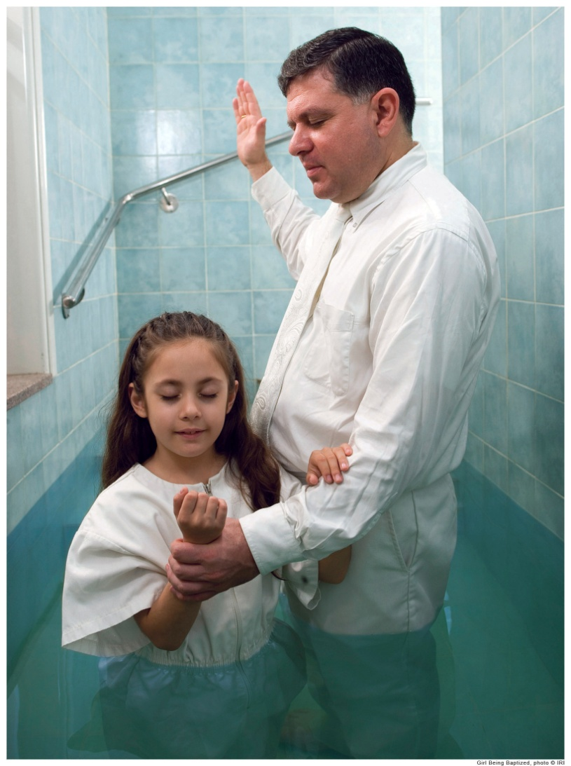
What do you think is the meaning of this scripture?
Remember, that being baptized is one of the first steps toward returning to live with Heavenly Father and Jesus Christ again.
People cannot enter the kingdom of God unless they have been baptized.

Slide 9
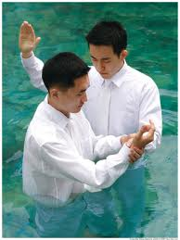
Many people have lived on the earth at times when baptism was not available or have died before they had a chance to learn about the true gospel and baptism by the proper priesthood authority.

Slide 10
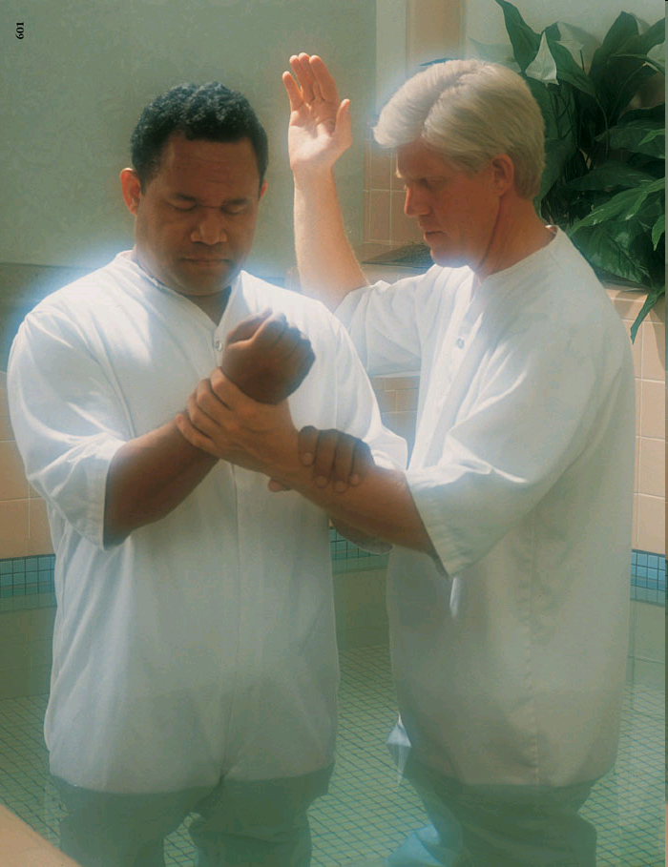
Since baptism is required of all people, how will these people be able to return to live with Heavenly Father and Jesus Christ?
  Someone must be baptized for them. .

Slide 11
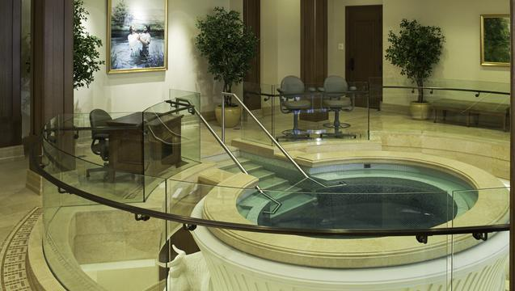
Heavenly Father loves each of his children equally and wants each one to have the opportunity to live again with him.

Slide 12
He has made it possible for members of the Church to help people who were not baptized when they lived on the earth.
We can do for these people what they cannot do for themselves.

Slide 13
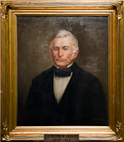
In May 1842 the Saints living in Nauvoo learned that Lilburn W. Boggs had been shot and wounded in Independence, Missouri.
Boggs had been the governor of Missouri when the Saints lived there, and he had issued the “extermination order” forcing the Saints out of Missouri.

Slide 14
Boggs had many political enemies who would have been likely suspects in the shooting, but Missouri authorities accused Joseph Smith of trying to kill Boggs.
Joseph knew that he was innocent of this charge, so he made a statement to a newspaper editor and forgot the incident.

Slide 15
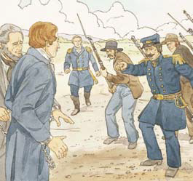
Two months later the Prophet and Orrin Porter Rockwell, one of his bodyguards, were arrested.
Boggs had formally accused Porter Rockwell of firing the gun and Joseph Smith of ordering him to do it.

Slide 16
Under the laws of the United States, however, the Prophet and Porter Rockwell had been improperly and illegally arrested, so they were released.

Slide 17
Realizing that he was in danger, the Prophet went into hiding for the next few months.

Slide 18
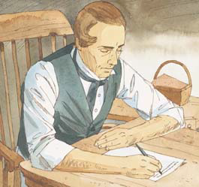
During this time of hiding, Joseph Smith wrote two inspired letters to the Saints in Nauvoo.
These letters contained instructions given by the Lord regarding how baptisms for the dead should be done.
The letters are now published as Doctrine and Covenants 127 and 128.

Slide 19
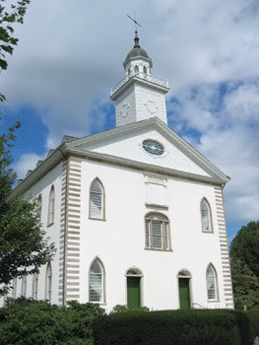
Several years earlier, in the Kirtland Temple, Joseph Smith had received a vision of the celestial kingdom in which he saw his brother Alvin, who had died before Joseph had received the gold plates (see D&C 137).

Slide 20
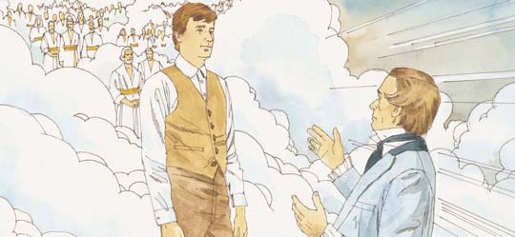
Joseph was surprised to see Alvin in the celestial kingdom, because Alvin had not been baptized before he died.

Slide 21
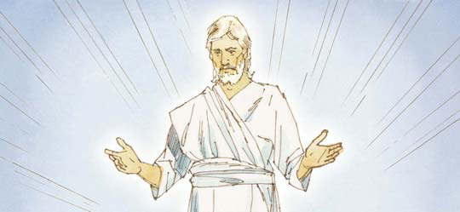
The Lord explained to Joseph that all people who would have received the gospel, been baptized, and lived righteously if they had been given the opportunity will be able to be in the celestial kingdom (see D&C 137:7).

Slide 22
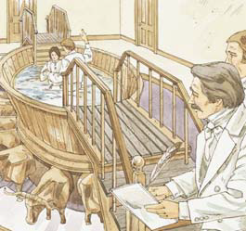
Joseph later learned that baptisms for the dead could be done vicariously, using people on the earth as proxies.

Slide 23
Vicarious
Proxy
A person does something
in place of someone else.
The person doing the work or activity.

Slide 24
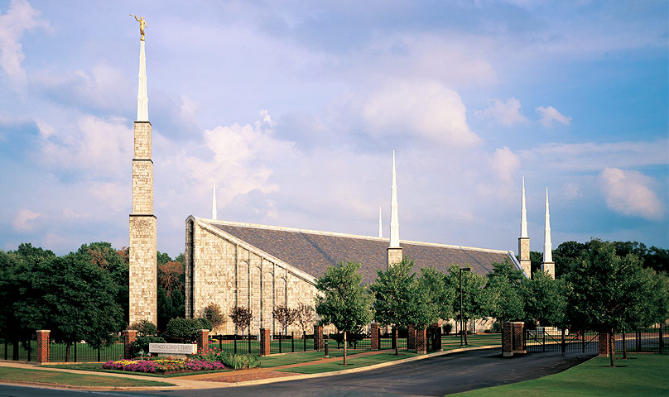
In the temple we can be baptized for people who died without being baptized.
We serve as proxy for these people.

Slide 25
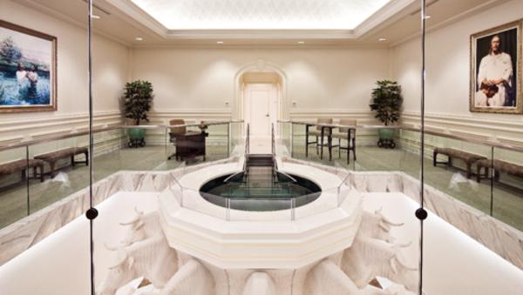
We are the ones who go down into the water and are baptized, but they are the ones for whom the baptism counts.
We are participating in vicarious baptisms.

Slide 26
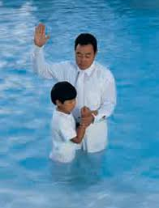
Everyone must be baptized in order to enter the celestial kingdom.
Because baptism is an earthly ordinance, baptisms can be done only by people living on the earth.
While we are on the earth, we can help people who have not been baptized by doing vicarious baptisms for them.

Slide 27
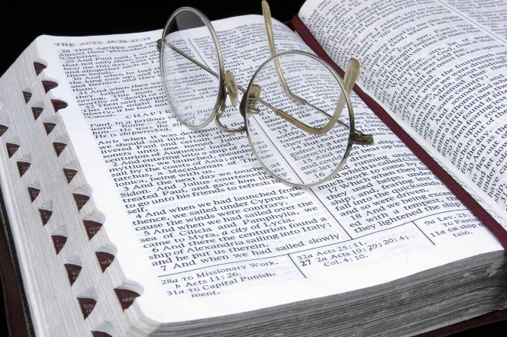
Vicarious baptisms for the dead were performed after Jesus Christ’s resurrection (see 1 Corinthians 15:29) until Christ’s church fell into apostasy and the priesthood was taken from the earth.
Before the Prophet Joseph learned about baptism for the dead, no one in his time realized that vicarious baptism was a part of the gospel of Jesus Christ.

Slide 28
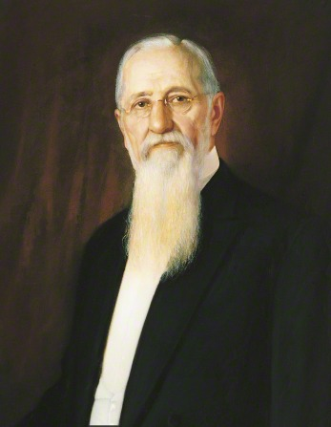
In 1918 Joseph F. Smith, the sixth President of the Church, received a revelation explaining more about what happens to those who die without baptism.
This revelation is published in Doctrine and Covenants 138.

Slide 29
President Smith saw Jesus Christ and some of his followers in the spirit world.
Jesus organized his followers to teach the gospel to people who had not had the opportunity to learn the gospel and be baptized before they died

Slide 30
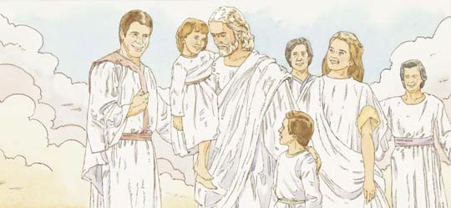
This teaching prepared the people to accept the vicarious baptisms that would be done for them.

Slide 31

Discussion Time

Slide 32

Why do we need to be baptized? (John 3:5; Articles of Faith 1:4.)
What is baptism for the dead?

Slide 33
Why do members of the Church perform baptisms for the dead?
How are we baptized?

Slide 34
Explain that the baptismal font is usually placed in the basement or lowest part of the temple.
Why did the Lord instruct the Saints to keep careful records of the baptisms they performed for the dead? (D&C 127:6–7, 9)

Slide 35

We baptized for the dead?
  Members of the Church at least twelve years old who have received an appropriate temple recommend from their bishop.

Slide 36
What did Joseph F. Smith see in his vision of the spirit world? (D&C 138:11–19, 28–35.)
What happens to people who die without being taught the gospel? (D&C 138:31–33.)

Slide 37
Why is it important for each of us to make sure our ancestors have had the ordinance of baptism performed for them? (D&C 128:15.)
Other ordinances, such as temple marriage, can also be performed for the dead by proxy.
This way all the members of our family can be sealed together for eternity.
All our righteous ancestors can be part of our eternal family.

Slide 38
TESTIMONY
I am grateful for your baptism and for the opportunity to help make baptism available to every person who ever lived on the earth.
I encourage you to talk with your families about having baptisms performed for your ancestors.

Slide 39

OUR CLOSING PRAYER WILL BE GIVEN BY
(Enter Name Here)

Slide 40
THE END

Slide 41
Images and clipart are from lds.org, Microsoft office, and other websites indicating the images were in the public domain or permitted for church and home use.
The Lesson and Scripture story are from lds.org. This presentation was created with the help of the presentation by Connie Mayes found on Sugar Doodle.net.
Please do not use this presentation for commercial use. Feel free to alter the presentation for use in church or home to suit personal preference.
This presentation is intended to supplement, not replace, the lesson manual and scriptures.
Teachers should refer to the manual, scriptures and other resources when preparing and conducting the lesson.

Slide 42
Doctrine and Covenants 127
1 Forasmuch as the Lord has revealed unto me that my enemies, both in Missouri and this State, were again in the pursuit of me; and inasmuch as they pursue me without a cause, and have not the least shadow or coloring of justice or right on their side in the getting up of their prosecutions against me; and inasmuch as their pretensions are all founded in falsehood of the blackest dye, I have thought it expedient and wisdom in me to leave the place for a short season, for my own safety and the safety of this people. I would say to all those with whom I have business, that I have left my affairs with agents and clerks who will transact all business in a prompt and proper manner, and will see that all my debts are canceled in due time, by turning out property, or otherwise, as the case may require, or as the circumstances may admit of. When I learn that the storm is fully blown over, then I will return to you again.

Slide 43
Doctrine and Covenants 127
2 And as for the perils which I am called to pass through, they seem but a small thing to me, as the envy and wrath of man have been my common lot all the days of my life; and for what cause it seems mysterious, unless I was ordained from before the foundation of the world for some good end, or bad, as you may choose to call it. Judge ye for yourselves. God knoweth all these things, whether it be good or bad. But nevertheless, deep water is what I am wont to swim in. It all has become a second nature to me; and I feel, like Paul, to glory in tribulation; for to this day has the God of my fathers delivered me out of them all, and will deliver me from henceforth; for behold, and lo, I shall triumph over all my enemies, for the Lord God hath spoken it.

Slide 44
Doctrine and Covenants 127
3 Let all the saints rejoice, therefore, and be exceedingly glad; for Israel’s God is their God, and he will mete out a just recompense of reward upon the heads of all their oppressors.
4 And again, verily thus saith the Lord: Let the work of my temple, and all the works which I have appointed unto you, be continued on and not cease; and let your diligence, and your perseverance, and patience, and your works be redoubled, and you shall in nowise lose your reward, saith the Lord of Hosts. And if they persecute you, so persecuted they the prophets and righteous men that were before you. For all this there is a reward in heaven.
5 And again, I give unto you a word in relation to the baptism for your dead.

Slide 45
Doctrine and Covenants 127
6 Verily, thus saith the Lord unto you concerning your dead: When any of you are baptized for your dead, let there be a recorder, and let him be eye-witness of your baptisms; let him hear with his ears, that he may testify of a truth, saith the Lord;
7 That in all your recordings it may be recorded in heaven; whatsoever you bind on earth, may be bound in heaven; whatsoever you loose on earth, may be loosed in heaven;
8 For I am about to restore many things to the earth, pertaining to the priesthood, saith the Lord of Hosts.
9 And again, let all the records be had in order, that they may be put in the archives of my holy temple, to be held in remembrance from generation to generation, saith the Lord of Hosts.

Slide 46
Doctrine and Covenants 127
10 I will say to all the saints, that I desired, with exceedingly great desire, to have addressed them from the stand on the subject of baptism for the dead, on the following Sabbath. But inasmuch as it is out of my power to do so, I will write the word of the Lord from time to time, on that subject, and send it to you by mail, as well as many other things.
11 I now close my letter for the present, for the want of more time; for the enemy is on the alert, and as the Savior said, the prince of this world cometh, but he hath nothing in me.
12 Behold, my prayer to God is that you all may be saved. And I subscribe myself your servant in the Lord, prophet and seer of The Church of Jesus Christ of Latter-day Saints.
Joseph Smith.

Slide 47
Revelation 20:12
12 And I saw the dead, small and great, stand before God; and the books were opened: and another book was opened, which is the book of life: and the dead were judged out of those things which were written in the books, according to their works.

Slide 48
Matthew 16:18, 19:
18 And I say also unto thee, That thou art Peter, and upon this rock I will build my church; and the gates of hell shall not prevail against it.
19 And I will give unto thee the keys of the kingdom of heaven: and whatsoever thou shalt bind on earth shall be bound in heaven: and whatsoever thou shalt loose on earth shall be loosed in heaven.

Slide 49
1 Corinthians 15:29:
29 Else what shall they do which are baptized for the dead, if the dead rise not at all? why are they then baptized for the dead?

Slide 50
1 Corinthians 15:46, 47, and 48
46 Howbeit that was not first which is spiritual, but that which is natural; and afterward that which is spiritual.
47 The first man is of the earth, earthy: the second man is the Lord from heaven.
48 As is the earthy, such are they also that are earthy: and as is the heavenly, such are they also that are heavenly.

Slide 51
Doctrine and Covenants 128
1 As I stated to you in my letter before I left my place, that I would write to you from time to time and give you information in relation to many subjects, I now resume the subject of the baptism for the dead, as that subject seems to occupy my mind, and press itself upon my feelings the strongest, since I have been pursued by my enemies.
2 I wrote a few words of revelation to you concerning a recorder. I have had a few additional views in relation to this matter, which I now certify. That is, it was declared in my former letter that there should be a recorder, who should be eye-witness, and also to hear with his ears, that he might make a record of a truth before the Lord.

Slide 52
Doctrine and Covenants 128
3 Now, in relation to this matter, it would be very difficult for one recorder to be present at all times, and to do all the business. To obviate this difficulty, there can be a recorder appointed in each ward of the city, who is well qualified for taking accurate minutes; and let him be very particular and precise in taking the whole proceedings, certifying in his record that he saw with his eyes, and heard with his ears, giving the date, and names, and so forth, and the history of the whole transaction; naming also some three individuals that are present, if there be any present, who can at any time when called upon certify to the same, that in the mouth of two or three witnesses every word may be established.

Slide 53
Doctrine and Covenants 128
4 Then, let there be a general recorder, to whom these other records can be handed, being attended with certificates over their own signatures, certifying that the record they have made is true. Then the general church recorder can enter the record on the general church book, with the certificates and all the attending witnesses, with his own statement that he verily believes the above statement and records to be true, from his knowledge of the general character and appointment of those men by the church. And when this is done on the general church book, the record shall be just as holy, and shall answer the ordinance just the same as if he had seen with his eyes and heard with his ears, and made a record of the same on the general church book..

Slide 54
Doctrine and Covenants 128
5 You may think this order of things to be very particular; but let me tell you that it is only to answer the will of God, by conforming to the ordinance and preparation that the Lord ordained and prepared before the foundation of the world, for the salvation of the dead who should die without a knowledge of the gospel.
6 And further, I want you to remember that John the Revelator was contemplating this very subject in relation to the dead, when he declared, as you will find recorded in Revelation 20:12 —And I saw the dead, small and great, stand before God; and the books were opened; and another book was opened, which is the book of life; and the dead were judged out of those things which were written in the books, according to their works. on earth shall be loosed in heaven.

Slide 55
Doctrine and Covenants 128
7 You will discover in this quotation that the books were opened; and another book was opened, which was the book of life; but the dead were judged out of those things which were written in the books, according to their works; consequently, the books spoken of must be the books which contained the record of their works, and refer to the records which are kept on the earth. And the book which was the book of life is the record which is kept in heaven; the principle agreeing precisely with the doctrine which is commanded you in the revelation contained in the letter which I wrote to you previous to my leaving my place—that in all your recordings it may be recorded in heaven.

Slide 56
Doctrine and Covenants 128
8 Now, the nature of this ordinance consists in the power of the priesthood, by the revelation of Jesus Christ, wherein it is granted that whatsoever you bind on earth shall be bound in heaven, and whatsoever you loose on earth shall be loosed in heaven. Or, in other words, taking a different view of the translation, whatsoever you record on earth shall be recorded in heaven, and whatsoever you do not record on earth shall not be recorded in heaven; for out of the books shall your dead be judged, according to their own works, whether they themselves have attended to the ordinances in their own propria persona, or by the means of their own agents, according to the ordinance which God has prepared for their salvation from before the foundation of the world, according to the records which they have kept concerning their dead.

Slide 57
Doctrine and Covenants 128
9 It may seem to some to be a very bold doctrine that we talk of—a power which records or binds on earth and binds in heaven. Nevertheless, in all ages of the world, whenever the Lord has given a dispensation of the priesthood to any man by actual revelation, or any set of men, this power has always been given. Hence, whatsoever those men did in authority, in the name of the Lord, and did it truly and faithfully, and kept a proper and faithful record of the same, it became a law on earth and in heaven, and could not be annulled, according to the decrees of the great Jehovah. This is a faithful saying. Who can hear it?

Slide 58
Doctrine and Covenants 128
10 And again, for the precedent, Matthew 16:18, 19: And I say also unto thee, That thou art Peter, and upon this rock I will build my church; and the gates of hell shall not prevail against it. And I will give unto thee the keys of the kingdom of heaven: and whatsoever thou shalt bind on earth shall be bound in heaven; and whatsoever thou shalt loose on earth shall be loosed in heaven.
11 Now the great and grand secret of the whole matter, and the summum bonum of the whole subject that is lying before us, consists in obtaining the powers of the Holy Priesthood. For him to whom these keys are given there is no difficulty in obtaining a knowledge of facts in relation to the salvation of the children of men, both as well for the dead as for the living.

Slide 59
Doctrine and Covenants 128
12 Herein is glory and honor, and immortality and eternal life—The ordinance of baptism by water, to be immersed therein in order to answer to the likeness of the dead, that one principle might accord with the other; to be immersed in the water and come forth out of the water is in the likeness of the resurrection of the dead in coming forth out of their graves; hence, this ordinance was instituted to form a relationship with the ordinance of baptism for the dead, being in likeness of the dead.
13 Consequently, the baptismal font was instituted as a similitude of the grave, and was commanded to be in a place underneath where the living are wont to assemble, to show forth the living and the dead, and that all things may have their likeness, and that they may accord one with another—that which is earthly conforming to that which is heavenly, as Paul hath declared, 1 Corinthians 15:46, 47, and 48:

Slide 60
Doctrine and Covenants 128
14 Howbeit that was not first which is spiritual, but that which is natural; and afterward that which is spiritual. The first man is of the earth, earthy; the second man is the Lord from heaven. As is the earthy, such are they also that are earthy; and as is the heavenly, such are they also that are heavenly. And as are the records on the earth in relation to your dead, which are truly made out, so also are the records in heaven. This, therefore, is the sealing and binding power, and, in one sense of the word, the keys of the kingdom, which consist in the key of knowledge.
15 And now, my dearly beloved brethren and sisters, let me assure you that these are principles in relation to the dead and the living that cannot be lightly passed over, as pertaining to our salvation. For their salvation is necessary and essential to our salvation, as Paul says concerning the fathers—that they without us cannot be made perfect—neither can we without our dead be made perfect.

Slide 61
Doctrine and Covenants 128
16 And now, in relation to the baptism for the dead, I will give you another quotation of Paul, 1 Corinthians 15:29: Else what shall they do which are baptized for the dead, if the dead rise not at all? Why are they then baptized for the dead?
17 And again, in connection with this quotation I will give you a quotation from one of the prophets, who had his eye fixed on the restoration of the priesthood, the glories to be revealed in the last days, and in an especial manner this most glorious of all subjects belonging to the everlasting gospel, namely, the baptism for the dead; for Malachi says, last chapter, verses 5th and 6th: Behold, I will send you Elijah the prophet before the coming of the great and dreadful day of the Lord: And he shall turn the heart of the fathers to the children, and the heart of the children to their fathers, lest I come and smite the earth with a curse.

Slide 62
Doctrine and Covenants 128
18 I might have rendered a plainer translation to this, but it is sufficiently plain to suit my purpose as it stands. It is sufficient to know, in this case, that the earth will be smitten with a curse unless there is a welding link of some kind or other between the fathers and the children, upon some subject or other—and behold what is that subject? It is the baptism for the dead. For we without them cannot be made perfect; neither can they without us be made perfect. Neither can they nor we be made perfect without those who have died in the gospel also; for it is necessary in the ushering in of the dispensation of the fulness of times, which dispensation is now beginning to usher in, that a whole and complete and perfect union, and welding together of dispensations, and keys, and powers, and glories should take place, and be revealed from the days of Adam even to the present time. And not only this, but those things which never have been revealed from the foundation of the world, but have been kept hid from the wise and prudent, shall be revealed unto babes and sucklings in this, the dispensation of the fulness of times.

Slide 63
Doctrine and Covenants 128
19 Now, what do we hear in the gospel which we have received? A voice of gladness! A voice of mercy from heaven; and a voice of truth out of the earth; glad tidings for the dead; a voice of gladness for the living and the dead; glad tidings of great joy. How beautiful upon the mountains are the feet of those that bring glad tidings of good things, and that say unto Zion: Behold, thy God reigneth! As the dews of Carmel, so shall the knowledge of God descend upon them!
20 And again, what do we hear? Glad tidings from Cumorah! Moroni, an angel from heaven, declaring the fulfilment of the prophets—the book to be revealed. A voice of the Lord in the wilderness of Fayette, Seneca county, declaring the three witnesses to bear record of the book! The voice of Michael on the banks of the Susquehanna, detecting the devil when he appeared as an angel of light! The voice of Peter, James, and John in the wilderness between Harmony, Susquehanna county, and Colesville, Broome county, on the Susquehanna river, declaring themselves as possessing the keys of the kingdom, and of the dispensation of the fulness of times!

Slide 64
Doctrine and Covenants 128
21 And again, the voice of God in the chamber of old Father Whitmer, in Fayette, Seneca county, and at sundry times, and in divers places through all the travels and tribulations of this Church of Jesus Christ of Latter-day Saints! And the voice of Michael, the archangel; the voice of Gabriel, and of Raphael, and of divers angels, from Michael or Adam down to the present time, all declaring their dispensation, their rights, their keys, their honors, their majesty and glory, and the power of their priesthood; giving line upon line, precept upon precept; here a little, and there a little; giving us consolation by holding forth that which is to come, confirming our hope!
22 Brethren, shall we not go on in so great a cause? Go forward and not backward. Courage, brethren; and on, on to the victory! Let your hearts rejoice, and be exceedingly glad. Let the earth break forth into singing. Let the dead speak forth anthems of eternal praise to the King Immanuel, who hath ordained, before the world was, that which would enable us to redeem them out of their prison; for the prisoners shall go free.

Slide 65
Doctrine and Covenants 128
23 Let the mountains shout for joy, and all ye valleys cry aloud; and all ye seas and dry lands tell the wonders of your Eternal King! And ye rivers, and brooks, and rills, flow down with gladness. Let the woods and all the trees of the field praise the Lord; and ye solid rocks weep for joy! And let the sun, moon, and the morning stars sing together, and let all the sons of God shout for joy! And let the eternal creations declare his name forever and ever! And again I say, how glorious is the voice we hear from heaven, proclaiming in our ears, glory, and salvation, and honor, and immortality, and eternal life; kingdoms, principalities, and powers!

Slide 66
Doctrine and Covenants 128
24 Behold, the great day of the Lord is at hand; and who can abide the day of his coming, and who can stand when he appeareth? For he is like a refiner’s fire, and like fuller’s soap; and he shall sit as a refiner and purifier of silver, and he shall purify the sons of Levi, and purge them as gold and silver, that they may offer unto the Lord an offering in righteousness. Let us, therefore, as a church and a people, and as Latter-day Saints, offer unto the Lord an offering in righteousness; and let us present in his holy temple, when it is finished, a book containing the records of our dead, which shall be worthy of all acceptation.
25 Brethren, I have many things to say to you on the subject; but shall now close for the present, and continue the subject another time. I am, as ever, your humble servant and never deviating friend,
Joseph Smith.

Slide 67
D&C 137
1 The heavens were opened upon us, and I beheld the celestial kingdom of God, and the glory thereof, whether in the body or out I cannot tell.
2 I saw the transcendent beauty of the gate through which the heirs of that kingdom will enter, which was like unto circling flames of fire;
3 Also the blazing throne of God, whereon was seated the Father and the Son.
4 I saw the beautiful streets of that kingdom, which had the appearance of being paved with gold.
5 I saw Father Adam and Abraham; and my father and my mother; my brother Alvin, that has long since slept;
6 And marveled how it was that he had obtained an inheritance in that kingdom, seeing that he had departed this life before the Lord had set his hand to gather Israel the second time, and had not been baptized for the remission of sins.

Slide 68
D&C 137
7 Thus came the voice of the Lord unto me, saying: All who have died without a knowledge of this gospel, who would have received it if they had been permitted to tarry, shall be heirs of the celestial kingdom of God;
8 Also all that shall die henceforth without a knowledge of it, who would have received it with all their hearts, shall be heirs of that kingdom;
9 For I, the Lord, will judge all men according to their works, according to the desire of their hearts.
10 And I also beheld that all children who die before they arrive at the years of accountability are saved in the celestial kingdom of heaven.

Slide 69
D&C 137:7
7 Thus came the voice of the Lord unto me, saying: All who have died without a knowledge of this gospel, who would have received it if they had been permitted to tarry, shall be heirs of the celestial kingdom of God;

Slide 70
D&C 138
You need to look this one up, it’s too long to include in this presentation, sorry.

Slide 71
John 3:5
5 Jesus answered, Verily, verily, I say unto thee, Except a man be born of water and of the Spirit, he cannot enter into the kingdom of God

Slide 72
Articles of Faith 1:4
4 We believe that the first principles and ordinances of the Gospel are: first, Faith in the Lord Jesus Christ; second, Repentance; third, Baptism by immersion for the remission of sins; fourth, Laying on of hands for the gift of the Holy Ghost.

Slide 73
D&C 138:11–19, 28–35
11 As I pondered over these things which are written, the eyes of my understanding were opened, and the Spirit of the Lord ^{e}rested upon me, and I saw the hosts of the dead, both small and great.
12 And there were gathered together in one place an innumerable company of the spirits of the ªjust, who had been ^{b}faithful in the testimony of Jesus while they lived in mortality;
13 And who had offered sacrifice in the similitude of the great sacrifice of the Son of God, and had suffered tribulation in their Redeemer’s name.
14 All these had departed the mortal life, firm in the hope of a glorious ^{b}resurrection, through the grace of God the Father and his Only Begotten Son, Jesus Christ.
15 I beheld that they were filled with joy and gladness, and were rejoicing together because the day of their deliverance was at hand.
16 They were assembled awaiting the advent of the Son of God into the spirit world, to declare their redemption from the bands of death.

Slide 74
D&C 138:11–19, 28–35
17 Their sleeping dust was to be restored unto its perfect frame, bone to his bone, and the sinews and the flesh upon them, the spirit and the body to be united never again to be divided, that they might receive a fulness of joy.
18 While this vast multitude waited and conversed, rejoicing in the hour of their deliverance from the chains of death, the Son of God appeared, declaring liberty to the captives who had been faithful;
19 And there he preached to them the everlasting gospel, the doctrine of the resurrection and the redemption of mankind from the fall, and from individual sins on conditions of repentance.
28 And I wondered at the words of Peter—wherein he said that the Son of God preached unto the spirits in prison, who sometime were disobedient, when once the long-suffering of God waited in the days of Noah—and how it was possible for him to preach to those spirits and perform the necessary labor among them in so short a time.

Slide 75
D&C 138:11–19, 28–35
29 And as I wondered, my eyes were opened, and my understanding quickened, and I perceived that the Lord went not in person among the wicked and the disobedient who had rejected the truth, to teach them;
30 But behold, from among the righteous, he organized his forces and appointed messengers, clothed with power and authority, and commissioned them to go forth and carry the light of the gospel to them that were in darkness, even to all the spirits of men; and thus was the gospel preached to the dead.

Slide 76
D&C 138:31-33
31 And the chosen messengers went forth to declare the acceptable day of the Lord and proclaim liberty to the captives who were bound, even unto all who would repent of their sins and receive the gospel.
32 Thus was the gospel preached to those who had died in their sins, without a knowledge of the truth, or in transgression, having rejected the prophets.
33 These were taught faith in God, repentance from sin, vicarious baptism for the remission of sins, the gift of the Holy Ghost by the laying on of hands,

Slide 77
D&C 138:11–19, 28–35
34 And all other principles of the gospel that were necessary for them to know in order to qualify themselves that they might be ªjudged according to men in the flesh, but live according to God in the spirit.
35 And so it was made known among the dead, both small and great, the unrighteous as well as the faithful, that redemption had been wrought through the sacrifice of the Son of God upon the cross.

Slide 78
D&C 128:15
15 And now, my dearly beloved brethren and sisters, let me assure you that these are principles in relation to the dead and the living that cannot be lightly passed over, as pertaining to our salvation. For their salvation is necessary and essential to our salvation, as Paul says concerning the fathers—that they without us cannot be made perfect—neither can we without our dead be made perfect.

