Slide 1
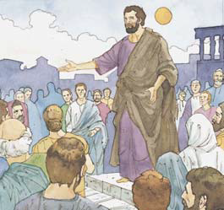
LESSON 2: The Apostasy and the Need for the Restoration of Jesus Christ’s Church

Slide 2
PURPOSE
To help the children understand that Jesus Christ’s church was taken from the earth because of apostasy and had to be restored to the earth.

Slide 3
We Thank Thee, O God, for a Prophet
1. We thank thee, O God, for a prophet
To guide us in these latter days.
We thank thee for sending the gospel
To lighten our minds with its rays.
We thank thee for every blessing
Bestowed by thy bounteous hand.
We feel it a pleasure to serve thee
And love to obey thy command.

Slide 4
We Thank Thee, O God, for a Prophet
2. When dark clouds of trouble hang o’er us
And threaten our peace to destroy,
There is hope smiling brightly before us,
And we know that deliv’rance is nigh.
We doubt not the Lord nor his goodness.
We’ve proved him in days that are past.
The wicked who fight against Zion
Will surely be smitten at last.

Slide 5
We Thank Thee, O God, for a Prophet
3. We’ll sing of his goodness and mercy.
We’ll praise him by day and by night,
Rejoice in his glorious gospel,
And bask in its life-giving light.
Thus on to eternal perfection
The honest and faithful will go,
While they who reject this glad message
Shall never such happiness know.
Text: William Fowler, 1830–1865
Music: Caroline Sheridan Norton, 1808–ca. 1877

Slide 6
OUR OPENING PRAYER WILL BE GIVEN BY
(Enter Name Here)

Slide 7
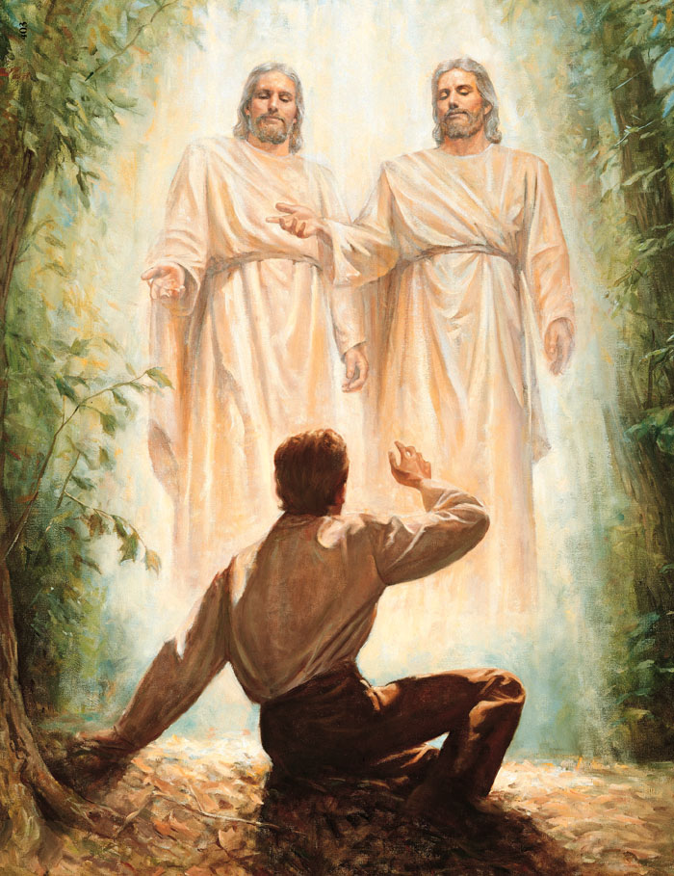
Why did Joseph Smith go into the woods to pray?
What answer did he expect to get to his prayer?
What answer did he get?
What had happened to the church Jesus Christ had organized when he was on the earth?

Slide 8
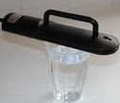
Does this glass or water look fit to drink?
If we add dirt and debris into the water, it could look something like this.

Slide 9
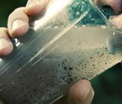
Does this glass or water look fit to drink?
If we add dirt and debris into the water, it could look something like this.

Slide 10
Would you want to drink this water now?
The water needs to be replaced with clean, pure water.

Slide 11
When Jesus Christ first organized his church on earth, it was organized properly and its leaders taught the truth.
The Church was like the clean glass of water.
Then people changed the Church, and it became like the glass of cloudy water.
The true Church and its teachings needed to be restored (brought back) to the earth.

Slide 12
This is what today’s lesson is about.

Slide 13
LESSON 2: The Apostasy and the Need for the Restoration of Jesus Christ’s Church

Slide 14
Ongoing Revelation
Priesthood authority from God
Living Prophets and Apostles
Ordinances done as Jesus taught
Heavenly Father, Jesus Christ and the Holy Ghost are 3 separate personages

Slide 15
No more revelation
Priesthood authority from God
Living Prophets and Apostles
Ordinances done as Jesus taught
Heavenly Father, Jesus Christ and the Holy Ghost are 3 separate personages

Slide 16
No more revelation
Priesthood taken away
Living Prophets and Apostles
Ordinances done as Jesus taught
Heavenly Father, Jesus Christ and the Holy Ghost are 3 separate personages

Slide 17
No more revelation
Priesthood taken away
No Living prophets or apostles
Ordinances done as Jesus taught
Heavenly Father, Jesus Christ and the Holy Ghost are 3 separate personages

Slide 18
No more revelation
Priesthood taken away
No Living prophets or apostles
Teachings and ordinances changed
Heavenly Father, Jesus Christ and the Holy Ghost are 3 separate personages

Slide 19
No more revelation
Priesthood taken away
No Living prophets or apostles
Teachings and ordinances changed
Heavenly Father, Jesus Christ, and the Holy Ghost thought to be one huge spirit

Slide 20
The Apostasy (falling away from Jesus’ true church) happened after Jesus Christ was crucified and Peter and the other Apostles were killed.
Without living prophets or apostles the Church no longer received revelation.
Teachings that were not true were added to the Church and some of the truths Jesus Christ had taught were taken away.
The priesthood (the authority to act in God’s name) was lost from the earth.
People were baptized by methods such as sprinkling instead of being immersed as Jesus was. It was not Jesus Christ’s church anymore.

Slide 21
The church that Jesus had organized was no longer on the earth.
Many different churches were organized.
Some people tried to bring their churches back to the teachings of Jesus Christ.
Although they could see from reading the Bible that some of the teachings of their churches were wrong, they could not change their churches back to Jesus Christ’s church because they did not have priesthood authority from Jesus to do this.
Many of these people were persecuted and even put to death because of their beliefs.

Slide 22
After the true church of Jesus Christ had gone into apostasy, Heavenly Father and Jesus Christ made preparations for the restoration of the true church.
The following three reformers were honest people who recognized how the churches they belonged to had been changed from Jesus’ church.
They wanted to reform their churches and make them more like Jesus’ original church.
The three men described here were some of the people who helped prepare the world for the restoration of the true church.

Slide 23
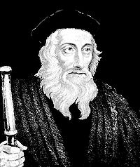
John Wycliffe was born in England in 1320.
He became a professor and a leader in his church.
Wycliffe realized that some of his church’s practices were different from those he read about in the Bible.
The church he belonged to would not let the people read the scriptures for themselves; the priests read and interpreted the scriptures for the people

Slide 24
Wycliffe helped translate the Bible into English so more people could read it.
He also sent out followers who lived among the people and helped them understand the teachings in the Bible.
The leaders of the church Wycliffe belonged to tried to stop his work, but Wycliffe continued to help the people understand how Jesus wanted the church to be.

Slide 25
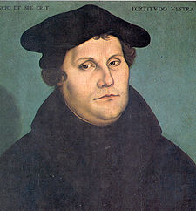
Martin Luther was born in Germany in 1483.
He became a priest in the Catholic Church and a teacher of religion.
As he studied the scriptures, Luther felt that the church was not teaching the same things the scriptures taught.
He wrote ninety-five statements of how the church had been changed from Jesus Christ’s church.
The church leaders became angry with Luther, but he continued to say his statements were true.

Slide 26
The church leaders held a trial and told Luther to take back what he said about the church’s false teachings.
However, Martin Luther said, “Unless I am convicted by Scripture and plain reason … I cannot and I will not recant [take back] anything, for to go against conscience is neither right nor safe. God help me. Amen” (quoted in Roland H. Bainton, Here I Stand: A Life of Martin Luther, p. 185).

Slide 27
Luther was told he could no longer be a member of the Catholic Church, and he was declared to be a criminal.
Protected by his friends, Luther went on to translate the Bible into German.
The newly invented printing press made it possible for Luther’s translation of the Bible to reach many people.

Slide 28
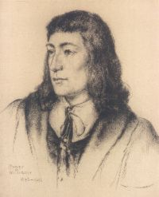
In 1620 a group of people known as the Pilgrims or Puritans wanted freedom to worship as they chose.
They came to America and started a town named Plymouth, built homes and churches, and were at last free to worship God as they wanted.
Roger Williams came to America in 1631, looking for a place to freely worship God.
Because he taught that all people should be able to worship as they wanted, the Puritans made him leave their town.

Slide 29
Roger Williams and a few followers built a new settlement.
Williams decided that Jesus Christ’s church was no longer on the earth and that the authority to act in the name of Jesus Christ was gone.
He believed that this could not be corrected until Jesus Christ called new Apostles with the authority to perform ordinances such as baptism and blessing the sacrament.

Slide 30
Wycliffe, Luther, and Williams did not have authority from Jesus Christ to correct the problems they saw in their churches.
However, by calling attention to these problems, they helped prepare the world for the time when Jesus’ church would be restored.

Slide 31
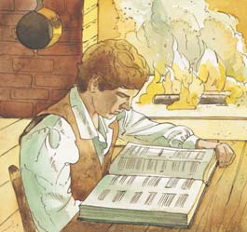
Because the true church was no longer on the earth, it was necessary for Jesus Christ to bring his true church back to the earth again.
This is known as the Restoration.
When the time was right for the church of Jesus Christ to be restored, Heavenly Father chose Joseph Smith to receive the authority for establishing Jesus Christ’s church on the earth again.

Slide 32
DISCUSSION TIME

Slide 33
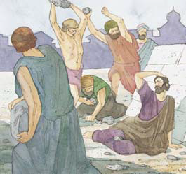
What does apostasy mean?
What happened to Jesus Christ’s church after Jesus was crucified and his original Apostles were killed?

Slide 34
Why was there a need for a restoration? (D&C 1:15–16.)
Why did Jesus Christ speak to Joseph Smith? (D&C 1:17.)
  Joseph Smith was the prophet of the Restoration.

Slide 35
What did John Wycliffe, Martin Luther, and Roger Williams see that was wrong with the churches they belonged to?
How did they try to correct these problems?
Why couldn’t they restore Jesus Christ’s church to the earth?

Slide 36
What did Jesus Christ reveal to Joseph Smith about his true church?

Slide 37
No more revelation
Priesthood taken away
No Living prophets or apostles
Teachings and ordinances changed
Heavenly Father, Jesus Christ, and the Holy Ghost thought to be one huge spirit

Slide 38
Ongoing Revelation
Priesthood taken away
No Living prophets or apostles
Teachings and ordinances changed
Heavenly Father, Jesus Christ, and the Holy Ghost thought to be one huge spirit

Slide 39
Ongoing Revelation
Priesthood authority from God
No Living prophets or apostles
Teachings and ordinances changed
Heavenly Father, Jesus Christ, and the Holy Ghost thought to be one huge spirit

Slide 40
Ongoing Revelation
Priesthood authority from God
Living prophets and apostles
Teachings and ordinances changed
Heavenly Father, Jesus Christ, and the Holy Ghost thought to be one huge spirit

Slide 41
Ongoing Revelation
Priesthood authority from God
Living prophets and apostles
Ordinances done as Jesus taught
Heavenly Father, Jesus Christ, and the Holy Ghost thought to be one huge spirit

Slide 42
Ongoing Revelation
Priesthood authority from God
Living prophets and apostles
Ordinances done as Jesus taught
Heavenly Father, Jesus Christ, and the Holy Ghost are three separate personages

Slide 43
To whom does Jesus Christ want his restored gospel to go? (D&C 1:2, 4.)
How can we share the restored gospel of Jesus Christ with others?

Slide 44
ENRICHMENT ACTIVITIES
T

Slide 45
There is something written on a piece of paper in the room that you should try to find.
Ask them to do so quietly.
Continue, once the paper is found, or it’s location reviled
T

Slide 46
What were you looking for but unable to find?
Read aloud the words on the paper.
Where was the word of the Lord during the Apostasy?
  Some of it was in the Bible
  Many teachings had been taken from the earth
Where can you find the word of the Lord today?
  In the Bible
  Book of Mormon
  Doctrine and Covenants
  Pearl of Great Price
  Messages from the latter-day prophets and apostles
  Revelation – the word of the Lord.
T

Slide 47
Let’s read Amos 8:11–12 aloud.
11 ¶Behold, the days come, saith the Lord God, that I will send a famine in the land, not a ªfamine of bread, nor a ^{b}thirst for water, but of hearing the ^{c}words of the Lord:
12 And they shall wander from sea to sea, and from the north even to the east, they shall ªrun to and fro to seek the word of the Lord, and shall not find it.
What did Amos say would happen?
What is a famine?
What did Amos mean by “a famine … of hearing the words of the Lord”?
T

Slide 48
Before the Church was restored by Jesus Christ through the Prophet Joseph Smith, many people looked for the true word of the Lord but could not find it.
There were no Church leaders with authority to receive revelation from the Lord.
When the Church was restored, the Lord began to again give revelation to his chosen leaders.
T

Slide 49
Before the Church was restored by Jesus Christ through the Prophet Joseph Smith, many people looked for the true word of the Lord but could not find it.
There were no Church leaders with authority to receive revelation from the Lord.
When the Church was restored, the Lord began to again give revelation to his chosen leaders.
T

Slide 50
Let’s try to memorize the ninth article of faith.
9 We believe all that God has ªrevealed, all that He does now reveal, and we believe that He will yet ^{b}reveal many great and important things pertaining to the Kingdom of God.
T

Slide 51
Before the Prophet Joseph Smith’s birth, Asael Smith, Joseph’s grandfather, had a strong feeling that one of his descendants would be “a great benefit to mankind” (quoted in Church History in the Fulness of Times [Church Educational System manual (32502), 1993], p. 17; see also History of the Church, 2:443).
Discuss how Joseph Smith, Asael’s grandson, did provide a great benefit to the world by helping Jesus Christ restore His church to the earth.
T

Slide 52
Testimony
I want to bear my testimony of the reality of the apostasy from Jesus Christ’s original church and the restoration of Christ’s church in the latter days.
I testify that through the Prophet Joseph Smith the true church of Jesus Christ has been restored to the earth.
I am thankful that Jesus Christ restored his church to help us.

Slide 53
OUR CLOSING PRAYER WILL BE GIVEN BY
(Enter Name Here)

Slide 54
THE END

Slide 55
Images and clipart are from lds.org, Microsoft Office, and other websites indicating the images were in the public domain or permitted for church and home use.
Some of the clipart were taken from the power point by Beth A. at sugardoodle.net
The Lesson and Scripture story are from lds.org.
Please do not use this presentation for commercial use. Feel free to alter the presentation for use in church or home to suit personal preference.
This presentation is intended to supplement, not replace, the lesson manual and scriptures.
Teachers should refer to the manual, scriptures and other resources when preparing and conducting the lesson.

Slide 56
D&C 1:15–16
15 For they have ªstrayed from mine ^{b}ordinances, and have ^{c}broken mine ^{d}everlasting covenant;
16 They ªseek not the Lord to establish his righteousness, but every man ^{b}walketh in his ^{c}own ^{d}way, and after the ^{e}image of his own god, whose image is in the likeness of the world, and whose substance is that of an idol, which waxeth ^{f}old and shall perish in Babylon, even ^{g}Babylon the great, which shall fall.
Return

Slide 57
D&C 1:17
17 Wherefore, I the Lord, ªknowing the calamity which should come upon the ^{b}inhabitants of the earth, ^{c}called upon my ^{d}servant Joseph Smith, Jun., and ^{e}spake unto him from heaven, and gave him ^{f}commandments;
Return

Slide 58
D&C 1:2, 4
2 For verily the ªvoice of the Lord is unto all men, and there is none to ^{b}escape; and there is no eye that shall not see, neither ^{c}ear that shall not hear, neither ^{d}heart that shall not be penetrated.
4 And the ªvoice of warning shall be unto all people, by the mouths of my disciples, whom I have ^{b}chosen in these ^{c}last days.
1
Return

