Slide 1
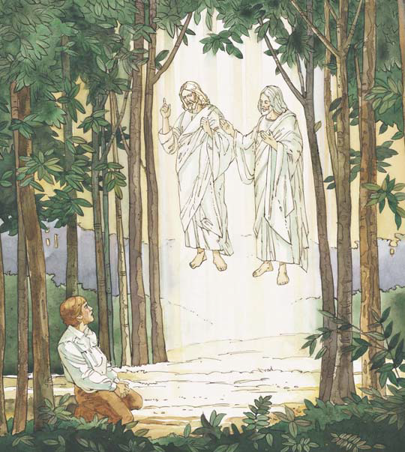
Lesson 1: Joseph Smith and the First Vision

Slide 2
PURPOSE
To strengthen each child’s testimony that the Prophet Joseph Smith saw Heavenly Father and his Son, Jesus Christ.

Slide 3
Joseph Smith’s First Prayer
1. Oh, how lovely was the morning!
Radiant beamed the sun above.
Bees were humming, sweet birds singing,
Music ringing thru the grove,
When within the shady woodland
Joseph sought the God of love,
When within the shady woodland
Joseph sought the God of love.
2. Humbly kneeling, sweet appealing—
’Twas the boy’s first uttered prayer—
When the pow’rs of sin assailing
Filled his soul with deep despair;
But undaunted, still he trusted
In his Heav’nly Father’s care;
But undaunted, still he trusted
In his Heav’nly Father’s care.

Slide 4
3. Suddenly a light descended,
Brighter far than noonday sun,
And a shining, glorious pillar
O’er him fell, around him shone,
While appeared two heav’nly beings,
God the Father and the Son,
While appeared two heav’nly beings,
God the Father and the Son.
4. “Joseph, this is my Beloved;
Hear him!” Oh, how sweet the word!
Joseph’s humble prayer was answered,
And he listened to the Lord.
Oh, what rapture filled his bosom,
For he saw the living God;
Oh, what rapture filled his bosom,
For he saw the living God.
Text: George Manwaring, 1854–1889
Music: Sylvanus Billings Pond, 1792–1871; adapted by A. C. Smyth, 1840–1909

Slide 5
OUR OPENING PRAYER WILL BE GIVEN BY
(Enter Name Here)

Slide 6
We need a volunteer?
Please step out of the room for a moment, we’ll call you back in when we are ready for you.
Thank you for volunteering.

Slide 7
We want to divide you into two groups/individuals.
We are going to show you two containers, the one on the left is for you (point to group).
The one on the right is for you (point to group).

Slide 9
When our volunteer returns, he is going to be asked to pick one of these containers.
Your job is to convince him to select your container.

Slide 10
Think about why he/she should select your container.
Are you ready?
Invite the volunteer back in.

Slide 11
(To volunteer) We are going to show you two containers.
With the help of the rest of the class, please choose one.

Slide 12
Right Container
Left Container

Slide 13
Why did you choose that container?
How did you feel when the rest of the class was trying to tell you what to do?

Slide 14
When Joseph Smith was fourteen years old, he was confused about a choice he needed to make.
He was trying to decide which church he should join.
Other people tried to help him choose a church, but he only became more confused.
He felt that he needed more information to make a wise decision: he wanted to know which church was true.
Joseph’s situation was similar to that of the child who had to choose between the two containers.
Everyone wanted him to choose their church, but he did not know which church was the right choice.

Slide 15
This is what our lesson is about today.

Slide 16
Lesson 1: Joseph Smith and the First Vision

Slide 17
GO TO THE VIDEO
GO TO THE SLIDES
DISCUSSION TIME

Slide 18
Video 1
Video 2
DISCUSSION TIME

Slide 19
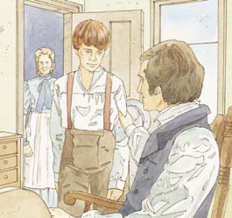
Joseph Smith was born on 23 December 1805.
His family lived in the state of Vermont in the United States of America.
Joseph Smith’s father was also named Joseph.
His mother’s name was Lucy.

Slide 20
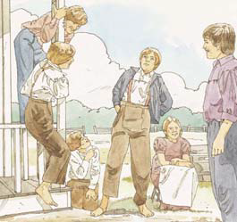
Joseph had five brothers and three sisters.

Slide 21
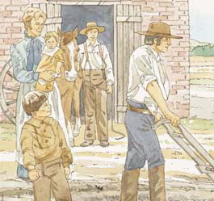
Joseph’s mother and father were good people.
They loved their children and worked hard to take care of them.

Slide 22
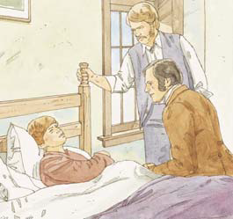
When Joseph was a little boy, he had a very bad sore on his leg.
Doctors tried to make his leg better, but they couldn’t.

Slide 23
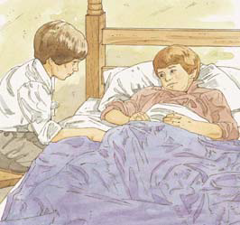
Hyrum Smith was one of Joseph’s older brothers.
He loved Joseph and was sad that Joseph’s leg hurt so much.
He sat by Joseph’s bed and tried to help him feel better.

Slide 24
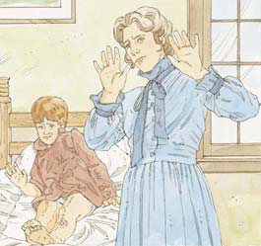
The doctors wanted to cut off Joseph’s leg, but his mother would not let them.
So the doctors decided to cut out part of the bone.
Joseph knew his leg would hurt when the doctors cut it, but he had faith that Heavenly Father would help him.

Slide 25
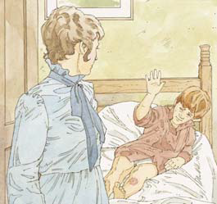
The doctors asked Joseph to drink some wine so the pain would not be so bad.
Joseph would not drink the wine.
Joseph asked his mother to go outside because he didn’t want her to see the doctors cut into his leg.

Slide 26
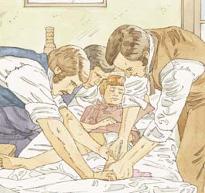
Joseph asked his father to hold him while the doctors cut into his leg.
They cut out the bad parts of the bone.
This hurt very much, but Joseph was brave.
After many days, his leg was better.

Slide 27
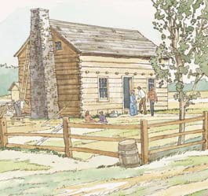
When Joseph was older, his family moved to the state of New York.
They lived in a log house on a farm near Palmyra.

Slide 28
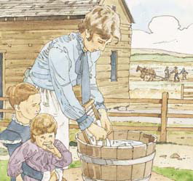
Joseph’s family was poor.
They worked hard to pay for the farm.
The boys helped their father plant crops and take care of the animals.
The girls worked with their mother.

Slide 29
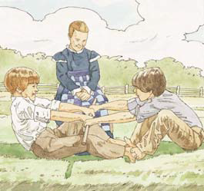
Joseph was a good boy.
He was happy and liked to laugh and have fun.

Slide 30
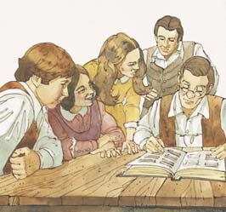
Joseph Smith and his family believed in God.
They read the Bible together.
Joseph’s parents taught their children to be good.

Slide 31
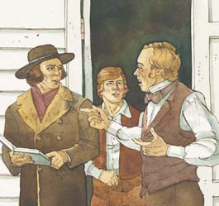
There were many churches where Joseph lived.
All the people disagreed on which church was right.
Joseph didn’t know which church to join.
He wanted to know which was the true Church of Jesus Christ.

Slide 32
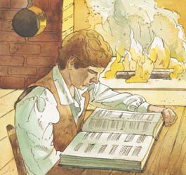
One day when Joseph was 14 years old, he read in the Bible that we should ask God when we want to know something.
Joseph decided to pray and ask God which church to join.

Slide 33
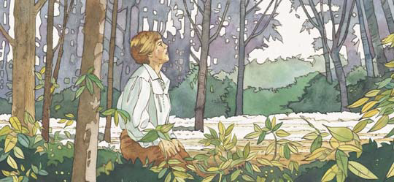
On a beautiful spring day, Joseph went to the woods near his home.
He knelt down and prayed out loud.
He had faith that Heavenly Father would answer his prayer.

Slide 34
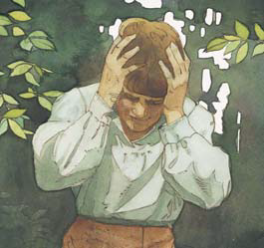
Satan did not want Joseph to pray.
He tried to stop Joseph and made it dark all around him.
Joseph was afraid and could not talk.

Slide 35
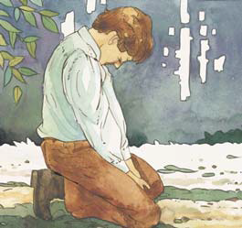
But Joseph did not stop praying.
Satan could not make him stop.

Slide 36
Then Joseph had a vision.
He saw a beautiful, bright light all around him.
He saw Heavenly Father and Jesus Christ standing above him in the air.
Heavenly Father pointed to Jesus and said, “This is My Beloved Son. Hear Him!”

Slide 37
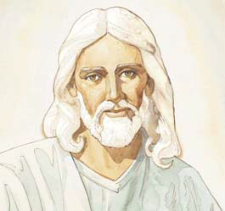
Joseph asked Jesus which church he should join.
Jesus told Joseph not to join any of the churches because they were all wrong.
None of them was His Church.
He told Joseph many other things.
Then the vision ended.

Slide 38
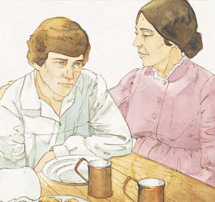
When Joseph went home, his mother asked if he was all right.
Joseph said he was.
Then he told his mother he had seen a vision.
He told her what he learned in his vision.

Slide 39
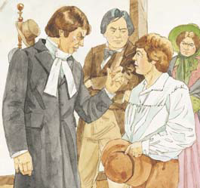
Joseph also told some people in the town about his vision.
The people did not believe him.
They said he was telling a lie, and they became angry and were mean to him.

Slide 40
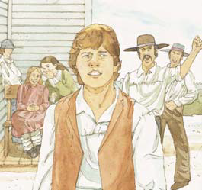
Joseph always told the truth about his vision.
He knew he had seen Heavenly Father and Jesus Christ.
He knew that none of the churches on earth was true.

Slide 41
DISCUSSION TIME

Slide 42
When and where was Joseph Smith born? (JS—H 1:3.)
What were the names of Joseph’s mother and father? (JS—H 1:4.)
How many children were in Joseph’s family? (JS—H 1:4.)
How did Joseph’s parents help prepare him for the work he was to do?

Slide 43
Where did Joseph Smith’s family move after they left Vermont? (JS—H 1:3.)
Although the family moved from Vermont to New York to find a better place to farm, a more
important reason for their move—a reason they did not know about—was so that Joseph could live close to the place where the gold plates were buried.
In what ways might Heavenly Father direct our lives without our knowing about it?

Slide 44
Why was Joseph confused about which church he should join? (JS—H 1:5–10).
How did the scriptures help Joseph decide what to do? (JS—H 1:11–13.)
How have the scriptures helped you make decisions?

Slide 45
Where did Joseph Smith go to pray? (JS—H 1:14.)
Why do you think he wanted a place where he could be alone?
The place where Joseph Smith went to pray is now called “The Sacred Grove.”

Slide 46
Why do you think Satan wanted to stop Joseph from praying?
How does Satan try to stop us from praying or doing what is right?
What can we do when Satan tempts us?

Slide 47
Who appeared to Joseph in the Sacred Grove? (JS—H 1:17.)
What did these personages look like?
What did Heavenly Father say to Joseph?
What did Joseph learn about Heavenly Father and Jesus Christ from this vision?

Slide 48
What did Jesus tell Joseph about which church he should join? (JS—H 1:18–19.)
  Why?
Both of these containers are empty. Neither container was the “right” choice.
Just like none of the churches on the earth in Joseph Smith’s time was the right choice.
Each of these churches had some good teachings, but none of them had the complete truth of the gospel.

Slide 49
How did the “professors of religion” react to Joseph’s vision? (JS—H 1:21–22.)
Why was Joseph surprised by their reactions? (JS—H 1:22–23.)
Explain that persecute means to cause someone to suffer because of what they believe.
Have you ever been persecuted for the things you believe?
What have you done about it?

Slide 50
How was Joseph’s testimony of his first vision affected by the persecution he received? (JS—H 1:25.)
Why is it important that we each have a personal testimony of Joseph Smith’s first vision?

Slide 51
ENRICHMENT ACTIVITIES
T

Slide 52
The following slides are for a crossword puzzle. Make a copy of the puzzle on the Blackboard to play the game.
Take turns trying to answer the questions.
T

Slide 53
5
6
7
T

Slide 54
What We Learn from the First Vision
1. We are made in the image of ________ and Jesus Christ.
2. Heavenly Father’s power is ________ than Satan’s power.
3. ________ is Heavenly Father’s Son.
4. Heavenly Father and Jesus are two ________ personages.
5. Heavenly Father will ________ our sincere prayers.
6. Satan is real and wants to ________ the work of Heavenly Father and Jesus.
7. Jesus told Joseph that no ________ then on the earth was true.
T

Slide 55
T

Slide 56
We need (2) Volunteers.
Would one of the Volunteers please read the follow quotation from Joseph Of. Smith, the sixth President of the Church.
“The greatest event that has ever occurred in the world, since the resurrection of the Son of God from the tomb and his ascension on high, was the coming of the Father and of the Son to that boy Joseph Smith. … Having accepted this truth, I find it easy to accept of every other truth that [Joseph Smith] … declared” (Gospel Doctrine, 5th ed. [Salt Lake City: Deseret Book Co., 1939], pp. 495–96).
T

Slide 57
Would the other volunteers please read the follow quotation from Ezra Taft Benson, thirteenth President of the Church.
“You should always bear testimony to the truth of the First Vision. Joseph Smith did see the Father and the Son. They conversed with him as he said they did” (The Teachings of Ezra Taft Benson [Salt Lake City: Bookcraft, 1988], p. 101).
(Gospel Doctrine, 5th ed. [Salt Lake City: Deseret Book Co., 1939], pp. 495–96).
T

Slide 58
Why is it important to have a testimony of the First Vision?
The First Vision is the foundation of a testimony of the true church of Jesus Christ.
Once we believe that Heavenly Father and Jesus Christ actually appeared and talked to Joseph Smith, then we can be sure that everything else the Prophet taught or restored to us is also the truth.
T

Slide 59
Let’s try to memorize the first article of faith
1 We ªbelieve in ^{b}God, the Eternal Father, and in His ^{c}Son, Jesus Christ, and in the ^{d}Holy Ghost.
Discuss how it testifies of a truth discovered in Joseph Smith’s first vision: that God the Eternal Father and his Son, Jesus Christ, are two separate personages.
T

Slide 60
Try to memorize part of Joseph Smith—History 1:25 (beginning with for I had seen a vision)
. . . For I had seen a vision; I knew it, and I knew that God knew it, and I could not ^{e}deny it, neither dared I do it; at least I knew that by so doing I would offend God, and come under condemnation.
T

Slide 61
Try to memorize James 1:5.
Show the children where the book of James is found in the New Testament (If necessary).
5 ªIf any of you lack ^{b}wisdom, let him ask of God, that ^{c}giveth to all men liberally, and ^{d}upbraideth not; and it shall be given him.
T

Slide 62
What does the phrase “giveth to all men liberally, and upbraideth not” mean.
that generously gives, and holds back nothing.
T

Slide 63
Joseph Smith was chosen before he was born to restore the gospel of Jesus Christ.
Let’s look up and read 2 Nephi 3:14–15.
Joseph of Egypt prophesied that one of his descendants would restore the gospel to the earth.
His name would also be Joseph, and he would be named after his father.
The Prophet Joseph Smith was named after his father.
He was called Joseph Smith Junior. His father was called Joseph Smith Senior.
T

Slide 64
When Joseph Smith received the first vision, he went to a grove of trees on the family farm.
“In 1860 … a boyhood friend of Joseph Smith …
purchased what had been the Smith farm. He later told his son … that he had never touched an ax to the trees in the woodlot on the west end of the farm because Joseph had identified this area as the
T

Slide 65
place where he had beheld his vision. … A century and a half after the First Vision, the ten-acre grove still retains much of its primeval [natural] beauty.
Trees of mature size in Joseph’s day still grace this aged forest. Many are more than 200 years old” (Donald Enders, “The Sacred Grove,” Ensign, Apr. 1990, p. 16)
T

Slide 66
While we know that the area now called the Sacred Grove is where Joseph Smith received his first vision, we do not know the exact location within the grove where Joseph saw the vision.
T

Slide 67
Testimony
I want to bear my testimony of the First Vision and of the Prophet Joseph Smith.
I know he was a true Prophet of our Heavenly Father and through his efforts, the Lord’s church was restored back on earth.
I want to encourage you to pray that your testimony of the First Vision may be strengthened.

Slide 68
OUR CLOSING PRAYER WILL BE GIVEN BY
(Enter Name Here)

Slide 69
THE END

Slide 70
Images and clipart are from lds.org, microsoft office, and other websites indicating the images were in the public domain or permitted for church and home use.
The Lesson and Scripture story are from lds.org.
Please do not use this presentation for commercial use. Feel free to alter the presentation for use in church or home to suit personal preference.
This presentation is intended to supplement, not replace, the lesson manual and scriptures.
Teachers should refer to the manual, scriptures and other resources when preparing and conducting the lesson.

Slide 71
JS—H 1:3
3 ªI was born in the year of our Lord one thousand eight hundred and five, on the twenty-third day of December, in the town of Sharon, Windsor county, State of Vermont … My father, ^{b}Joseph Smith, Sen., left the State of Vermont, and moved to Palmyra, Ontario (now Wayne) county, in the State of New York, when I was in my tenth year, or thereabouts. In about four years after my father’s arrival in Palmyra, he moved with his family into Manchester in the same county of Ontario—
Return

Slide 72
JS—H 1:4
4 His family consisting of eleven souls, namely, my father, Joseph Smith; my ªmother, Lucy Smith (whose name, previous to her marriage, was Mack, daughter of Solomon Mack); my brothers, ^{b}Alvin (who died November 19th, 1823, in the 26th year of his age), ^{c}Hyrum, myself, ^{d}Samuel Harrison, William, Don Carlos; and my sisters, Sophronia, Catherine, and Lucy.
Return

Slide 73
JS—H 1:4
4 His family consisting of eleven souls, namely, my father, Joseph Smith; my ªmother, Lucy Smith (whose name, previous to her marriage, was Mack, daughter of Solomon Mack); my brothers, ^{b}Alvin (who died November 19th, 1823, in the 26th year of his age), ^{c}Hyrum, myself, ^{d}Samuel Harrison, William, Don Carlos; and my sisters, Sophronia, Catherine, and Lucy.
Return

Slide 74
JS—H 1:3
3 ªI was born in the year of our Lord one thousand eight hundred and five, on the twenty-third day of December, in the town of Sharon, Windsor county, State of Vermont … My father, ^{b}Joseph Smith, Sen., left the State of Vermont, and moved to Palmyra, Ontario (now Wayne) county, in the State of New York, when I was in my tenth year, or thereabouts. In about four years after my father’s arrival in Palmyra, he moved with his family into Manchester in the same county of Ontario—
Return

Slide 75
JS—H 1:5–10
5 Some time in the second year after our removal to Manchester, there was in the place where we lived an unusual excitement on the subject of religion. It commenced with the Methodists, but soon became general among all the sects in that region of country. Indeed, the whole district of country seemed affected by it, and great multitudes united themselves to the different religious parties, which created no small stir and division amongst the people, some crying, ª“Lo, here!” and others, “Lo, there!” Some were contending for the Methodist faith, some for the Presbyterian, and some for the Baptist.

Slide 76
JS—H 1:5–10
6 For, notwithstanding the great ªlove which the converts to these different faiths expressed at the time of their conversion, and the great zeal manifested by the respective clergy, who were active in getting up and promoting this extraordinary scene of religious feeling, in order to have everybody converted, as they were pleased to call it, let them join what sect they pleased; yet when the converts began to file off, some to one party and some to another, it was seen that the seemingly good feelings of both the priests and the converts were more ^{b}pretended than real; for a scene of great confusion and bad feeling ensued—priest contending against priest, and convert against convert; so that all their good feelings one for another, if they ever had any, were entirely lost in a strife of words and a contest about opinions.

Slide 77
JS—H 1:5–10
7 I was at this time in my fifteenth year. My father’s family was proselyted to the Presbyterian faith, and four of them joined that church, namely, my mother, Lucy; my brothers Hyrum and Samuel Harrison; and my sister Sophronia.
8 During this time of great excitement my mind was called up to serious reflection and great uneasiness; but though my feelings were deep and often poignant, still I kept myself aloof from all these parties, though I attended their several meetings as often as occasion would permit. In process of time my mind became somewhat partial to the Methodist sect, and I felt some desire to be united with them; but so great were the confusion and ªstrife among the different denominations, that it was impossible for a person young as I was, and so unacquainted with men and things, to come to any certain conclusion who was ^{b}right and who was wrong.

Slide 78
JS—H 1:5–10
9 My mind at times was greatly excited, the cry and tumult were so great and incessant. The Presbyterians were most decided against the Baptists and Methodists, and used all the powers of both reason and sophistry to prove their errors, or, at least, to make the people think they were in error. On the other hand, the Baptists and Methodists in their turn were equally zealous in endeavoring to establish their own tenets and disprove all others.
10 In the midst of this war of words and tumult of opinions, I often said to myself: What is to be done? Who of all these parties are right; or, are they all wrong together? If any one of them be ªright, which is it, and how shall I know it?
Return

Slide 79
JS—H 1:11–13
11 While I was laboring under the extreme difficulties caused by the contests of these parties of religionists, I was one day reading the Epistle of ªJames, first chapter and fifth verse, which reads: If any of you lack ^{b}wisdom, let him ask of God, that giveth to all men liberally, and upbraideth not; and it shall be given him.
12 Never did any passage of ªscripture come with more power to the heart of man than this did at this time to mine. It seemed to enter with great force into every feeling of my heart. I reflected on it again and again, knowing that if any person needed ^{b}wisdom from God, I did; for how to act I did not know, and unless I could get

Slide 80
JS—H 1:11–13
more wisdom than I then had, I would never know; for the teachers of religion of the different sects ^{c}understood the same passages of scripture so differently as to destroy all confidence in settling the question by an appeal to the Bible.
13 At length I came to the conclusion that I must either remain in ªdarkness and confusion, or else I must do as James directs, that is, ask of God. I at length came to the determination to “ask of God,” concluding that if he gave wisdom to them that lacked wisdom, and would ^{b}give liberally, and not upbraid, I might venture.
Return

Slide 81
JS—H 1:14
14 So, in accordance with this, my determination to ask of God, I retired to the ªwoods to make the attempt. It was on the morning of a ^{b}beautiful, clear day, early in the spring of eighteen hundred and twenty. It was the first time in my life that I had made such an attempt, for amidst all my anxieties I had never as yet made the attempt to ^{c}pray ^{d}vocally.
Return

Slide 82
JS—H 1:15
15 After I had retired to the place where I had previously designed to go, having looked around me, and finding myself alone, I kneeled down and began to offer up the desires of my heart to God. I had scarcely done so, when immediately I was ªseized upon by some power which entirely overcame me, and had such an astonishing influence over me as to bind my tongue so that I could not speak. Thick ^{b}darkness gathered around me, and it seemed to me for a time as if I were doomed to sudden destruction.
Return

Slide 83
JS—H 1:16
16 But, exerting all my powers to ªcall upon God to deliver me out of the power of this enemy which had seized upon me, and at the very moment when I was ready to sink into ^{b}despair and abandon myself to destruction—not to an imaginary ruin, but to the power of some actual being from the unseen world, who had such marvelous power as I had never before felt in any being—just at this moment of great alarm, I saw a pillar of ^{c}light exactly over my head, above the brightness of the ^{d}sun, which descended gradually until it fell upon me.
Return

Slide 84
JS—H 1:17
17 It no sooner appeared than I found myself ªdelivered from the enemy which held me bound. When the light rested upon me I ^{b}saw two ^{c}Personages, whose brightness and ^{d}glory defy all description, ^{e}standing above me in the air. One of them spake unto me, calling me by name and said, pointing to the other—This is My ^{f}Beloved ^{g}Son. Hear Him!
Return

Slide 85
JS—H 1:17
17 It no sooner appeared than I found myself ªdelivered from the enemy which held me bound. When the light rested upon me I ^{b}saw two ^{c}Personages, whose brightness and ^{d}glory defy all description, ^{e}standing above me in the air. One of them spake unto me, calling me by name and said, pointing to the other—This is My ^{f}Beloved ^{g}Son. Hear Him!
Return

Slide 86
JS—H 1:18–19
18 My object in going to ªinquire of the Lord was to know which of all the sects was right, that I might know which to join. No sooner, therefore, did I get possession of myself, so as to be able to speak, than I asked the Personages who stood above me in the light, which of all the sects was right (for at this time it had never entered into my heart that all were wrong)—and which I should join.
19 I was answered that I must join none of them, for they were all ªwrong; and the Personage who addressed me said that all their creeds were an abomination in his sight; that those ^{b}professors were all ^{c}corrupt; that: “they ^{d}draw near to me with their lips, but their ^{e}hearts are far from me, they teach for doctrines the ^{f}commandments of men, having a form of godliness, but they deny the ^{g}power thereof.”
Return

Slide 87
JS—H 1:21–22
21 Some few days after I had this vision, I happened to be in company with one of the Methodist preachers, who was very active in the before mentioned religious excitement; and, conversing with him on the subject of religion, I took occasion to give him an account of the vision which I had had. I was greatly surprised at his behavior; he treated my communication not only lightly, but with great contempt, saying it was all of the devil, that there were no such things

Slide 88
ªvisions or ^{b}revelations in these days; that all such things had ceased with the apostles, and that there would never be any more of them.
22 I soon found, however, that my telling the story had excited a great deal of prejudice against me among professors of religion, and was the cause of great ªpersecution, which continued to increase; and though I was an ^{b}obscure boy, only between fourteen and fifteen years of age, and my circumstances in life such as to make a boy of

Slide 89
JS—H 1:21–22
consequence in the world, yet men of high standing would take notice sufficient to excite the public mind against me, and create a bitter persecution; and this was common among all the sects—all united to persecute me.
Return

Slide 90
JS—H 1:22–23
22 I soon found, however, that my telling the story had excited a great deal of prejudice against me among professors of religion, and was the cause of great ªpersecution, which continued to increase; and though I was an ^{b}obscure boy, only between fourteen and fifteen years of age, and my circumstances in life such as to make a boy of no consequence in the world, yet men of high standing would take notice sufficient to excite the public mind against me, and create

Slide 91
a bitter persecution; and this was common among all the sects—all united to persecute me.
23 It caused me serious reflection then, and often has since, how very strange it was that an obscure ªboy, of a little over fourteen years of age, and one, too, who was doomed to the necessity of obtaining a scanty maintenance by his daily ^{b}labor, should be thought a character of sufficient importance to attract the attention of the great ones of the most popular sects of the

Slide 92
day, and in a manner to create in them a spirit of the most bitter ^{c}persecution and ^{d}reviling. But strange or not, so it was, and it was often the cause of great sorrow to myself.
Return

Slide 93
JS—H 1:25
25 So it was with me. I had actually seen a light, and in the midst of that light I saw two ªPersonages, and they did in reality speak to me; and though I was ^{b}hated and ^{c}persecuted for saying that I had seen a vision, yet it was true; and while they were persecuting me, reviling me, and speaking all manner of evil against me ^{d}falsely for so saying, I was led to say in my heart: Why persecute me for telling the truth? I have actually seen a vision; and who am I that I can withstand God, or why does the world think to

Slide 94
make me deny what I have actually seen? For I had seen a vision; I knew it, and I knew that God knew it, and I could not ^{e}deny it, neither dared I do it; at least I knew that by so doing I would offend God, and come under condemnation.
Return

Slide 95
2 Nephi 3:14–15
14 And thus prophesied Joseph, saying: Behold, that seer will the Lord bless; and they that seek to destroy him shall be confounded; for this promise, which I have obtained of the Lord, of the fruit of my loins, shall be fulfilled. Behold, I am sure of the fulfilling of this promise;
15 And his ªname shall be called after me; and it shall be after the ^{b}name of his father. And he shall be ^{c}like unto me; for the thing, which the Lord shall bring forth by his hand, by the power of the Lord shall bring ^{d}my people unto ^{e}salvation.
Return

Slide 96
Return

Slide 97
Return

Slide 98
Return

Slide 99
Return

Slide 100
Return

Slide 101
Return

Slide 102
FACES

