Slide 1
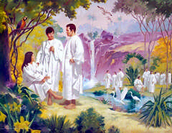
LESSON 3: The Commandments Help Us Choose the Right

Slide 2
PURPOSE
To help each child understand that Heavenly Father gave us commandments to help us make right choices.

Slide 3
OUR OPENING PRAYER WILL BE GIVEN BY
(Enter Name Here)

Slide 4
Where going on a Treasure Hunt
Follow the clues, signs and hints to see if you can find the treasure.

Slide 5
I want you to imagine you are going to someone’s house to pick up some important papers to bring back with you.
This person’s house is far away and no one can go with you to help you find your way.
What would help you find your way to the house?

Slide 6
If the path was marked with signs or arrows, could you find your way?
When Heavenly Father sent us to earth, he sent us on an important errand.
He wants us to find our way back to him.

Slide 7
Where did we live before we were born?
  With Heavenly Father.

Slide 8
Why did we leave Heavenly Father to come to earth?
  We left Heavenly Father so we could receive bodies, have experiences, and learn to choose the right.

Slide 9
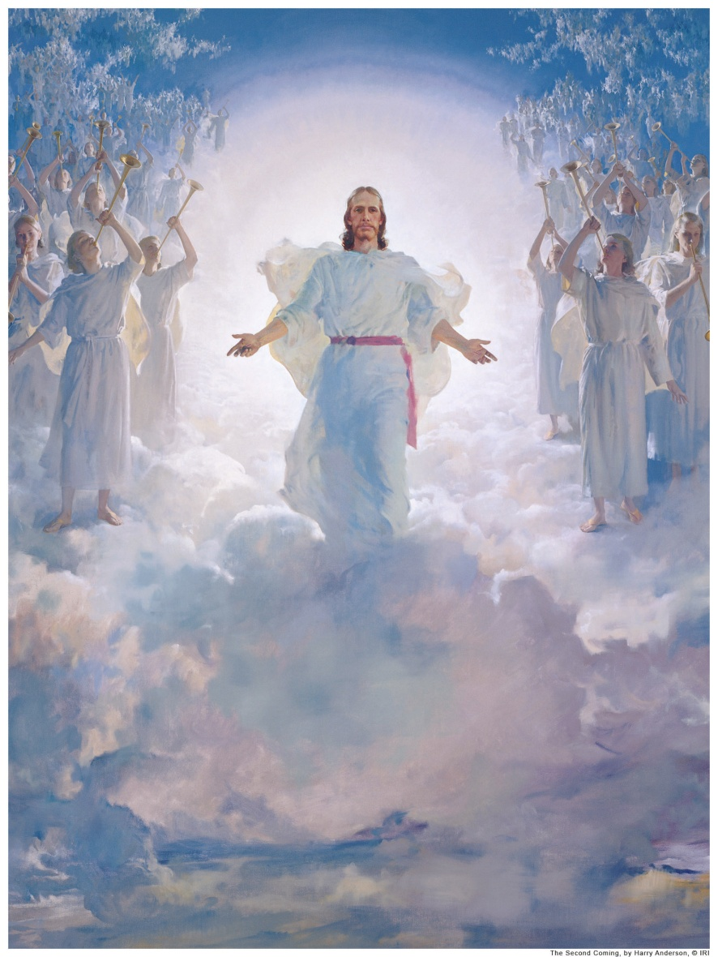
Heavenly Father planned for us to leave him and live on this earth, he wanted all of us to return and live with him again..

Slide 10
He knew that we would have to make right choices in order to return to him and that choosing the right would make us happy.

Slide 11
He gave us commandments to help us make the right choices.
What are commandments?
  Things Heavenly Father has told us to do.

Slide 12
What are some of the commandments?
Explain that the commandments are like road signs to help us find our way.

Slide 13
They show us the right path to follow to return to Heavenly Father

Slide 14
Let’s all sing the song
“Keep the Commandments”

Slide 15
Keep the Commandments
Keep the commandments; keep the commandments!
In this there is safety; in this there is peace.
He will send blessings;
He will send blessings.
Words of a prophet:
Keep the commandments.
In this there is safety and peace.
2. We are His children; we are His children,
and we must be tested to show we are true.
Hold to His promises;
Hold to His promises,
Heeding the prophets:
Keep the commandments.
In this there is safety and peace.
Words and music: Barbara A. McConochie, b. 1940. (c) 1975 IRI. Obbligato by Barbara A. McConochie (c) 1989 IRI. Arr. by Darwin Wolford (c) 1986, 1989 Deseret Book Company. Used by permission.

Slide 16
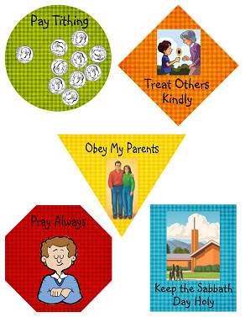
Commandment Road Signs
These are some of the commandments that we should be doing daily.
Click on the number to see the related scripture.
1
2
3
4
5

Slide 17
Commandment Road Signs
We will show you a situation.
Your job is to decide which commandment on a road sign will help them choose the right
1
2
3
4
5

Slide 18
Commandment Road Signs
1. You are walking home from a friend’s house when another friend sees you.
He asks you to come to his house to play.
But your mother had asked you to come straight home, and you promised you would.
1
2
3
4
5

Slide 19
Commandment Road Signs
Your friend tells you that it won’t hurt to be a little late getting home.
What commandment would help you choose the right?
1
2
3
4
5

Slide 20
Commandment Road Signs
2. You have been earning money to buy a ball by doing extra chores for your parents.
The store has the ball on sale, but you still don’t have enough money unless you borrow from your tithing
1
2
3
4
5

Slide 21
Commandment Road Signs
Which commandment would help you choose the right?
1
2
3
4
5

Slide 22
Commandment Road Signs
3. It’s late and your family has just returned home.
You are tired and want to go to bed.
Then you remember that your family forgot to pray before everyone went off to bed.
1
2
3
4
5

Slide 23
Commandment Road Signs
1
2
What commandment will help you choose the right?
3
4
5

Slide 24
Commandment Road Signs
4. Your best friend invites you to go to a movie on Sunday.
You have wanted to see that movie for a long time.
What commandment would help you choose the right?
1
2
3
4
5

Slide 25
Commandment Road Signs
5. You are playing with your friends.
A boy who has called you names comes along and wants to play too.
What commandment would help you choose the right?
1
2
3
4
5

Slide 26
Commandment Road Signs
6. You are with some friends and some of them want you to take a drink of some alcohol that one of them brought from home.
Your parents have taught you that drinking alcohol is wrong.
1
2
3
4
5

Slide 27
Commandment Road Signs
6. You are with some friends and some of them want you to take a drink of some alcohol that one of them brought from home.
Your parents have taught you that drinking alcohol is wrong.
What commandment would help you choose the right?
1
2
3
4
5

Slide 28
Congratulations on making the right choices and knowing what commandments to follow.

Slide 29

When We Choose the Right, We Feel Good
When you choose the right can give them a good feeling.
Let’s look at the first two situations from
1. How do you think you would feel if you went home as your mother asked instead of going to play with your friend?

Slide 30

When We Choose the Right, We Feel Good
  You might have fun playing with your friend.
  But even while you were playing, you might have an unhappy feeling about having broken your promise to your mother.

Slide 31
When We Choose the Right, We Feel Good
  Even if it is hard to choose the right and to do what Jesus Christ has asked you to do, if you do it anyway, you will feel good inside.
  You will feel good about yourself for the choice you make.

Slide 32

When We Choose the Right, We Feel Good
2. How do you think you would feel if you bought a new ball by using some of your tithing money? Would you feel good when you were playing with the ball

Slide 33
When We Choose the Right, We Feel Good
  You might have fun playing with your friends, but you would not feel good about yourself because you did not choose to pay your tithing as Heavenly Father commanded.

Slide 34
If we reviewed the other situations in the same way, you would see that the good feeling that you have inside when they obey a commandment of the Lord—especially when it seems hard to do.

Slide 35
That good feeling is the Holy Ghost telling them that Heavenly Father is pleased with their actions.

Slide 36

When you make a wrong choice, You could be left with an empty, unhappy feeling.
This feeling could also be the Holy Ghost telling us to repent and make the right choice.

Slide 37
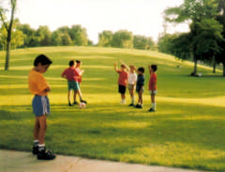
Listen to the following story and see how choosing the right made Julio feel:

Slide 38
When Julio’s Aunt María gave him a soccer ball, he could hardly believe it was his
. He knew that his Aunt María didn’t have much money. But Julio knew that she would feel badly if he didn’t take the ball..)

Slide 39
“Thank you,” he said softly. “But why are you giving it to me?”
“Because you help me so much,” Aunt María said. “You run errands for me and help me clean my yard. All I ask is that you always remember why it is yours. Now go play.”

Slide 40
As Julio kicked the ball down the sidewalk in front of himself, he wondered about what Aunt
María had said. “Remember why it is yours,” she had said.
Julio loved to play soccer, and he was good. Someday he hoped to play for the national team of Brazil.

Slide 41
Aunt María knows that, he thought. Maybe that’s why she gave me the ball
Soon, Antonio came out to play with Julio. Before long, other boys joined them, and soon there were enough to start a soccer game.

Slide 42
Julio saw a younger boy watching the soccer game from the sidewalk.
“Oh, no,” Antonio whispered to Julio. “Paulo is coming. Don’t let him play! He always messes up the game. We’ll lose if he plays!”

Slide 43
It was true that Paulo was not a good player.
But Julio knew how much Paulo liked to play.
“Can I play?” Paulo asked hopefully

Slide 44
What would you say?
Julio didn’t answer right away.
He looked for a second at Aunt María’s window, and he could see her there watching him. She looked concerned as she waited for Julio’s answer.

Slide 45
“Remember why it is yours.” Her words came to Julio’s mind
Once more he looked at Aunt María. He had shared his time and efforts to help her, and he wondered if she were trying to tell him to keep sharing.

Slide 46
Antonio looked at Julio and smiled. “Sure, I’d be happy to!
We’ll all teach you to be a great soccer player,” he said to Paulo. “All of us would be glad to help you learn.”

Slide 47
All of the boys began to play again. Julio looked up at Aunt María’s window.
Aunt María was smiling. Then Julio knew why his aunt had given him a new soccer ball. (Adapted from Sherrie Johnson, “The Soccer Ball,” Friend, June 1973, pp. 10–12.)

Slide 48
How did Julio feel after he chose to share?
  He felt happy and good inside
What might have happened if he had not shared?
  He might have felt bad for turning Paulo away; Paulo would have felt bad too.

Slide 49
Did Julio do what Heavenly Father and Jesus Christ wanted him to do?
We will make many choices during our lifetimes.
These choices will make us feel either good or bad.
Choosing to obey the commandments will always make us feel good.

Slide 50

Your CTR Ring can help you to remember to choose the right.

Slide 51
Making the right choices isn’t always easy and that sometimes we may go the wrong way.
Heavenly Father’s commandments can help us find the right way to go and give us a good feeling so that we know we are making right choices.

Slide 52
They will help us to return to our Heavenly Father. We will be glad about our choices if we choose the right.

Slide 53
ENRICHMENT ACTIVITIES

Slide 54
On the following slides is the story of Lehi’s Dream to share with the class.

Slide 55
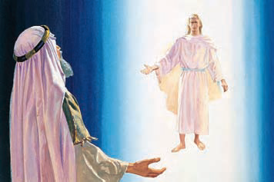
In his dream Lehi saw a man wearing a white robe who told Lehi to follow him.
Lehi followed the man into a dark and dreary wilderness.

Slide 56
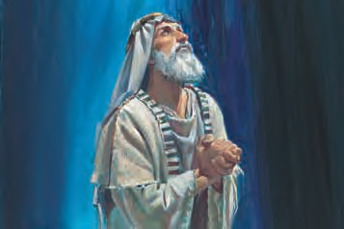
After traveling in the darkness for many hours, Lehi prayed for help.

Slide 57
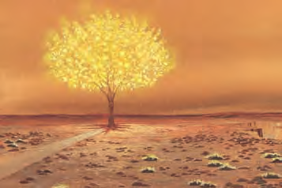
Then he saw a tree with white fruit. This sweet fruit made those who ate it happy.

Slide 58
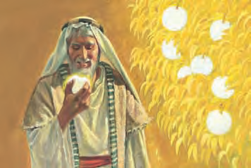
Lehi ate the fruit, and it filled him with joy.
He wanted his family to taste the fruit because he knew it would make them happy too.

Slide 59
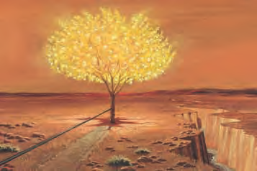
Lehi saw a rod of iron and a strait and narrow path leading to the tree.

Slide 60
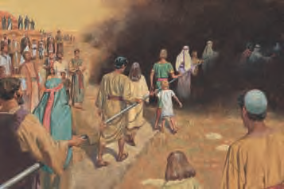
He saw many people walking on or toward the path.
Because of a mist of darkness, some wandered off the path and became lost.

Slide 61
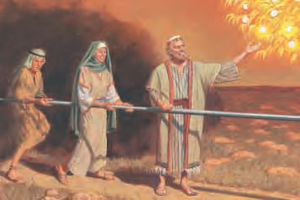
Others held tightly to the iron rod and made it through the darkness to the tree.
They tasted the fruit.

Slide 62
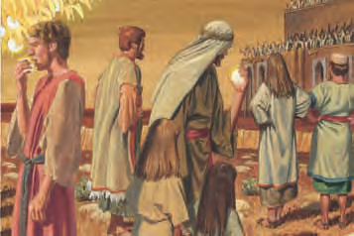
People in a large building on the other side of the river made fun of those who ate the fruit.
Some who had eaten the fruit became ashamed and left the tree.

Slide 63
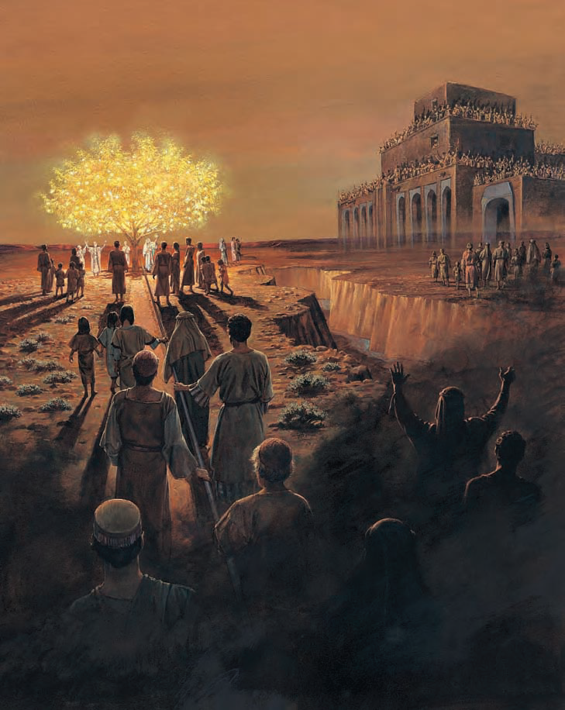
Lehi saw many people in his dream.
Some held firmly to the iron rod and traveled through the darkness to the tree.
They tasted the fruit.
Others went to the large building or drowned in the river or became lost.

Slide 64
Laman and Lemuel would not eat the fruit.
Lehi worried about them and tried to help them obey God’s commandments.

Slide 65
The Iron Rod Represents the word of God.
The tree of life represents the Love of God.
God’s commandments help us to feel his love.

Slide 66
Hidden behind the 9 puzzle pieces that follows is a very important message.
Each time you name a commandment that you can obey because your parents or another adult has taught them, we will remove a piece (in number order).

Slide 67
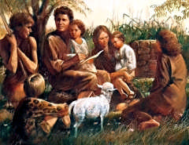
1
4
7
6
9
2
3
8
5

Slide 68
4
7
6
9
2
3
8
5

Slide 69
4
7
6
9
3
8
5

Slide 70
4
7
6
9
8
5

Slide 71
7
6
9
8
5

Slide 72
7
6
9
8

Slide 73
7
9
8

Slide 74
9
8

Slide 75
9

Slide 76
Adam and Eve teaching their children

Slide 77
How have parents, teachers, and other Leaders helped you to learn to obey the commandments?

Slide 78
Testimony
I testify to you of the importance of reading the Book of Mormon.
Reading the Book of Mormon will help you to always choose the right.

Slide 79
OUR CLOSING PRAYER WILL BE GIVEN BY
(Enter Name Here)

Slide 80
THE END

Slide 81
Images and clipart are from lds.org, microsoft office, and other websites indicating the images were in the public domain or permitted for church and home use.
The Lesson and Scripture story are from lds.org.
Please do not use this presentation for commercial use. Feel free to alter the presentation for use in church or home to suit personal preference.
This presentation is intended to supplement, not replace, the lesson manual and scriptures.
Teachers should refer to the manual, scriptures and other resources when preparing and conducting the lesson.

Slide 82
3 Nephi 24:10
10 Bring ye all the ªtithes into the storehouse, that there may be ^{b}meat in my house; and prove me now herewith, saith the Lord of Hosts, if I will not open you the ^{c}windows of heaven, and pour you out a ^{d}blessing that there shall not be room enough to receive it.
Return

Slide 83
Mosiah 13:20
20 ªHonor thy ^{b}father and thy mother, that thy days may be long upon the land which the Lord thy God giveth thee.
Return

Slide 84
2 Nephi 32:9
9 But behold, I say unto you that ye must ªpray always, and not faint; that ye must not perform any thing unto the Lord save in the first place ye shall ^{b}pray unto the Father in the ^{c}name of Christ, that he will ^{d}consecrate thy performance unto thee, that thy performance may be for the ^{e}welfare of thy soul.
Return

Slide 85
Mosiah 13:16
16 Remember the ªsabbath day, to keep it holy.
Return

Slide 86
3 Nephi 12:44
44 But behold I say unto you, love your ªenemies, bless them that curse you, do ^{b}good to them that hate you, and ^{c}pray for them who despitefully use you and persecute you;
Return

