Slide 1
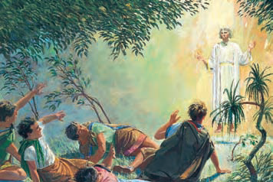
Lesson 22: The Atonement of Jesus Christ
“LESSON 22: THE ATONEMENT OF JESUS CHRIST,” PRIMARY 3: CHOOSE THE RIGHT B, (1994),103

Slide 2
Purpose
To help the children realize that people can repent because Jesus Christ atoned for our sins.

Slide 3
Dare to Do Right
1. Dare to do right! Dare to be true!
You have a work that no other can do;
Do it so bravely, so kindly, so well,
Angels will hasten the story to tell.
Chorus
Dare, dare, dare to do right;
Dare, dare, dare to be true,
Dare to be true, dare to be true.
2. Dare to do right! Dare to be true!
Other men’s failures can never save you.
Stand by your conscience, your honor, your faith;
Stand like a hero and battle till death.
Words: George L. Taylor, b. 1835
Music: Arr. by A. C. Smyth, 1840–1909

Slide 4
OUR OPENING PRAYER WILL BE GIVEN BY
(Enter Name Here)

Slide 5
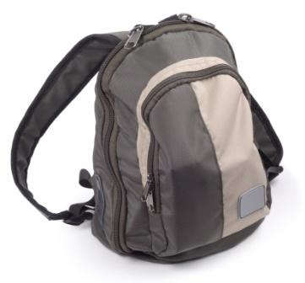
I have a backpack here that I need someone to lift.
It’s a little heavy…

Slide 6
Does anyone else want to lift the backpack?

Slide 7
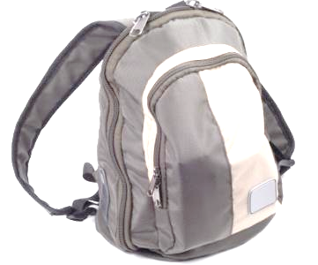
Let’s take each object out, one at a time, to see what is inside.
Each of these represents a sin.

Slide 8
When all the “sins” are removed, the “burden,” or heavy load, becomes light.

Slide 9
Listen to this story about Josh and the heavy load he made for himself and how he lightened his load.

Slide 10
While Josh and his mother were shopping, Josh had taken something from the store without paying for it.
Josh knew he had done the wrong thing.
He had just been baptized and knew that he should have chosen the right.

Slide 11
How did Josh felt about what he had stolen.
Would someone like to pretend to be Josh.
Try putting the full backpack over your shoulder.
Josh did not feel good about stealing.
It was like a heavy weight inside that kept him from being completely happy.

Slide 12
How could Josh become happier?

Slide 13
How could Josh become happier?
      By repenting.

Slide 14
How could Josh become happier?
      By repenting.
What can Josh do to correct his wrong choice?

Slide 15
How could Josh become happier?
      By repenting.
What can Josh do to correct his wrong choice?
      Repent.

Slide 16
Repentance
Do you remember a few weeks ago we learned about the steps to repentance?
Feel Sorry
Ask Forgiveness
Right the Wrong
Don’t repeat the wrong

Slide 17
Repentance
What can Josh do to repent?
Feel Sorry
Ask Forgiveness
Right the Wrong
Don’t repeat the wrong

Slide 18
Repentance
What can Josh do to repent?
      Take back what he had stolen
Feel Sorry
Ask Forgiveness
Right the Wrong
Don’t repeat the wrong

Slide 19
Repentance
What can Josh do to repent?
      Take back what he had stolen
      Pay for what he had stolen
Feel Sorry
Ask Forgiveness
Right the Wrong
Don’t repeat the wrong

Slide 20
Repentance
What can Josh do to repent?
      Take back what he had stolen
      Pay for what he had stolen
      Apologize to the storekeeper
Feel Sorry
Ask Forgiveness
Right the Wrong
Don’t repeat the wrong

Slide 21
Repentance
What can Josh do to repent?
      Take back what he had stolen
      Pay for what he had stolen
      Apologize to the storekeeper
      Offer to do something for the storekeeper to make up for the wrong
Feel Sorry
Ask Forgiveness
Right the Wrong
Don’t repeat the wrong

Slide 22
Repentance
When we repent, we free ourselves from heavy, sad feelings, and we are happier.
The opportunity to repent and be forgiven is a wonderful blessing.
Feel Sorry
Ask Forgiveness
Right the Wrong
Don’t repeat the wrong

Slide 23
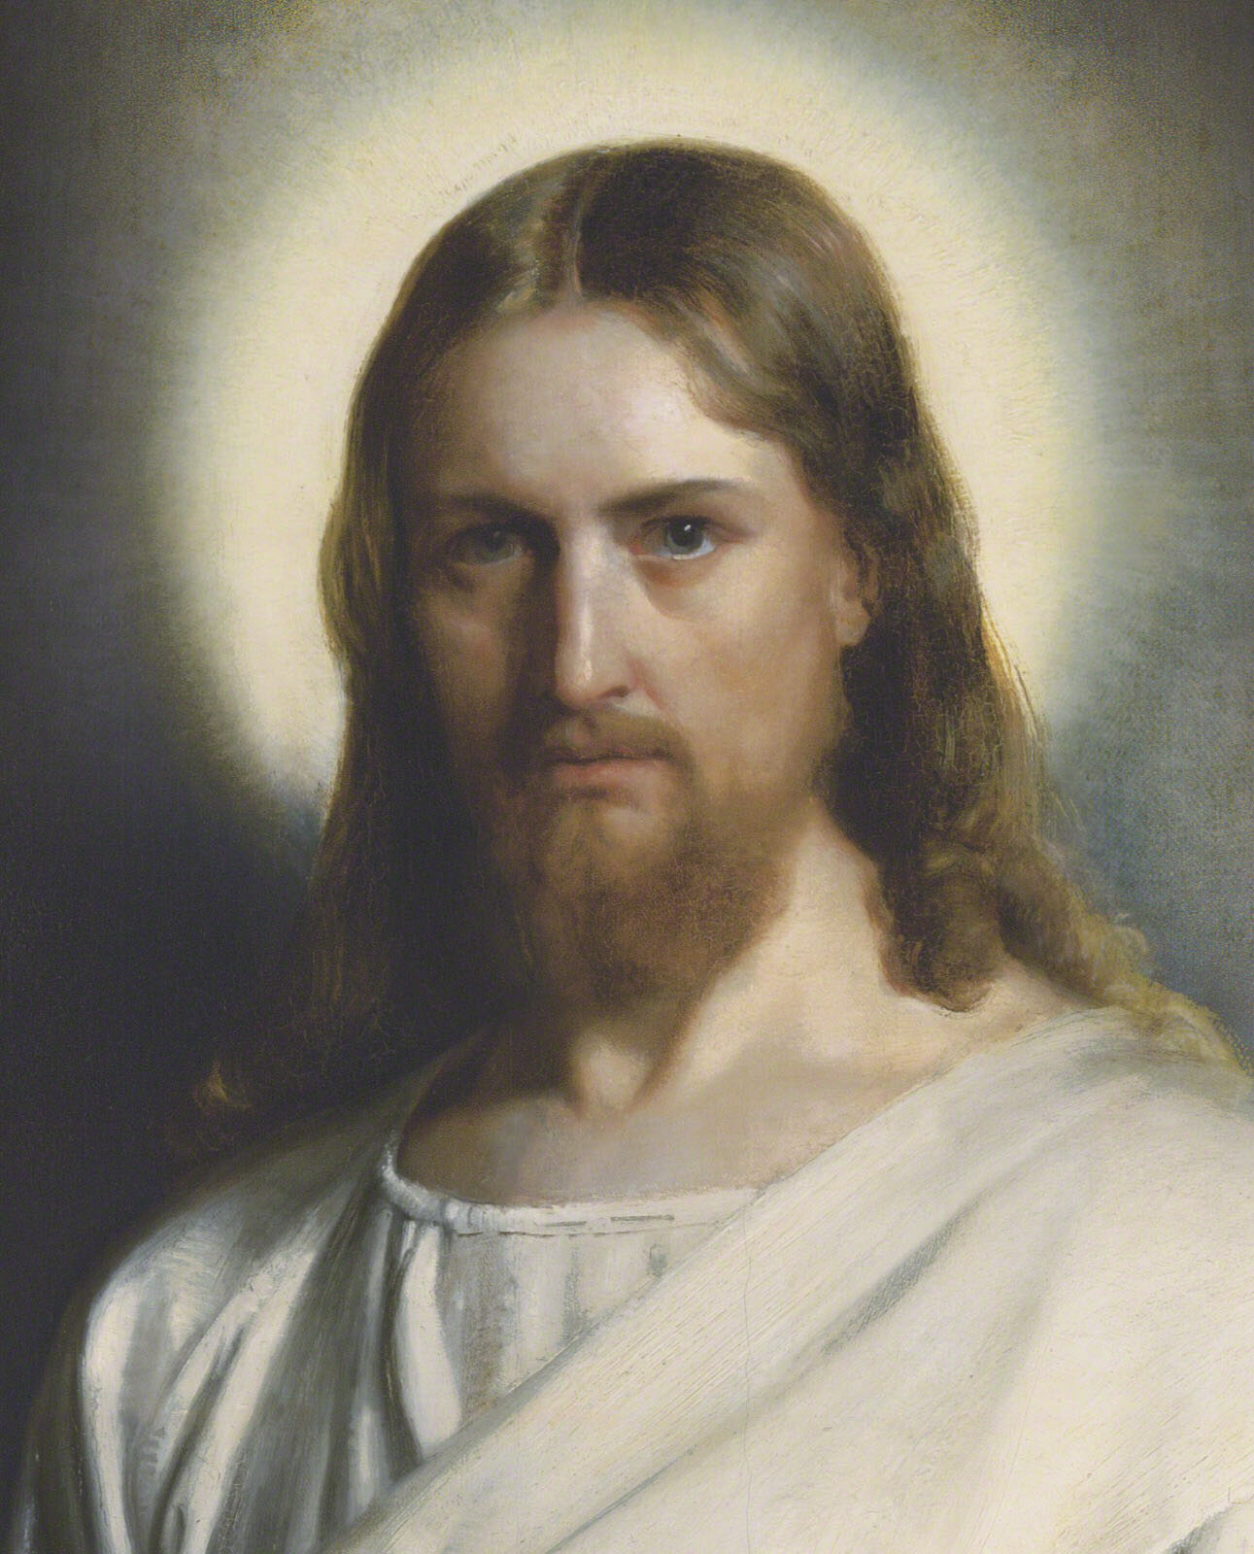
The Savior made it possible for people to be forgiven.

Slide 24
The Savior made it possible for people to be forgiven.

Slide 25
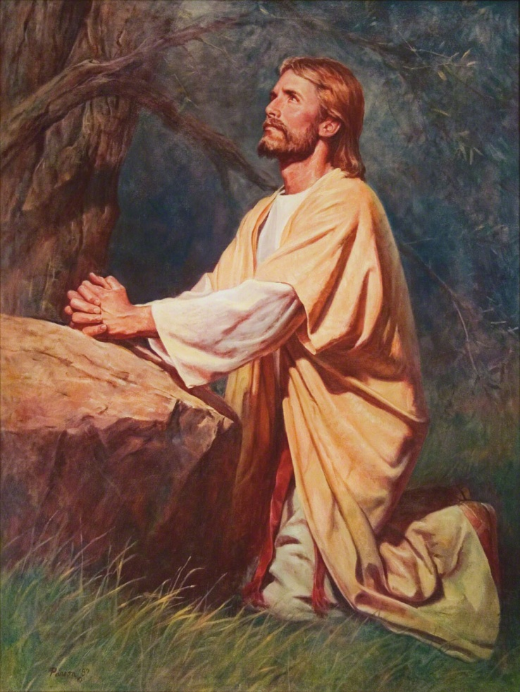
Shortly before Jesus Christ died on the cross, he and his Apostles went to a garden called Gethsemane.
Three of the Apostles—Peter, James, and John—went into the garden with him
They waited a short distance away while Jesus went farther into the garden and prayed to Heavenly Father.
Jesus knew that he would have to suffer for us so that we could repent and be forgiven of our sins.

Slide 26
In the Garden of Gethsemane and on the cross, Jesus suffered great pain for us.
He suffered for our sins, or the wrong things we do.

Slide 27
ATONEMENT
The Atonement means that Jesus Christ paid the price for our sins so that we could repent and be forgiven.
He did this because he loves us and because he wanted to make it possible for us to repent and be clean.
We say that he atoned for our sins and wrong choices.
Can you say the word Atonement.

Slide 28
Atonement
Heavenly Father loves us, too, and wants each one of us to repent and live with him again.
Because of the atonement of Jesus Christ, we can be forgiven for sins and wrong choices we make after the age of eight.

Slide 29
Go to Video
Go to Slides
Continue

Slide 30
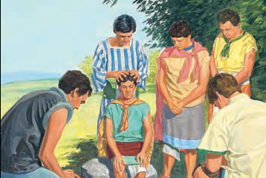
King Mosiah made Alma the leader of the Church in Zarahemla.
Alma then chose other men to help him teach the Nephites.

Slide 31
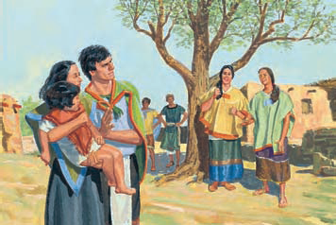
Alma and King Mosiah worried because unbelievers were making Church members suffer because of their beliefs.

Slide 32
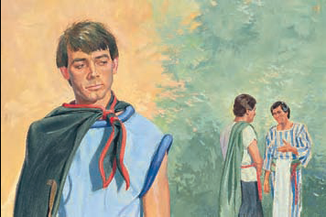
Alma had a son named Alma.
Alma the Younger did not believe the teachings of his father and became a wicked man.

Slide 33
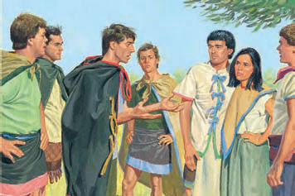
Alma the Younger and the four sons of King Mosiah fought against the Church.
They persuaded many people to leave the Church and become wicked.

Slide 34
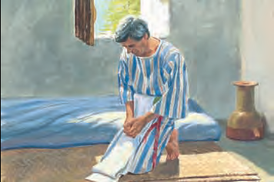
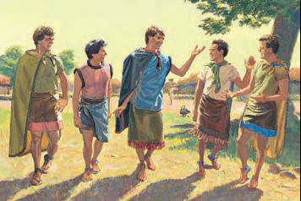
Alma prayed that his son would learn the truth and repent.
Alma the Younger and the sons of King Mosiah continued trying to destroy the Church.

Slide 35
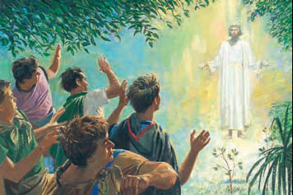
One day an angel appeared to them.
The angel spoke in a loud voice that shook the ground.

Slide 36
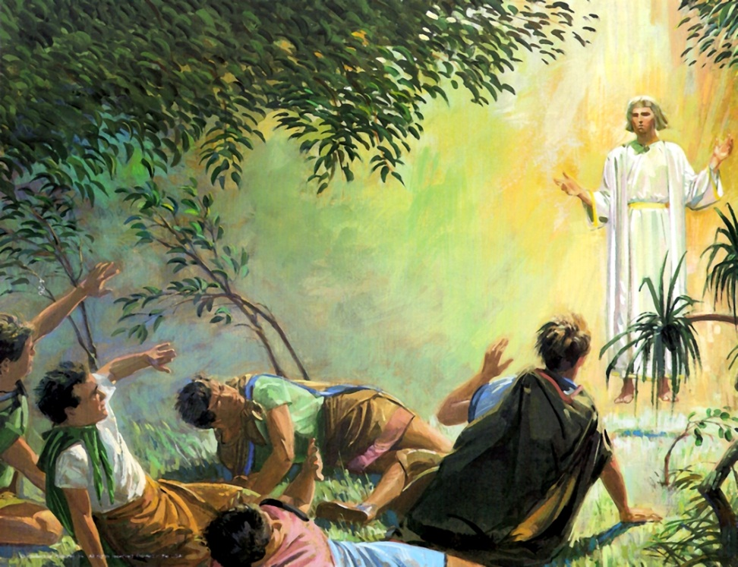
The five young men were so frightened that they fell down.
At first they could not understand what the angel was saying.

Slide 37
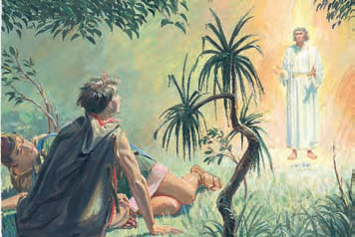
The angel had come in answer to the prayers of Church members.
The angel asked Alma the Younger why he was fighting against the Church.

Slide 38
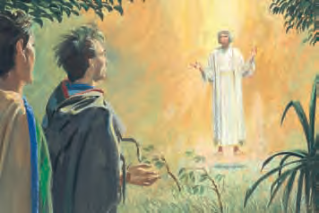
The ground shook as the angel told Alma the Younger to stop trying to destroy the Church.

Slide 39
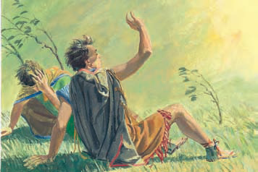
Alma the Younger and the sons of Mosiah fell down again.
They had seen an angel, and they knew the power of God had shaken the ground.
Notes:
39

Slide 40
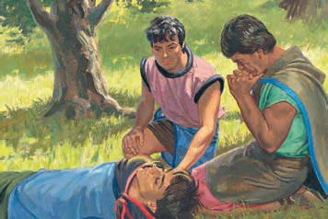
Alma the Younger was so astonished that he could not speak.
He became so weak that he could not even move his hands.

Slide 41
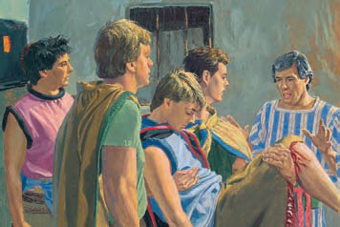
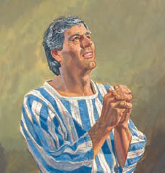
The sons of Mosiah carried Alma the Younger to his father and told him all that had happened to them.
Alma was happy. He knew that God had answered his prayers.

Slide 42
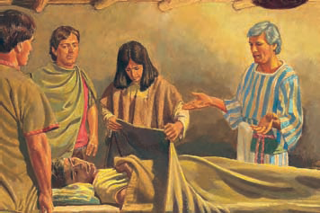
Alma called many people together to see what the Lord had done for his son and for the sons of Mosiah.

Slide 43
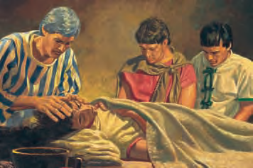
Alma, along with other Church leaders, fasted and prayed and asked God to help Alma the Younger become strong again.

Slide 44
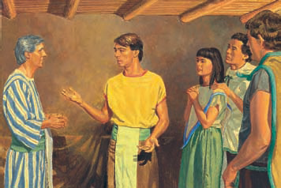
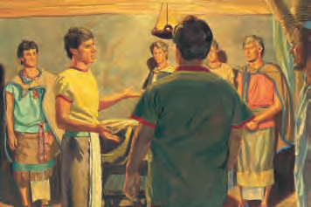
After two days and nights, Alma the Younger was able to speak and move.
He told the people he had repented of his sins and God had forgiven him.

Slide 45
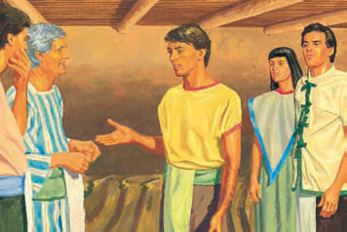
He taught that everyone must become righteous in order to enter God’s kingdom.
He also told of the great pain he had suffered because of his sins.

Slide 46
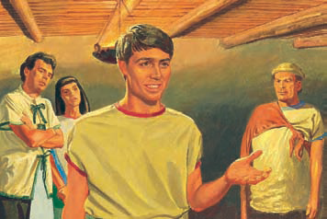
Alma the Younger was happy because he had repented and God had forgiven him.
He knew God loved him.

Slide 47
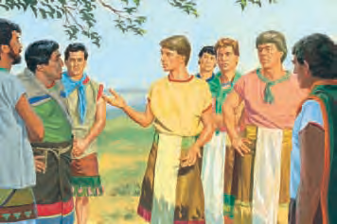
Alma the Younger and the sons of King Mosiah began to teach the truth throughout the land, telling everyone what they had seen and heard.

Slide 48
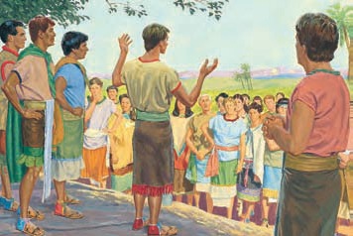
They tried to undo the wrong they had done.
They explained the scriptures to the people and taught them about Jesus Christ.

Slide 49
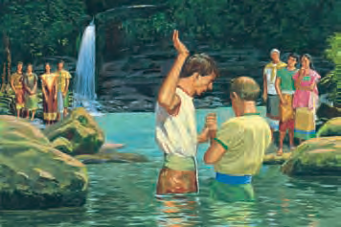
God blessed Alma the Younger and the sons of Mosiah as they taught the gospel.
Many people listened to them and believed.

Slide 50
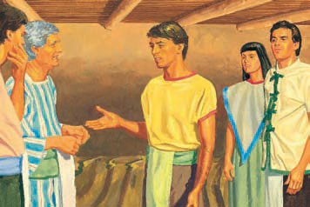
We often call the son Alma the Younger so we don’t confuse him with his father.
This story can be found in Mosiah 27:8-14

Slide 51
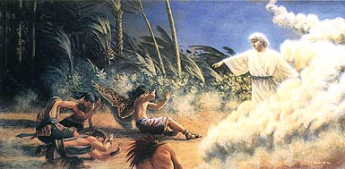
Discussion Time

Slide 52
How did Heavenly Father answer the prayer of Alma the Younger’s father?

Slide 53
How did Heavenly Father answer the prayer of Alma the Younger’s father?
        He sent an angel to tell Alma and his friends to repent.

Slide 54
Does anyone know what happened after that?

Slide 55
Does anyone know what happened after that?
1. Alma and his friends were so afraid when they saw the angel that they fell to the earth.

Slide 56
Does anyone know what happened after that?
1. Alma and his friends were so afraid when they saw the angel that they fell to the earth.
2. Alma lost his ability to speak or to move.

Slide 57
Does anyone know what happened after that?
1. Alma and his friends were so afraid when they saw the angel that they fell to the earth.
2. Alma lost his ability to speak or to move.
3. His friends carried him to his father’s house and told his father all that had happened.

Slide 58
Does anyone know what happened after that?
1. Alma and his friends were so afraid when they saw the angel that they fell to the earth.
2. Alma lost his ability to speak or to move.
3. His friends carried him to his father’s house and told his father all that had happened.
4. For two days Alma’s father and the priests of the Church fasted and prayed that Alma might regain his strength and speak to them.

Slide 59
Does anyone know what happened after that?
1. Alma and his friends were so afraid when they saw the angel that they fell to the earth.
2. Alma lost his ability to speak or to move.
3. His friends carried him to his father’s house and told his father all that had happened.
4. For two days Alma’s father and the priests of the Church fasted and prayed that Alma might regain his strength and speak to them.
5. Their prayers were answered, and Alma the Younger stood up and said something that made his father very happy and grateful.

Slide 60
What did Alma say he had done? (Mosiah 27:24)

Slide 61
What did Alma say he had done? (Mosiah 27:24)
        “For, said he, I have repented of my sins.”

Slide 62
Repentance
Let’s discuss how we know that Alma the Younger really repented.
Here are the steps to repentance.
Feel Sorry
Ask Forgiveness
Right the Wrong
Don’t repeat the wrong

Slide 63
Repentance
Feel Sorry
Did Alma the Younger feel sorry for what he had done?
Ask Forgiveness
Right the Wrong
Don’t repeat the wrong

Slide 64
Repentance
Feel Sorry
Did Alma the Younger feel sorry for what he had done?
        Yes
Ask Forgiveness
Right the Wrong
Don’t repeat the wrong

Slide 65
Repentance
Feel Sorry
Whom did Alma the Younger need to ask to forgive him?
Ask Forgiveness
Right the Wrong
Don’t repeat the wrong

Slide 66
Repentance
Feel Sorry
Whom did Alma the Younger need to ask to forgive him?
        Heavenly Father; his father, Alma; and the Church.
Ask Forgiveness
Right the Wrong
Don’t repeat the wrong

Slide 67
Repentance
To right the wrong, Alma went from city to city telling everyone about the true Church.
Feel Sorry
Ask Forgiveness
Right the Wrong
Don’t repeat the wrong

Slide 68
Repentance
He became a missionary.
Feel Sorry
Ask Forgiveness
Right the Wrong
Don’t repeat the wrong

Slide 69
Repentance
Feel Sorry
Do you think that Alma truly repented?
Ask Forgiveness
Right the Wrong
Don’t repeat the wrong

Slide 70
Repentance
Feel Sorry
Do you think that Alma truly repented?
        Alma’s life completely changed after he repented.
Ask Forgiveness
Right the Wrong
Don’t repeat the wrong

Slide 71
Repentance
Feel Sorry
Why was Alma able to be forgiven when he repented?
Ask Forgiveness
Right the Wrong
Don’t repeat the wrong

Slide 72
Repentance
Feel Sorry
Why was Alma able to be forgiven when he repented?
        Because of the atonement of Jesus Christ, who would later suffer for Alma the Younger’s sins.
Ask Forgiveness
Right the Wrong
Don’t repeat the wrong

Slide 73
Because of Jesus Christ’s love and atonement, people can repent when they do something wrong, and Heavenly Father and Jesus will forgive them.
It is much better not to do wrongthings so we do not need to repent.
But when we do sin, we can repent and become clean and pure.
Jesus promises us that he will not even remember the wrong things we do if we truly repent (see D&C 58:42).

Slide 74
TESTIMONY
I want to bear your testimony about the atonement of Jesus Christ and the importance of repentance.
I testify to you that thru Christ’s atonement, we will all be able to live again in the presence of our heavenly father.

Slide 75

OUR CLOSING PRAYER WILL BE GIVEN BY
(ENTER NAME HERE)

Slide 76
THE END

Slide 77
Images and clipart are from lds.org, Microsoft office, and other websites indicating the images were in the public domain or permitted for church and home use.
The Lesson and Scripture story are from lds.org. some Additional material came from Primary 4 – Lesson 14 by Erica Covalt
Please do not use this presentation for commercial use. Feel free to alter the presentation for use in church or home to suit personal preference.
This presentation is intended to supplement, not replace, the lesson manual and scriptures.
Teachers should refer to the manual, scriptures and other resources when preparing and conducting the lesson.

Slide 78
Mosiah 27:8–14:
8 Now the sons of Mosiah were numbered among the unbelievers; and also one of the sons of Alma was numbered among them, he being called Alma, after his father; nevertheless, he became a very wicked and an idolatrous man. And he was a man of many words, and did speak much flattery to the people; therefore he led many of the people to do after the manner of his iniquities.
9 And he became a great hinderment to the prosperity of the church of God; stealing away the hearts of the people; causing much dissension among the people; giving a chance for the enemy of God to exercise his power over them.

Slide 79
Mosiah 27:8–14:
10 And now it came to pass that while he was going about to destroy the church of God, for he did go about secretly with the sons of Mosiah seeking to destroy the church, and to lead astray the people of the Lord, contrary to the commandments of God, or even the king—
11 And as I said unto you, as they were going about rebelling against God, behold, the angel of the Lord appeared unto them; and he descended as it were in a cloud; and he spake as it were with a voice of thunder, which caused the earth to shake upon which they stood;

Slide 80
Mosiah 27:8–14:
12 And so great was their astonishment, that they fell to the earth, and understood not the words which he spake unto them.
13 Nevertheless he cried again, saying: Alma, arise and stand forth, for why persecutest thou the church of God? For the Lord hath said: This is my church, and I will establish it; and nothing shall overthrow it, save it is the transgression of my people.

Slide 81
Mosiah 27:24
24 For, said he, I have repented of my sins, and have been redeemed of the Lord; behold I am born of the Spirit.

Slide 82
D&C 58:42
42 Behold, he who has repented of his sins, the same is forgiven, and I, the Lord, remember them no more.

