Slide 1
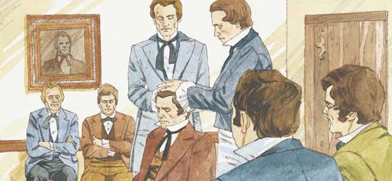
Lesson 12: The Gift of the Holy Ghost
“Lesson 12: The Gift of the Holy Ghost,” Primary 3: Choose the Right B, (1994),56

Slide 2
Purpose
To help the children appreciate the privilege of receiving the gift of the Holy Ghost when they are confirmed members of The Church of Jesus Christ of Latter-day Saints.

Slide 3

Our opening Prayer will be given today by
Enter Name Here

Slide 4
Why do we give each other gifts?
How do you feel when someone gives you a gift?

Slide 5
The day we become members of The Church of Jesus Christ of Latter-day Saints is one of the most important days of our lives.

Slide 6
When you become a member of the church Heavenly Father gives you a precious gift
It can’t be bought with money
Can’t hold it in our hands or see it

Slide 7
Worth more than any other gift a person can receive.
Worthy Church members are helped and comforted by it throughout their lives.

Slide 8
We receive this gift when men who hold the Melchizedek
Priesthood lay their hands upon our heads and confirm us members of The Church of Jesus Christ of Latter-day Saints.

Slide 9
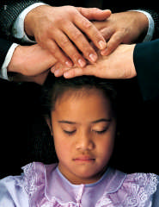
What is this gift you receive?

Slide 10
What is this gift you receive?
The gift of the Holy Ghost

Slide 11
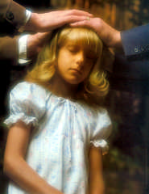
Following a person’s baptism, men who hold the Melchizedek Priesthood place their hands upon the person’s head, as shown in this picture.

Slide 12
One of the men (usually the father, the bishop, a missionary, or a friend of the person being confirmed) says the prayer.

Slide 13
During the prayer, the person is confirmed a member of the Church and receives the gift of the Holy Ghost.

Slide 14
What do you know about the Holy Ghost?

Slide 15
The Holy Ghost
He has a spirit body in the form of a man.
Teaches us about Heavenly Father and Jesus Christ
Bears witness of those things we are taught about them.

Slide 16
The Holy Ghost
Bears witness to us when we are taught the truth that what we are hearing is truth.
Is sent from Heavenly Father and Jesus Christ to help us choose the right.

Slide 17

Gift of the Holy Ghost
Not all people who live on earth have the privilege of receiving the gift of the Holy Ghost.
Baptism
Repentance
Faith in Jesus Christ

Slide 18
Gift of the Holy Ghost
Only those who have been baptized and confirmed members of The Church of Jesus Christ of Latter-day Saints have that blessing.
Baptism
Repentance
Faith in Jesus Christ

Slide 19
When we receive the gift of the Holy Ghost at confirmation, we become official members of the Church.
Gift of the Holy Ghost
Baptism
Repentance
Faith in Jesus Christ

Slide 20
Lets review the 4 steps starting with Faith in Jesus Christ.
Gift of the Holy Ghost
Baptism
Repentance
Faith in Jesus Christ

Slide 21
Fourth Article of Faith
We believe that the first four principles and ordinances of the gospel are:
First – faith in the lord Jesus Christ
Second - Repentance
Third – Baptism by immersion for the remission of sins
Fourth – laying on of hands for the gift of the Holy Ghost

Slide 22
Fourth Article of Faith
Try it again
We believe that the first ____ principles and ordinances of the gospel are:
First – _____ in the lord Jesus Christ
Second - Repentance
Third – Baptism by _________ for the remission of sins
Fourth – laying on of _____ for the gift of the Holy Ghost

Slide 23
Fourth Article of Faith
Try it again
We believe that the first ____ principles and __________ of the gospel are:
First – _____ in the lord _____ Christ
Second - __________
Third – Baptism by _________ for the _________ of sins
Fourth – laying on of _____ for the gift of the ____ Ghost

Slide 24
Fourth Article of Faith
Try it again
We _______ that the first ____ principles and __________ of the gospel are:
First – _____ in ___ lord _____ Christ
Second - __________
Third – _______ by _________ for the _________ of sins
Fourth – ______ on of _____ for the gift of the ____ Ghost

Slide 25
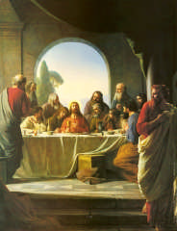
The Last Supper
The night before Jesus was crucified:
He ate one last supper with the 12 apostles
At that time, he also taught them something very important.

Slide 26
The Last Supper
The night before Jesus was crucified:
He knew they would be sad after he died
He knew they would need help
He promised the Apostles that he would not leave them alone but would send someone to help and comfort them.

Slide 27
Let’s read John 14:26
But the comforter, which is the Holy Ghost, whom the Father will send in my name, he shall teach you all things, and bring all things to your remembrance, whatsoever I have said unto you.

Slide 28
What is another name for the Comforter whom Jesus promised to send the Apostles?

Slide 29
What is another name for the Comforter whom Jesus promised to send the Apostles?
The Holy Ghost

Slide 30
Let’s read John 14:26
But the comforter, which is the Holy Ghost, whom the Father will send in my name, he shall teach you all things, and bring all things to your remembrance, whatsoever I have said unto you.

Slide 31
Jesus Christ sent the Holy Ghost to help and comfort his Apostles.

Slide 32
Even though the Apostles could not see the Holy Ghost, they could feel him helping and comforting them.

Slide 33
That is why he is called the Comforter.

Slide 34
Song – “The Holy Ghost”
When Christ was on the earth,
He promised he would send
The Holy Ghost to comfort us,
Our true, eternal friend.
The Holy Spirit whispers with a still small voice.
He testifies of God and Christ and makes our hearts rejoice.
And when we are confirmed
By sacred priesthood pow’r,
The Holy Ghost is giv’n to us
To guide us ev’ry hour.
Oh, may I always listen to that still small voice.
And with his light I’ll do what’s right each time I make a choice.
Words: Jeanne P. Lawler, b. 1924; alt. (c) 1977, 1989 IRI
Music: Jeanne P. Lawler, b. 1924. (c) 1977 IRI

Slide 35
We have the same privilege the Apostles did of having the Holy Ghost to help and comfort us.
The companionship of the Holy Ghost is one of the greatest gifts that we can enjoy in this life.

Slide 36
We can always have his companionship if we are worthy and live righteously.
The Holy Ghost can help us know what to do when we have hard choices to make.

Slide 37
I want to encourage you to follow your feelings from the Holy Ghost when they are afraid or hurt.
He will help them know what they should do, such as prompting them to tell someone who can help.

Slide 38
Story
Listen to the folowing Story home from work and told the family that he was changing his job and that they would be moving to a larger city.
• How do you think Jan felt?
Jan felt sad and upset each time she thought of moving. It was hard for her to think that soon she was going to leave her friends, home, school, and ward behind.
Jan was worried. She wondered if she would have a hard time making new friends. What would her new home and ward be like? Would the schoolwork be too hard for her?
No one was able to help her get rid of her worried feelings. Jan decided to pray and ask Heavenly Father for help.
Jan prayed to Heavenly Father with all her heart. As she prayed, something wonderful began to happen. All of the worried and frightened feelings started to go away.
Jan felt that someone was comforting her.
• Who do you think was comforting Jan? (The Holy Ghost.)
Jan’s family moved, and everything turned out fine. She always remembered the loving help she received from Heavenly Father through the Holy Ghost.
Listen to the following story.
Listen to find out how the Holy Ghost Helped and comforted a girl named Jan.

Slide 39
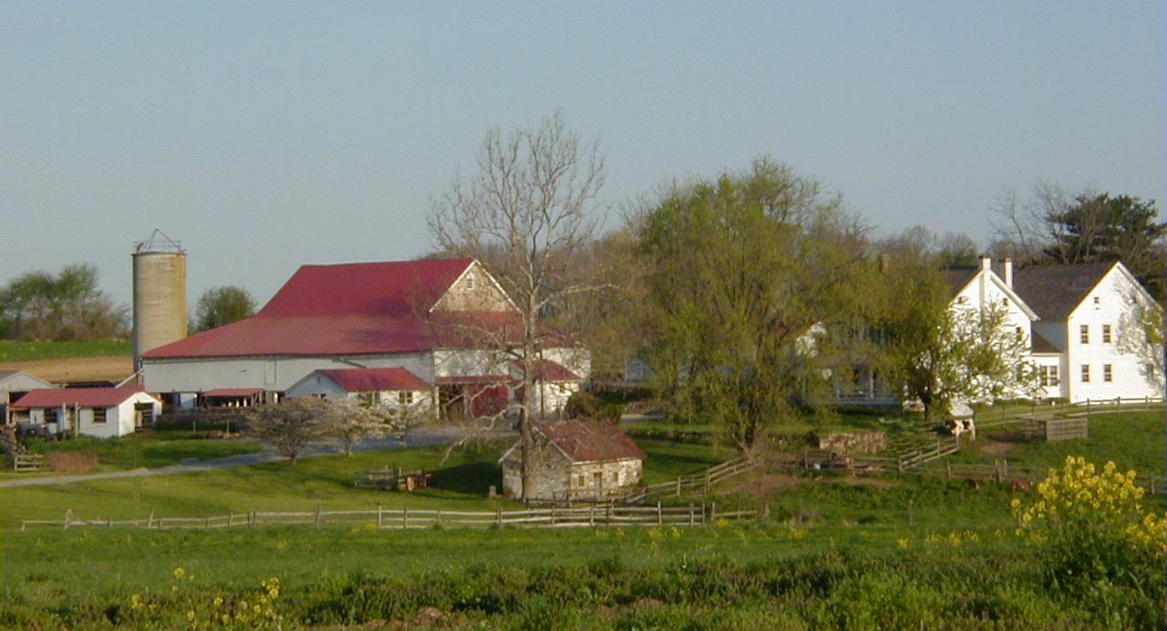
Jan had lived most of her life in a small farming town.
She loved the town and the people who lived there.

Slide 40
Often Jan thought how wonderful it was to live in a town that was so full of friendly people.

Slide 41
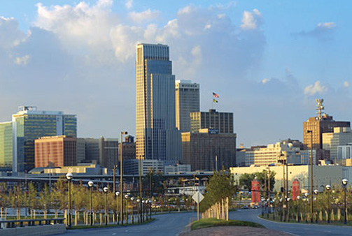
One day, Jan’s father came home from work and told the family that he was changing his job and that they would be moving to a larger city.

Slide 42
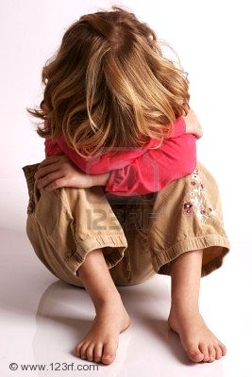
How do you think Jan felt?

Slide 43
How do you think Jan felt?
Jan felt sad and upset each time she thought of moving. It was hard for her to think that soon she was going to leave her friends, home, school, and ward behind.

Slide 44
Jan was worried.
She wondered if she would have a hard time making new friends.
What would her new home and ward be like?
Would the schoolwork be too hard for her?

Slide 45
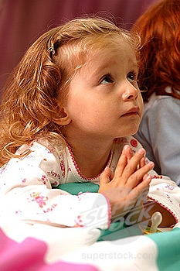
No one was able to help her get rid of her worried feelings.
Jan decided to pray and ask Heavenly Father for help.

Slide 46
Jan prayed to Heavenly Father with all her heart.
As she prayed, something wonderful began to happen.

Slide 47
All of the worried and frightened feelings started to go away.
Jan felt that someone was comforting her.

Slide 48
Who do you think was comforting Jan?

Slide 49
Who do you think was comforting Jan?
The Holy Ghost.

Slide 50
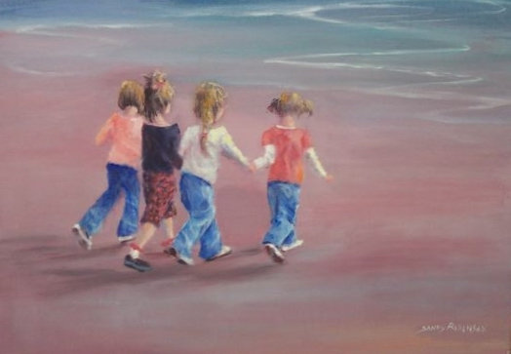
Jan’s family moved, and everything turned out fine.
She always remembered the loving help she received from Heavenly Father through the Holy Ghost.

Slide 51
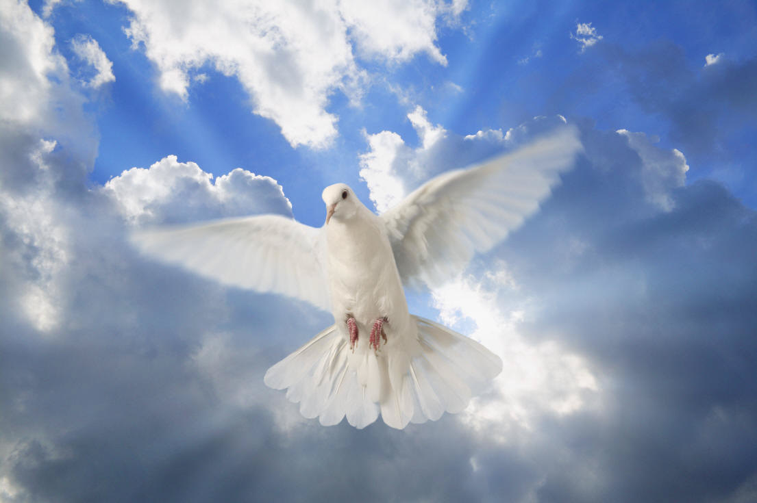
We can all feel the Holy Ghost if we but listen.

Slide 52
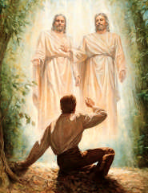
The first article of faith tells about the Holy Ghost.
1 We believe in God, the Eternal Father, and in His Son, Jesus Christ, and in the Holy Ghost.

Slide 53
Enrichment Activity 2
Is there someone who makes them feel warm, happy, and safe, especially when they have been feeling sad.
Such persons can sometimes give us comfort when we are sad or feeling lonely.
The Holy Ghost is sometimes called the Comforter.
He can give us great comfort throughout our lives.
Jesus Christ sent him to be with us when we feel sad or troubled.

Slide 54
Enrichment Activity 3
Let’s recite the last two lines of “The Still Small Voice”
Listen, listen. (Cup hand to ear)
The Holy Ghost will whisper. (Place index finger to lips)
Listen, listen (Cup hand to ear)
To the still small voice. (Hand over heart)

Slide 55
Testimony
I want to bear my testimony that the Holy Ghost can comfort and guide us.
The gift of the Holy Ghost that we receive following baptism is one of the most precious gifts that Heavenly Father could ever give us to help us to choose the right throughout our lives.

Slide 56
Our closing Prayer will be given today by
Enter Name Here

Slide 57
THE END

Slide 58
Images and clipart are from lds.org, microsoft office, and other websites indicating the images were in the public domain or permitted for church and home use.
The Lesson and Scripture story are from lds.org. This power point was modified from the original power point made by Shawna Millard.
Please do not use this presentation for commercial use. Feel free to alter the presentation for use in church or home to suit personal preference.
This presentation is intended to supplement, not replace, the lesson manual and scriptures.
Teachers should refer to the manual, scriptures and other resources when preparing and conducting the lesson.

