Slide 1
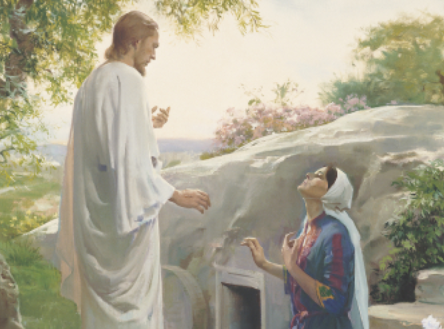
Lesson 43: Jesus Christ Will Come Again
“Lesson 43: Jesus Christ Will Come Again” Primary 2: Choose the Right A, (1995), 235–39

Slide 2
Purpose
To help you want to prepare for Jesus Christ’s second coming by following Jesus’ teachings.

Slide 3
OUR OPENING PRAYER WILL BE GIVEN BY
(Enter name here)

Slide 4
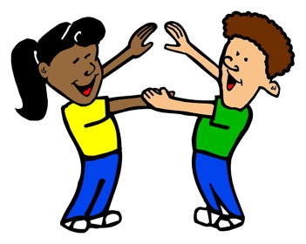
A while back, I had a friend that went away for a long period of time.
This made me feel . . .

Slide 5

When I heard that they were returning back from their long trip away . . .

Slide 6

Can you think of times when someone they love went away for a while?

Slide 7
Some possibilities could include :
  when a parent went on a trip,
  when a mother went to the hospital to have a baby,
  when a sibling or other family member went on a mission.

Slide 8

How did you feel when these people left to go away?

Slide 9
How did you feel when they returned home again?

Slide 10
  We miss our loved ones when they go away.

Slide 11

  We miss our loved ones when they go away.
  We are happy when they come home.

Slide 12
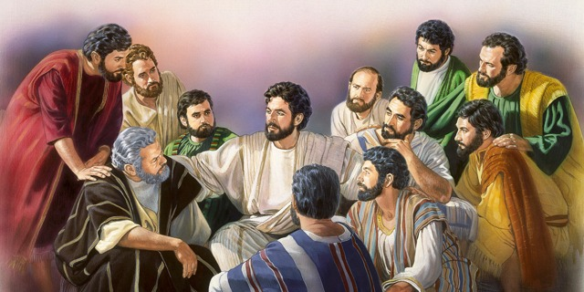
  When Jesus Christ lived on the earth he had friends who loved him very much.

Slide 13
  These friends followed him and listened to his teachings.

Slide 14
  Because they did what he taught them to do, they were called his disciples.

Slide 15
  Jesus loved his disciples.

Slide 16
  He helped them learn what they needed to do to live with him and Heavenly Father again.

Slide 17
  He helped them understand the difference between right and wrong so they could choose the right.

Slide 18
Remember a few weeks ago we learned about Jesus being resurrected.

Slide 19
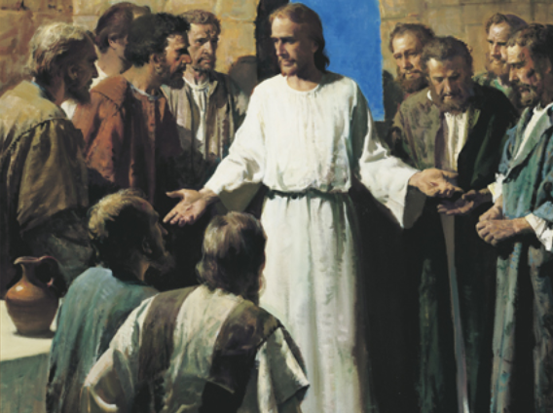
We talked about how, after he was resurrected, Jesus visited his disciples.

Slide 20
Jesus visited and taught his disciples for forty days after he was resurrected
(see Acts 1:3).

Slide 21
He wanted to be sure they knew he was alive again and understood his teachings.

Slide 22
Jesus wanted his disciples to obey his teachings even when he was no longer with them.

Slide 23
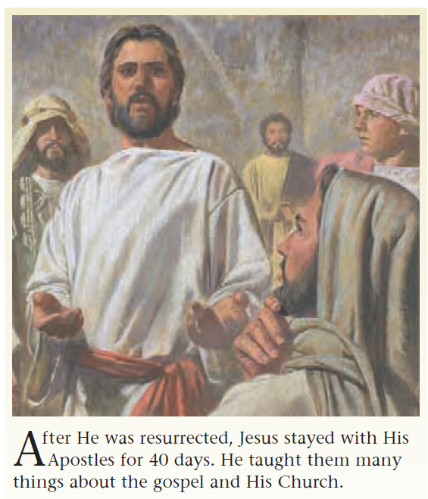

Slide 24
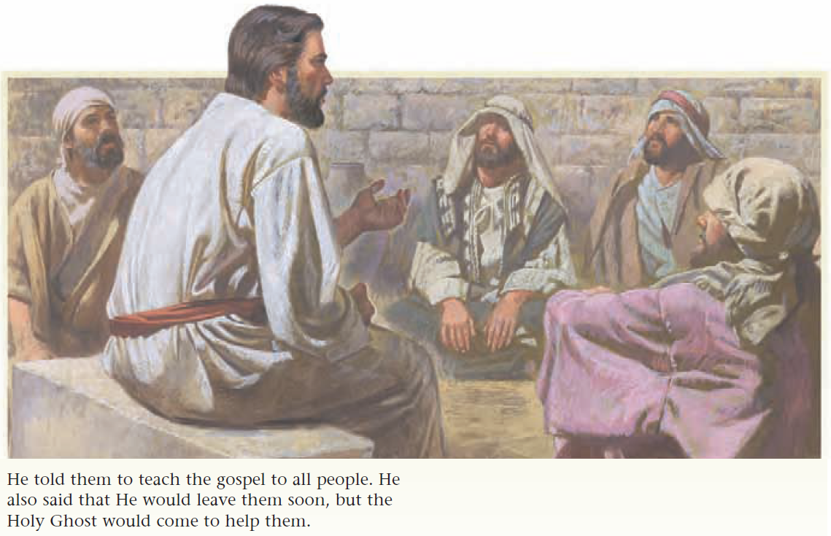

Slide 25
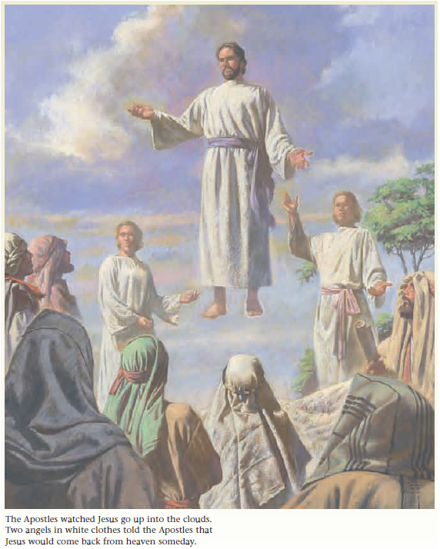
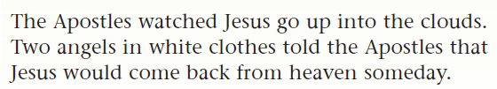

Slide 26
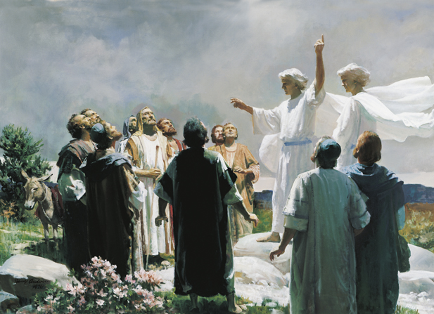
Before he left, Jesus gave his disciples a blessing.

Slide 27
Jesus left his disciples and rose up into a cloud to join Heavenly Father in heaven.

Slide 28
The disciples stood and watched until Jesus disappeared.

Slide 29
As the disciples stood looking up toward heaven, two angels dressed in white appeared beside them.

Slide 30
Let’s read aloud what the angels said to the disciples in Acts 1:11 (beginning with Why stand ye).

Slide 31
Let’s read aloud what the angels said to the disciples in Acts 1:11 (beginning with Why stand ye).
11 . . . why stand ye gazing up into heaven? this same Jesus, which is taken up from you into heaven, shall so come in like manner as ye have seen him go into heaven.

Slide 32
The angels told the disciples that Jesus Christ would someday come back to earth in the same way he left, we refer to this as the Second Coming.

Slide 33
We do not know exactly when Jesus will come again.

Slide 34
Only Heavenly Father knows the exact time (see Matthew 24:36).

Slide 35
But we do know that someday Jesus will return to the earth to live.

Slide 36
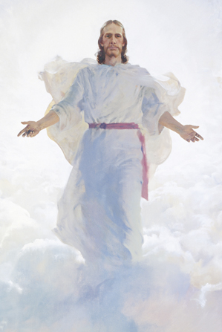
When Jesus comes again he will live among the people on earth.

Slide 37
Everyone will know that he is Jesus Christ, our Savior, and will worship him.

Slide 38
Would you like to be here when Jesus comes again?

Slide 39
Would you like to be here when Jesus comes again?
Why?

Slide 40
Can you imagine how wonderful it will be on earth when Jesus comes again.

Slide 41
People will be able to see Jesus, to walk and talk with him, and to have him put his loving arms around them.

Slide 42
After Jesus comes, everyone will be friends.

Slide 43
There will be no evil people.

Slide 44
We will not need to lock our doors because everything and everybody will be safe.

Slide 45
There will be no disease to cause us sickness or pain, and all the animals will be friends with us and with each other.

Slide 46
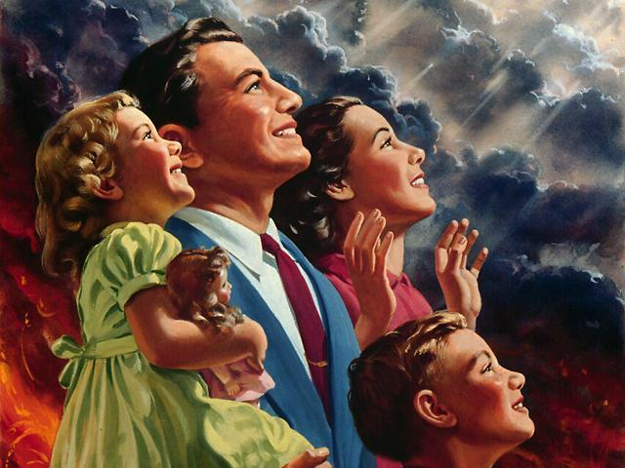
It’s time to play the
SECOND COMING
game

Slide 47
I will ask a question about the Second Coming.

Slide 48
I will ask a question about the Second Coming.
If you know the answer, stand up.

Slide 49
I will ask a question about the Second Coming.
If you know the answer, stand up.
Don’t answer till you are called upon.

Slide 50
I will ask a question about the Second Coming.
If you know the answer, stand up.
Don’t answer till you are called upon.
It’s that simple

Slide 51
So, If you are ready,
Let’s play the “Second Coming” game.

Slide 52

For how many days did Jesus Christ visit his disciples after he was resurrected?

Slide 53

For how many days did Jesus Christ visit his disciples after he was resurrected?
Forty

Slide 54
Who knows when Jesus will come again?

Slide 55
Who knows when Jesus will come again?
Only Heavenly Father. No one on earth knows

Slide 56
Will there be wars or fighting after Jesus comes again?

Slide 57
Will there be wars or fighting after Jesus comes again?
No. Everyone on earth will be friends

Slide 58
What will happen to people who are sick or disabled when Jesus comes again?

Slide 59
What will happen to people who are sick or disabled when Jesus comes again?
They will be healed. There will be no more sickness or pain when Jesus returns to the earth.

Slide 60
What will the animals be like when Jesus comes again?

Slide 61
What will the animals be like when Jesus comes again?
They will all be friendly to us and to each other

Slide 62
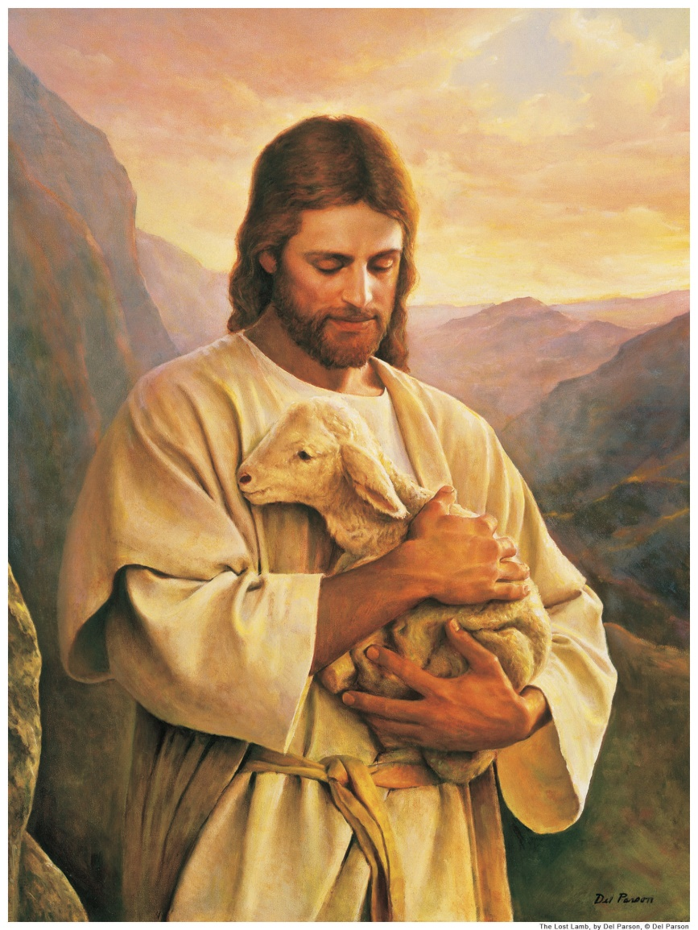
Remember the preparations they made when their loved ones returned home

Slide 63
We must also prepare for Jesus Christ’s return to the earth.

Slide 64
We can prepare by learning and following Jesus’ teachings.

Slide 65
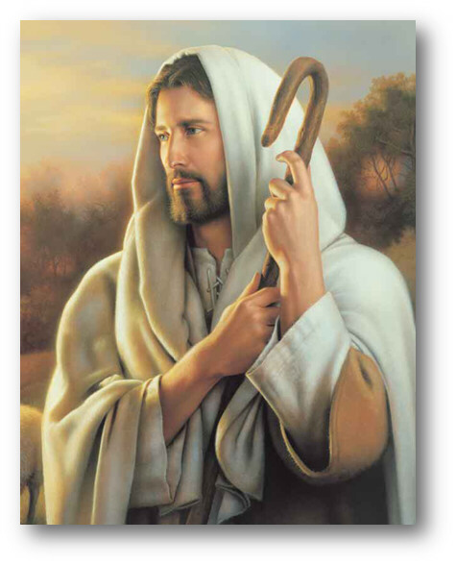
If we are prepared, we will be happy to see the Savior.

Slide 66
He wants everyone to live with him again, but only those who follow his teachings and choose the right will be able to do so.

Slide 67
Jesus helped his disciples learn what they had to do to live with him again, and he has also given us teachings to help us be prepared when he comes again.

Slide 68
Let’s sing the second verse of
“When He Comes Again”

Slide 69
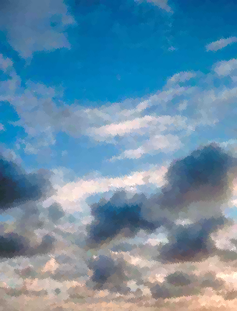
When He Comes Again
2. I wonder, when he comes again,
Will I be ready there
To look upon his loving face
And join with him in prayer?
Each day I'll try to do his will
And let my light so shine
That others seeing me may seek
For greater light divine.
Then, when that blessed day is here,
He'll love me and he'll say,
"You've served me well, my little child;
Come unto my arms to stay."
Words and music: Mirla Greenwood Thayne, 1907-1997. (c) 1952 by Mirla Greenwood Thayne, Provo, Utah
Verse 1

Slide 70
When He Comes Again
2. I wonder, when he comes again,
Will I be ready there
To look upon his loving face
And join with him in prayer?
Each day I'll try to do his will
And let my light so shine
That others seeing me may seek
For greater light divine.
Then, when that blessed day is here,
He'll love me and he'll say,
"You've served me well, my little child;
Come unto my arms to stay."
Words and music: Mirla Greenwood Thayne, 1907-1997. (c) 1952 by Mirla Greenwood Thayne, Provo, Utah
Verse 1

Slide 71
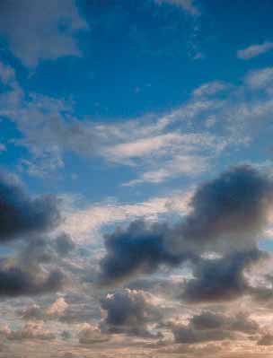
I testify that Jesus Christ will come to the earth again, although we do not know when.
We should all want to follow the teachings of Jesus so we can have the privilege of seeing him when he comes again.

Slide 72

OUR CLOSING PRAYER WILL BE GIVEN BY
(Enter Name Here)

Slide 73
THE END

Slide 74
Images and clipart are from lds.org, Microsoft office, and other websites indicating the images were in the public domain or permitted for church and home use.
The hymns, Lesson and Scripture story are from lds.org.
No copyrighted materials were knowingly used in this presentation. Please do not use this presentation for commercial use. Feel free to alter the presentation for use in church or home to suit personal preference.
This presentation is intended to supplement, not replace, the lesson manual and scriptures.
Teachers should refer to the manual, scriptures and other resources when preparing and conducting the lesson.

Slide 75
When He Comes Again
1. I wonder, when he comes again,
Will herald angels sing?
Will earth be white with drifted snow,
Or will the world know spring?
I wonder if one star will shine
Far brighter than the rest;
Will daylight stay the whole night through?
Will songbirds leave their nests?
I'm sure he'll call his little ones
Together 'round his knee,
Because he said in days gone by,
"Suffer them to come to me."

