Slide 1
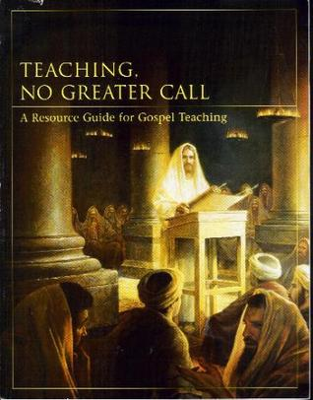
Teaching, No Greater Call:
A Resource Guide for Gospel Teaching
Teaching the Gospel Course

Slide 2
Lesson 2: Love Those you Teach
Teaching the Gospel Course

Slide 3
Purpose
To help you seek to be filled with Christlike love for those you teach.

Slide 4
Teachers with Christlike love make a difference in the lives of those they teach.

Slide 5
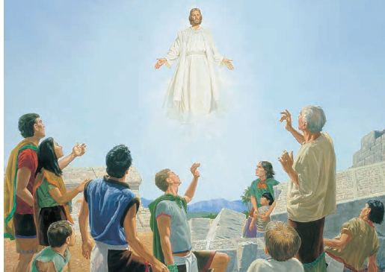
Let’s watch and listen to the account of the resurrected Savior’s Visit to the Nephites.

Slide 6

Click above to start video
Click here if video doesn’t start

Slide 7
He did heal them every one.

Slide 8

Click above to start video
Click here if video doesn’t start

Slide 9
He did heal them every one.
He took their little children, one by one, and blessed them.

Slide 10

Click above to start video
Click Here if video doesn’t start

Slide 11
Ponder the love that the Savior showed toward the Nephites.

Slide 12
Think about what the Nephites might have felt as Jesus ministered to them one by one.

Slide 13

In what ways might a teacher’s Christlike love influence those who are being taught?

Slide 14
A teacher’s Christlike love could . . .
Invite the Spirit
Help people overcome fear
Lead people to be more receptive to the gospel

Slide 15

Let’s read the statement from the Prophet Joseph Smith found on Page 30 of the “Teaching, no greater Call” Manual

Slide 16
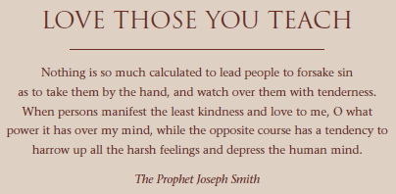

Slide 17

Has anyone here ever been influenced by the love of a teacher?

Slide 18
Has anyone here ever been influenced by the love of a teacher?
This lesson includes teachings from the scriptures that can help us be filled with Christlike love for those we teach.
It also includes a discussion on how our Christlike love influences our service as teachers.

Slide 19
We need some volunteers to read the following versus from the scriptures.
  John 15:10
  Ephesians 4:32
  Mosiah 2:17
  Mosiah 4:11–12
  Alma 38:12
  3 Nephi 11:29–30
  Moroni 7:48

Slide 20
  John 15:10
10 If ye keep my commandments, ye shall abide in my love; even as I have kept my Father’s commandments, and abide in his love.

Slide 21
  John 15:10
10 If ye keep my commandments, ye shall abide in my love; even as I have kept my Father’s commandments, and abide in his love.
What is the principles in this passage that can help us be filled with Christlike love.

Slide 22
  John 15:10
10 If ye keep my commandments, ye shall abide in my love; even as I have kept my Father’s commandments, and abide in his love.
What is the principles in this passage that can help us be filled with Christlike love.
Keeping the commandments

Slide 23
  Ephesians 4:32
32 And be ye kind one to another, tenderhearted, forgiving one another, even as God for Christ’s sake hath forgiven you.

Slide 24
  Ephesians 4:32
32 And be ye kind one to another, tenderhearted, forgiving one another, even as God for Christ’s sake hath forgiven you.
What is the principles in this passage that can help us be filled with Christlike love.

Slide 25
  Ephesians 4:32
32 And be ye kind one to another, tenderhearted, forgiving one another, even as God for Christ’s sake hath forgiven you.
What is the principles in this passage that can help us be filled with Christlike love.
Forgiving others

Slide 26
  Mosiah 2:17
17 And behold, I tell you these things that ye may learn wisdom; that ye may learn that when ye are in the service of your fellow beings ye are only in the service of your God.

Slide 27
  Mosiah 2:17
17 And behold, I tell you these things that ye may learn wisdom; that ye may learn that when ye are in the service of your fellow beings ye are only in the service of your God.
What is the principles in this passage that can help us be filled with Christlike love.

Slide 28
  Mosiah 2:17
17 And behold, I tell you these things that ye may learn wisdom; that ye may learn that when ye are in the service of your fellow beings ye are only in the service of your God.
What is the principles in this passage that can help us be filled with Christlike love.
Serving

Slide 29
  Mosiah 4:11-12
11 And again I say unto you as I have said before, that as ye have come to the knowledge of the glory of God, or if ye have known of his goodness and have tasted of his love, and have received a remission of your sins, which causeth such exceedingly great joy in your souls, even so I would that ye should remember, and always retain in remembrance, the greatness of God,

Slide 30
  Mosiah 4:11-12
and your own nothingness, and his goodness and long-suffering towards you, unworthy creatures, and humble yourselves even in the depths of humility, calling on the name of the Lord daily, and standing steadfastly in the faith of that which is to come, which was spoken by the mouth of the angel.

Slide 31
  Mosiah 4:11-12
12 And behold, I say unto you that if ye do this ye shall always rejoice, and be filled with the love of God, and always retain a remission of your sins; and ye shall grow in the knowledge of the glory of him that created you, or in the knowledge of that which is just and true.

Slide 32
  Mosiah 4:11-12
11 And again I say unto you as I have said before, that as ye have come to the knowledge of the glory of God, or if ye have known of his goodness and have tasted of his love, and have received a remission of your sins, which causeth such exceedingly great joy in your souls, even so I would that ye should remember, and always retain in remembrance, the greatness of God, and your own nothingness, and his goodness and long-suffering towards you, unworthy creatures, and humble yourselves even in the depths of humility, calling on the name of the Lord daily, and standing steadfastly in the faith of that which is to come, which was spoken by the mouth of the angel.
12 And behold, I say unto you that if ye do this ye shall always rejoice, and be filled with the love of God, and always retain a remission of your sins; and ye shall grow in the knowledge of the glory of him that created you, or in the knowledge of that which is just and true.
What is the principles in this passage that can help us be filled with Christlike love.
Repenting, being humble, and exercising faith

Slide 33
  Alma 38:12
12 Use boldness, but not overbearance; and also see that ye bridle all your passions, that ye may be filled with love; see that ye refrain from idleness.

Slide 34
  Alma 38:12
12 Use boldness, but not overbearance; and also see that ye bridle all your passions, that ye may be filled with love; see that ye refrain from idleness.
What is the principles in this passage that can help us be filled with Christlike love.

Slide 35
  Alma 38:12
12 Use boldness, but not overbearance; and also see that ye bridle all your passions, that ye may be filled with love; see that ye refrain from idleness.
What is the principles in this passage that can help us be filled with Christlike love.
Bridling passions

Slide 36
  3 Nephi 11:29-30
29 For verily, verily I say unto you, he that hath the spirit of contention is not of me, but is of the devil, who is the father of contention, and he stirreth up the hearts of men to contend with anger, one with another.
30 Behold, this is not my doctrine, to stir up the hearts of men with anger, one against another; but this is my doctrine, that such things should be done away.

Slide 37
  3 Nephi 11:29-30
29 For verily, verily I say unto you, he that hath the spirit of contention is not of me, but is of the devil, who is the father of contention, and he stirreth up the hearts of men to contend with anger, one with another.
30 Behold, this is not my doctrine, to stir up the hearts of men with anger, one against another; but this is my doctrine, that such things should be done away.
What is the principles in this passage that can help us be filled with Christlike love.

Slide 38
  3 Nephi 11:29-30
29 For verily, verily I say unto you, he that hath the spirit of contention is not of me, but is of the devil, who is the father of contention, and he stirreth up the hearts of men to contend with anger, one with another.
30 Behold, this is not my doctrine, to stir up the hearts of men with anger, one against another; but this is my doctrine, that such things should be done away.
What is the principles in this passage that can help us be filled with Christlike love.
Ceasing contention

Slide 39
  Moroni 7:48
48 Wherefore, my beloved brethren, pray unto the Father with all the energy of heart, that ye may be filled with this love, which he hath bestowed upon all who are true followers of his Son, Jesus Christ; that ye may become the sons of God; that when he shall appear we shall be like him, for we shall see him as he is; that we may have this hope; that we may be purified even as he is pure. Amen.

Slide 40
  Moroni 7:48
48 Wherefore, my beloved brethren, pray unto the Father with all the energy of heart, that ye may be filled with this love, which he hath bestowed upon all who are true followers of his Son, Jesus Christ; that ye may become the sons of God; that when he shall appear we shall be like him, for we shall see him as he is; that we may have this hope; that we may be purified even as he is pure. Amen.
What is the principles in this passage that can help us be filled with Christlike love.

Slide 41
  Moroni 7:48
48 Wherefore, my beloved brethren, pray unto the Father with all the energy of heart, that ye may be filled with this love, which he hath bestowed upon all who are true followers of his Son, Jesus Christ; that ye may become the sons of God; that when he shall appear we shall be like him, for we shall see him as he is; that we may have this hope; that we may be purified even as he is pure. Amen.
What is the principles in this passage that can help us be filled with Christlike love.
Praying to be filled with the pure love of Christ

Slide 42
Review of the principles in the passage that can help you to be filled with Christlike love.
  John 15:10 (Keeping the commandments)
  Ephesians 4:32 (Forgiving others)
  Mosiah 2:17 (Serving)
  Mosiah 4:11–12 (Repenting, being humble, and exercising faith)
  Alma 38:12 (Bridling passions)
  3 Nephi 11:29–30 (Ceasing contention)
  Moroni 7:48 (Praying to be filled with the pure love of Christ)

Slide 43
Our Christlike love for those we teach should be reflected in our preparation, our teaching, and our everyday lives.

Slide 44
Let’s go to the chalkboard.
(You may also what to copy the following blackboard discussion in your notebooks.)

Slide 45
Preparation
Teaching
Everyday Life

Slide 46
What are some things you can do to show Christlike love for these people?

Slide 47
Preparation
Teaching
Everyday Life
Pray for them
Greet them warmly at the beginning of class
Pray for them
Be aware of their needs and interests
Express your love for them
Be friendly when you see them
Be well prepared to teach them
Listen attentively
Be aware of their activities and accomplishments
Respond respectfully as they participate in class
Attend activities in which they are participating
Here are some suggestions from the manual – You may want to copy these into your notebooks too.
Encourage them to live the principles you teach
Encourage them to live the principles you teach
Compliment them when appropriate
Show concern and give encouragement when they experience trials

Slide 48
Is there anyone that would like to discuss some of the ideas you have written in your notebooks?

Slide 49
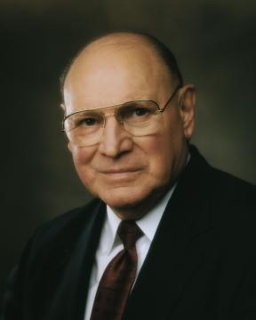
Listen to this statement by Elder Joseph B. Wirthlin from the October 1997 General Conference, which briefly summarizes today’s lesson.

Slide 50
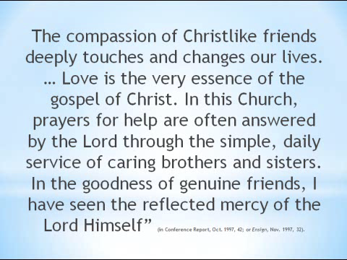
Click above to start video
Click Here if video doesn’t start

Slide 51
The compassion of Christlike friends deeply touches and changes our lives. … Love is the very essence of the gospel of Christ. In this Church, prayers for help are often answered by the Lord through the simple, daily service of caring brothers and sisters. In the goodness of genuine friends, I have seen the reflected mercy of the Lord Himself” (in Conference Report, Oct. 1997, 42; or Ensign, Nov. 1997, 32).

Slide 52
Testimony
I want to testify to you that when you have a Christlike love for those you teach, your lessons will be magnified through your sincere love of your students.
You will enjoy teaching, preparing lessons, and the personal journey you will discover when your are filled with this Christlike love.

Slide 53
Let’s conclude todays lesson by singing
“Love one another”

Slide 54
LOVE ONE ANOTHER
As I have loved you,
Love one another.
This new commandment:
Love one another.
By this shall men know
Ye are my disciples,
If ye have love
One to another.
Duet
Text and music: Luacine Clark Fox, 1914-2002, arr. (c) 1961 Luacine C. Fox. Renewed 1989.

Slide 55

OUR CLOSING PRAYER WILL BE GIVEN BY
(Enter Name Here)

Slide 56
Assignments
I want to encourage you to:
1. Select at least one idea from the notebook activity on page 196. Use this idea in a teaching opportunity during the coming week. Write in their notebooks about the results of this action.
2. Continue last week’s assignment to seek the guidance of the Spirit in connection with an upcoming family home evening lesson, Church assignment, or other opportunity to teach. Remember the Lord’s words: “The Spirit shall be given unto you by the prayer of faith” (D&C 42:14). Write in their notebooks about their experiences with this assignment. (As part of lesson 3, some class members will be asked to report on these experiences.)
3. Review the principles taught in this lesson by studying the section of this book titled “Love Those You Teach”(pages 30–39).

Slide 57
THE END

Slide 58
Images and clipart are from lds.org, Microsoft office, and other websites indicating the images were in the public domain or permitted for church and home use.
The hymns, Lesson and Scripture story are from lds.org.
No copyrighted materials were knowingly used in this presentation. Please do not use this presentation for commercial use. Feel free to alter the presentation for use in church or home to suit personal preference.
This presentation is intended to supplement, not replace, the lesson manual and scriptures.
Teachers should refer to the manual, scriptures and other resources when preparing and conducting the lesson.

